Slide 1
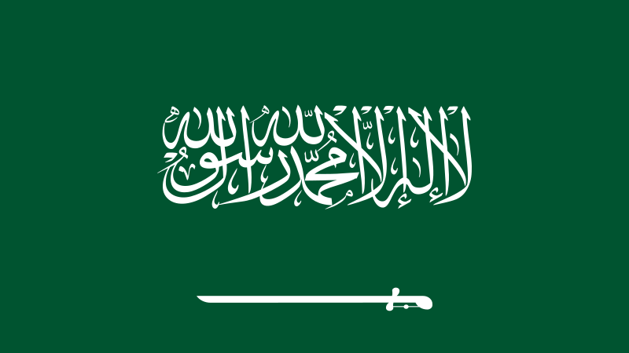
Saudi Arabia
Notes:
This is the flag of Saudi Arabia.

Slide 2
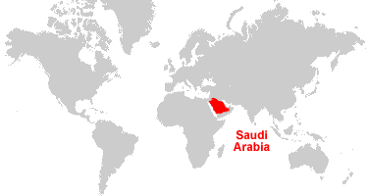
Saudi Arabia in World Map
Saudi Arabia is located in the Arabian Peninsula between Europe and Africa

Slide 3
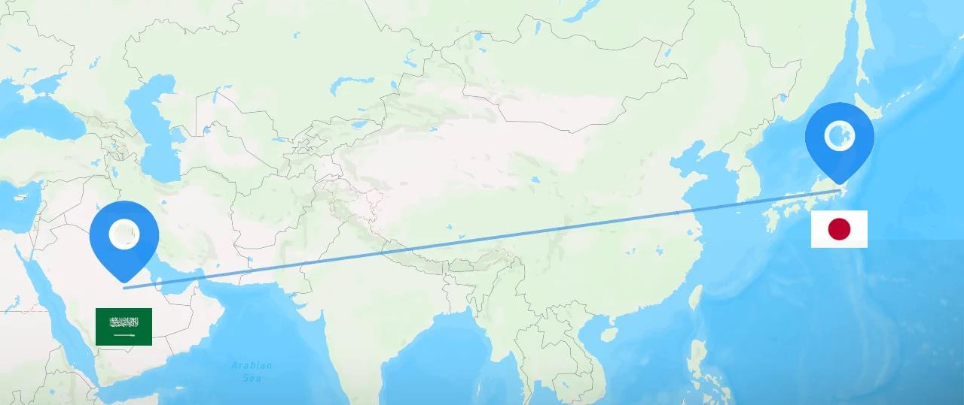
Distance between Saudi Arabia and Japan is 15 hrs 46 mins by flight
S.

Slide 4
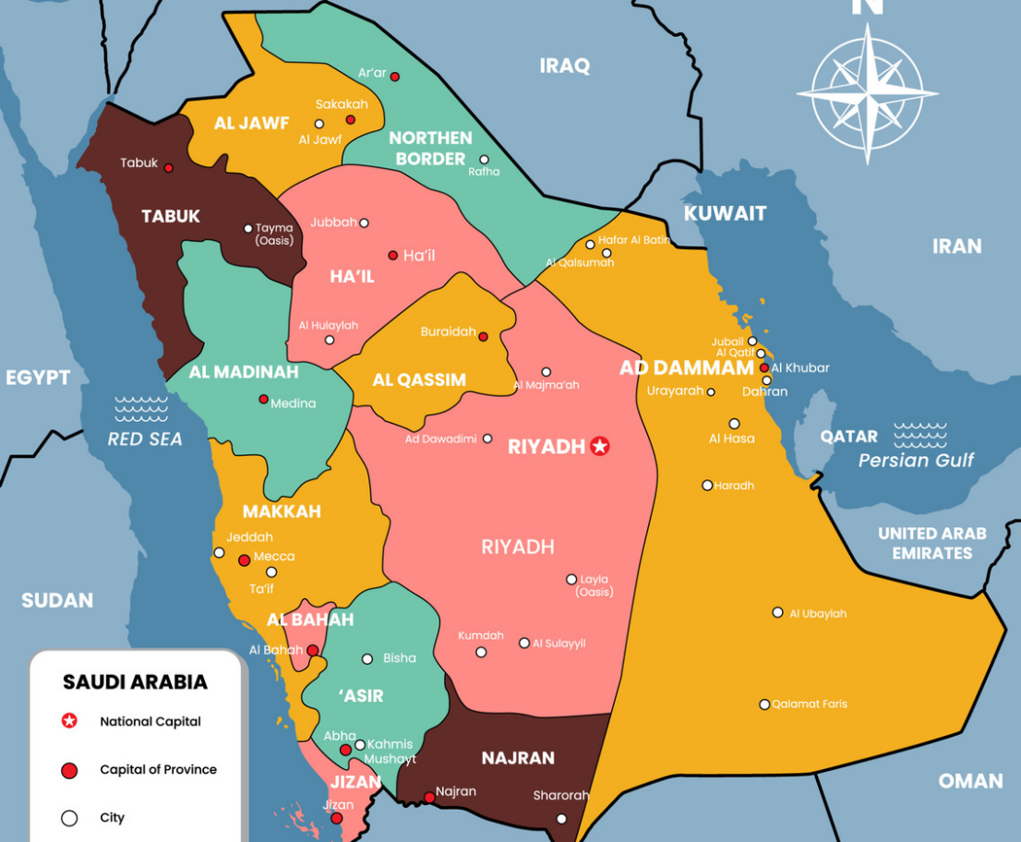

Saudi Arabia
Map & Capital
Capital: Riyadh

Slide 5
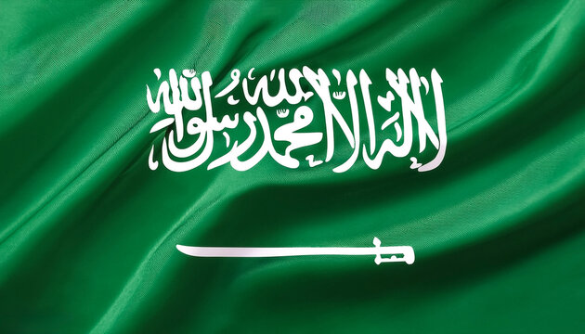
The Flag
Green- Growth & Fertile soil
White- Peace & Purity
Sword- Justice & Security

Slide 6
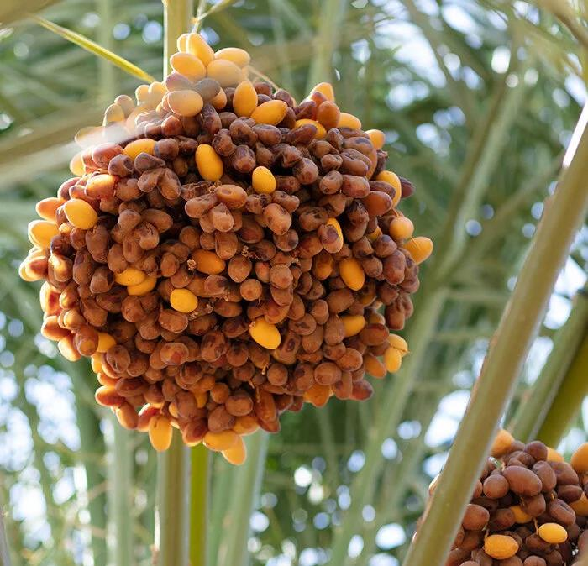
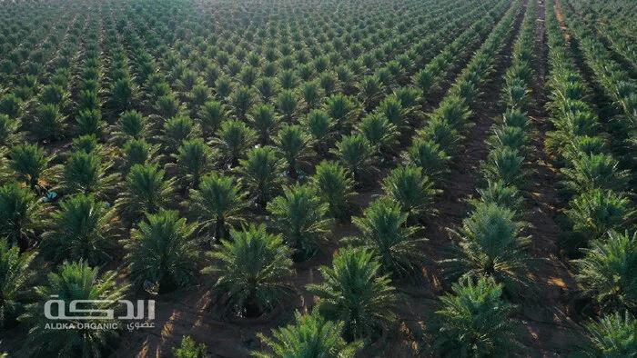
Growth &
Fertile soil
=
Date Farm

Slide 7
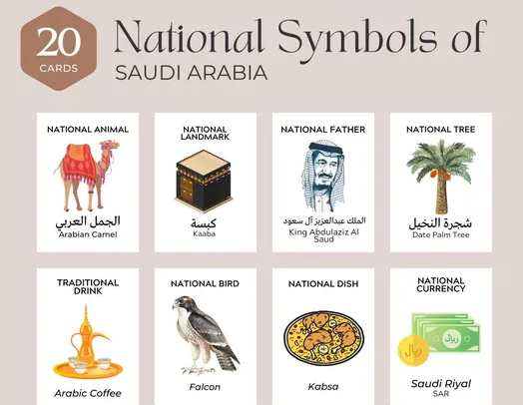
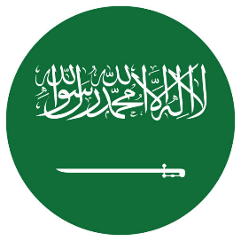

Slide 8
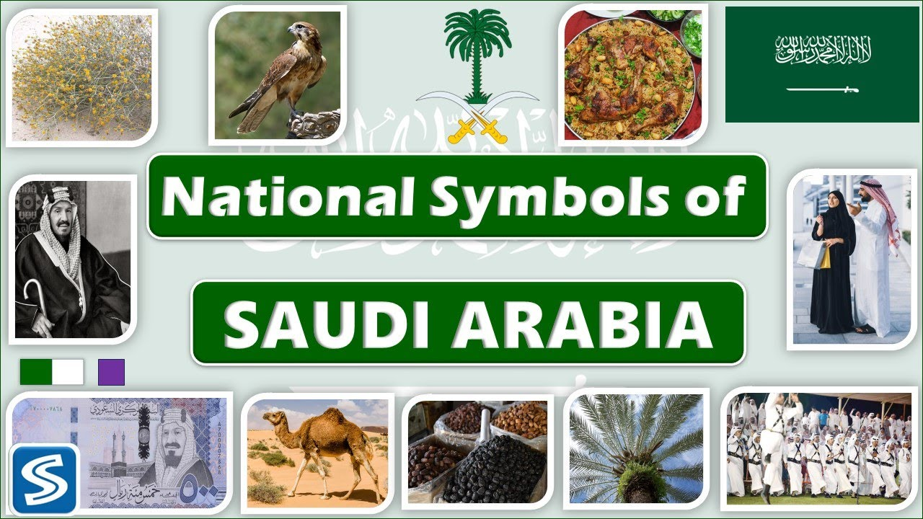

Slide 9
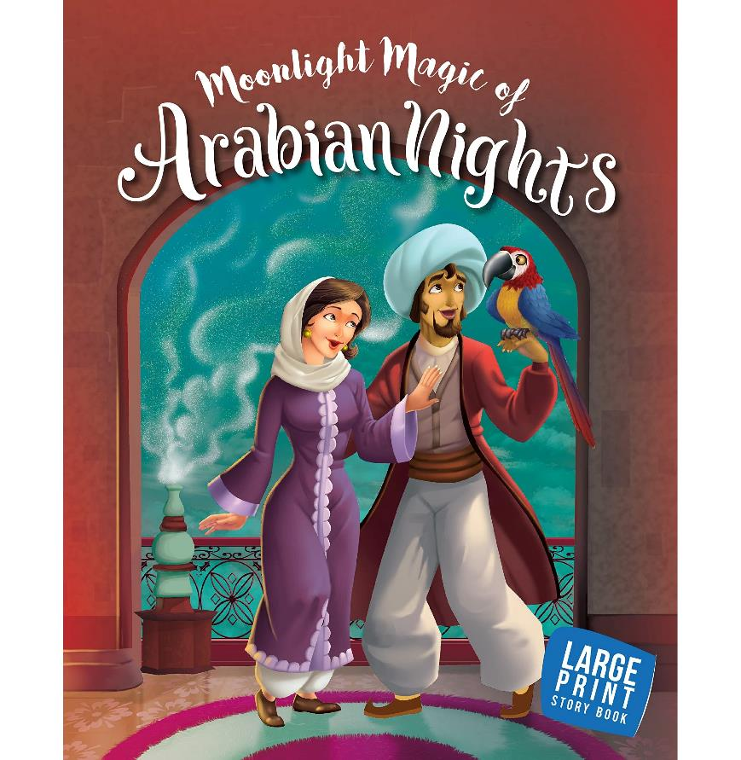
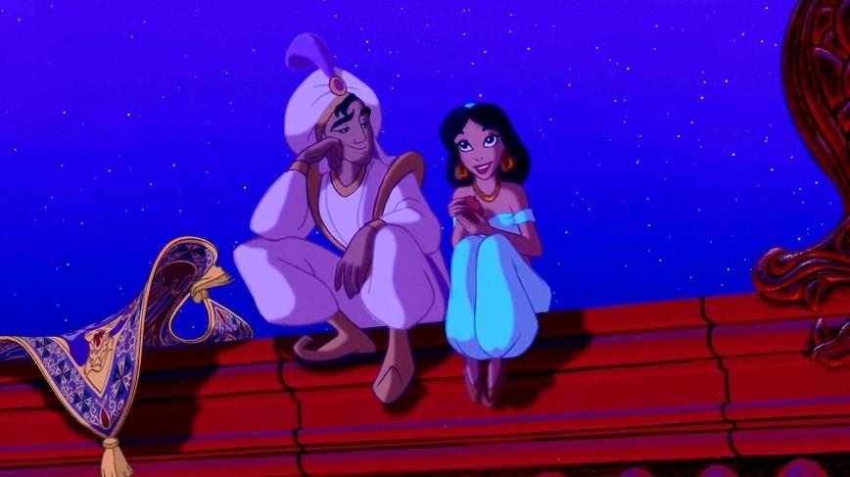
Arab Inspired Popular Stories

Slide 10
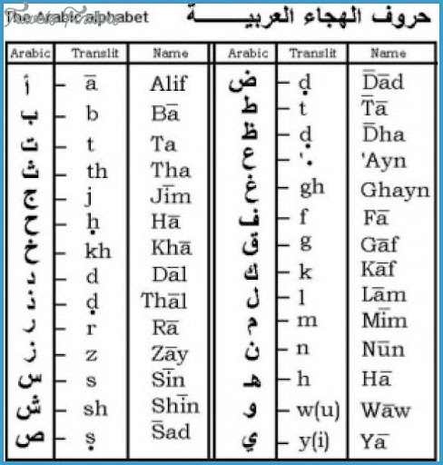
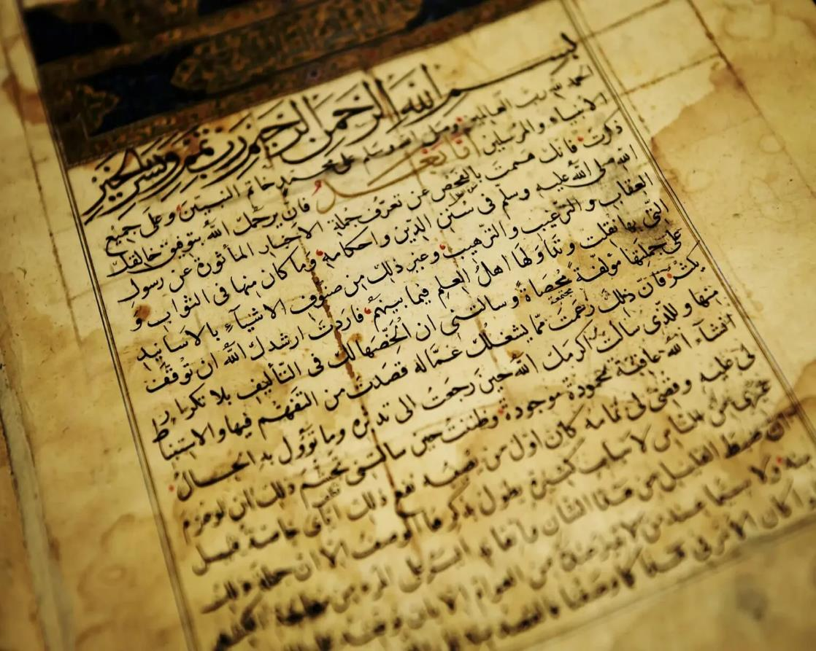
The National language of Saudi Arabia is Arabic

Slide 11
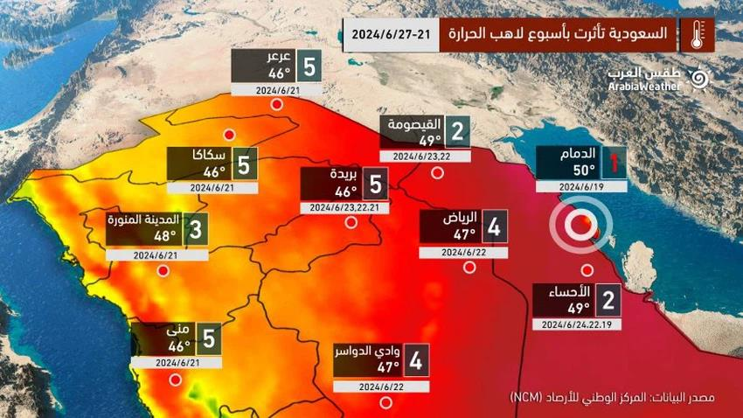
Temperature during the summer

Slide 12
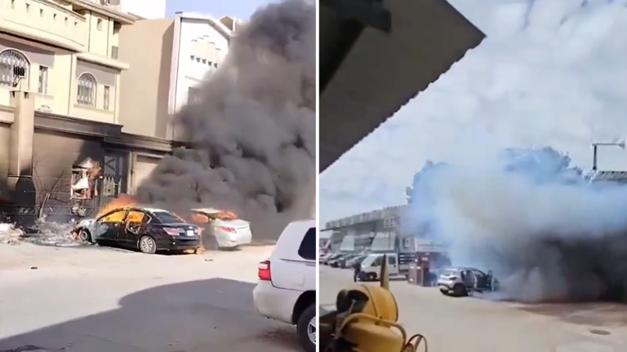
Intense heat makes cars catch fire

Slide 13
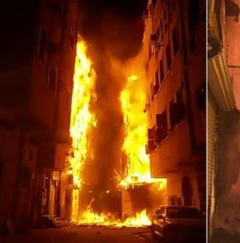
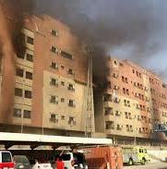
Even buildings catch fire!

Slide 14
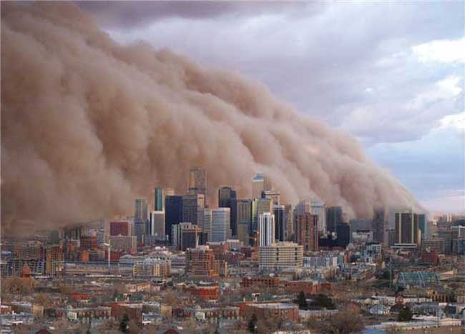
Sandstorm in the city

Slide 15
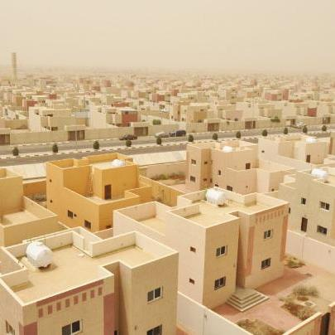
Houses in Saudi Arabia
Light colour so it does not attract heat
Small windows to prevent sand from coming in

Slide 16
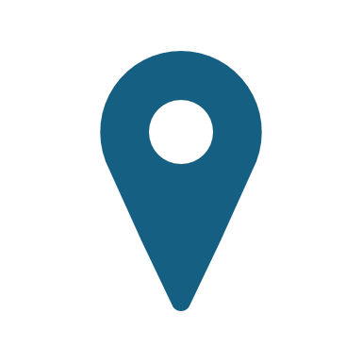
Famous Places to Visit

Slide 17
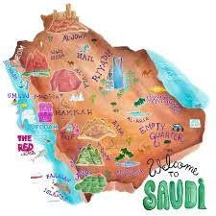
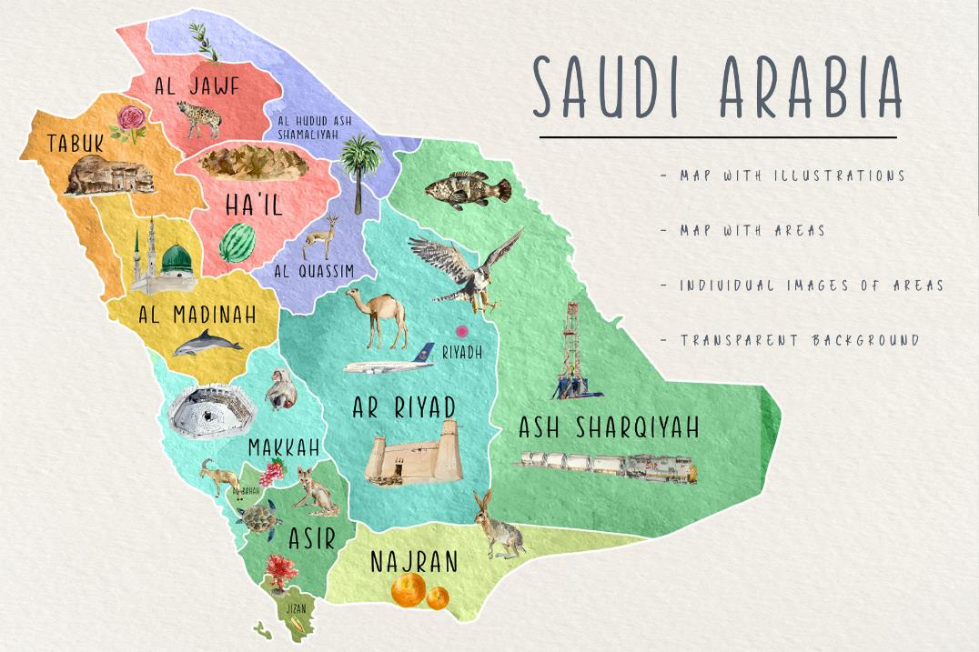
13 regions in Saudi Arabia

Slide 18
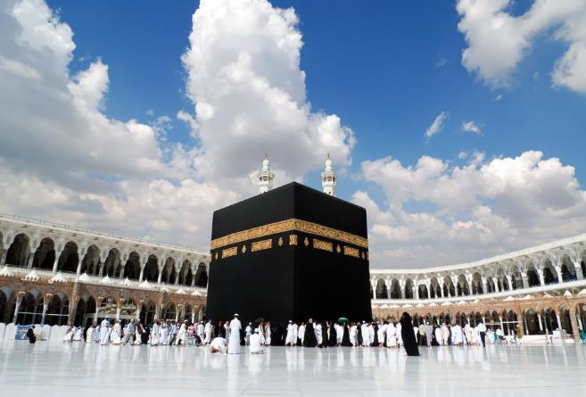
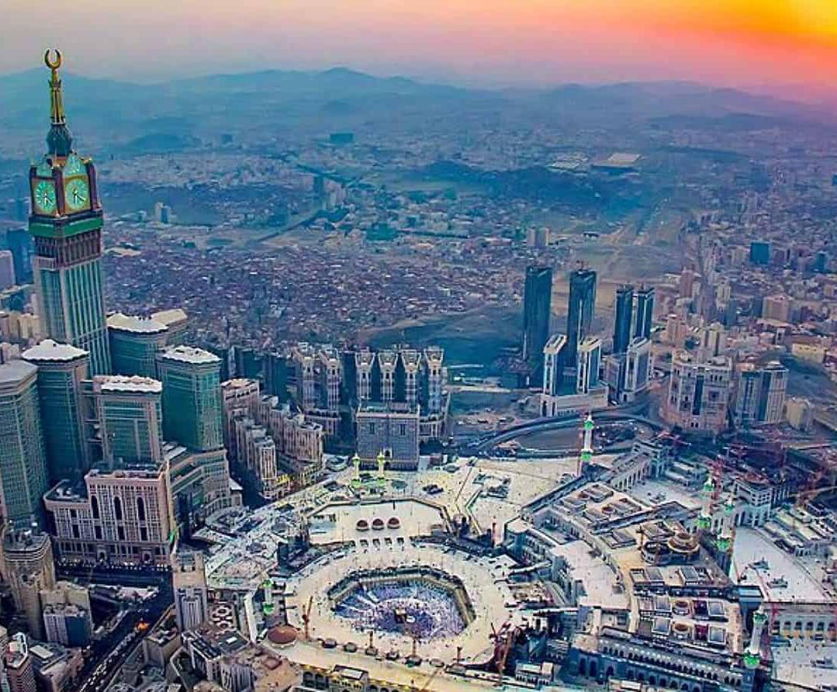
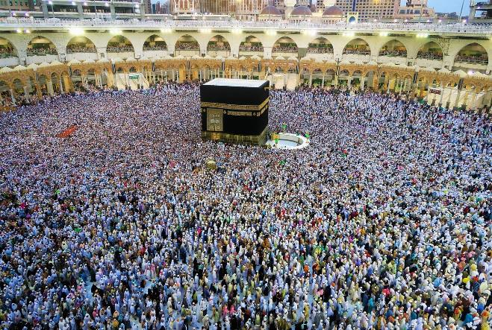
Mecca

Slide 19
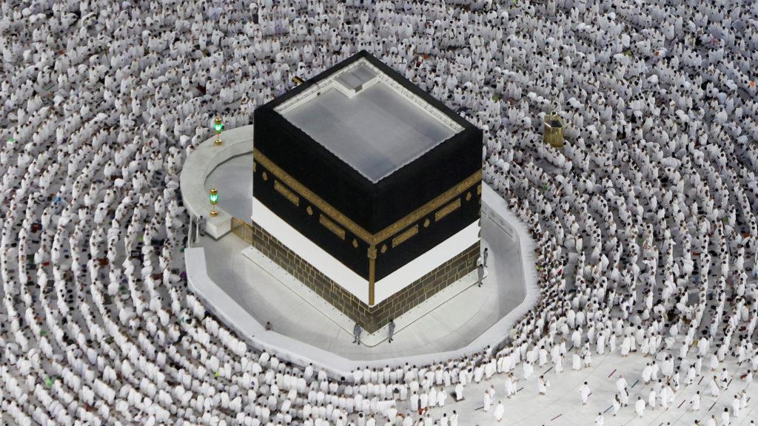
19,300,000 (19.3 million) pilgrims annually

Slide 20
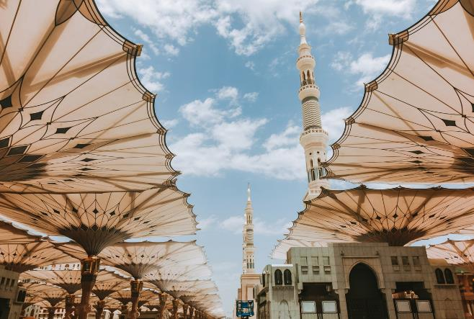
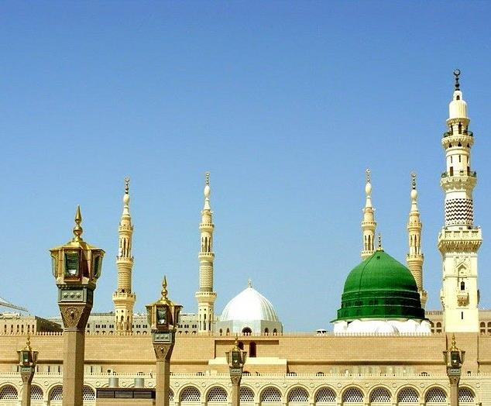
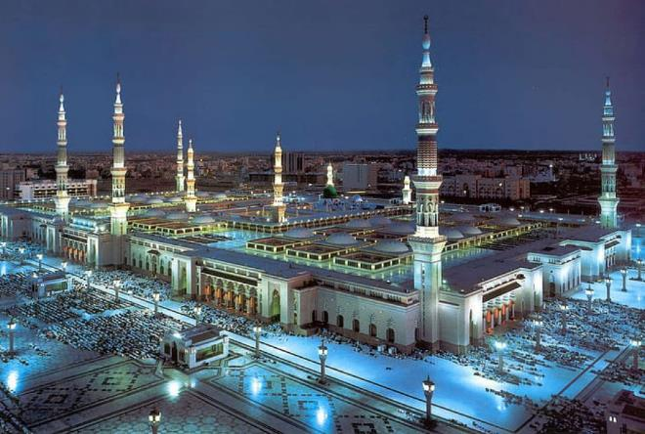
Medinah

Slide 21
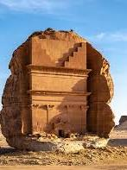
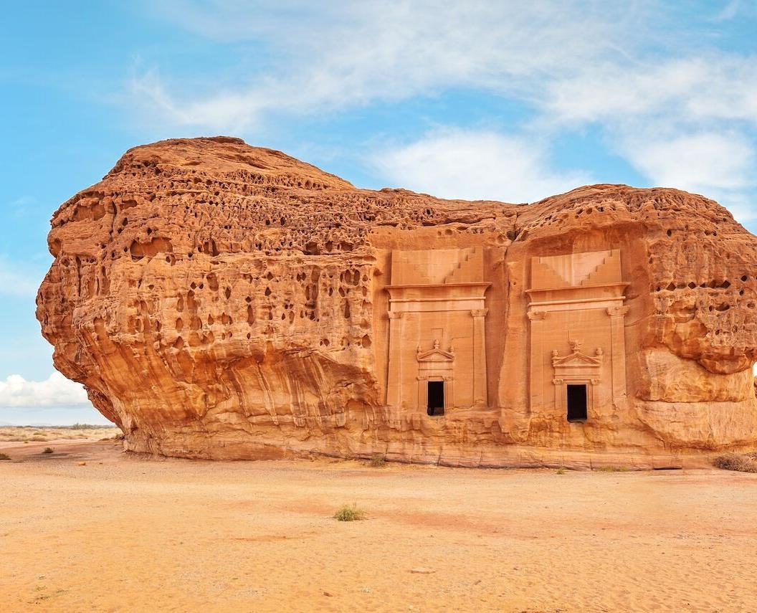
Hegra
Archeological site

Slide 22
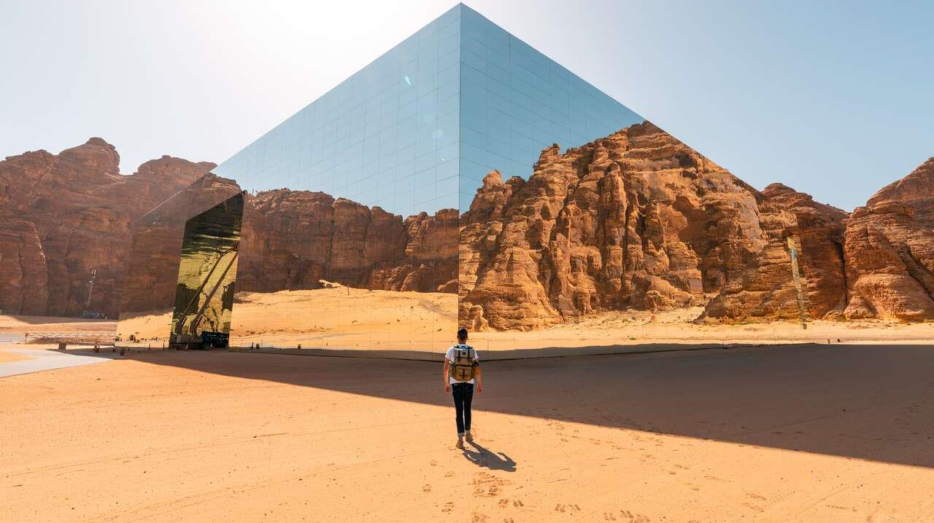
Maraya
Largest mirror building in the world

Slide 23
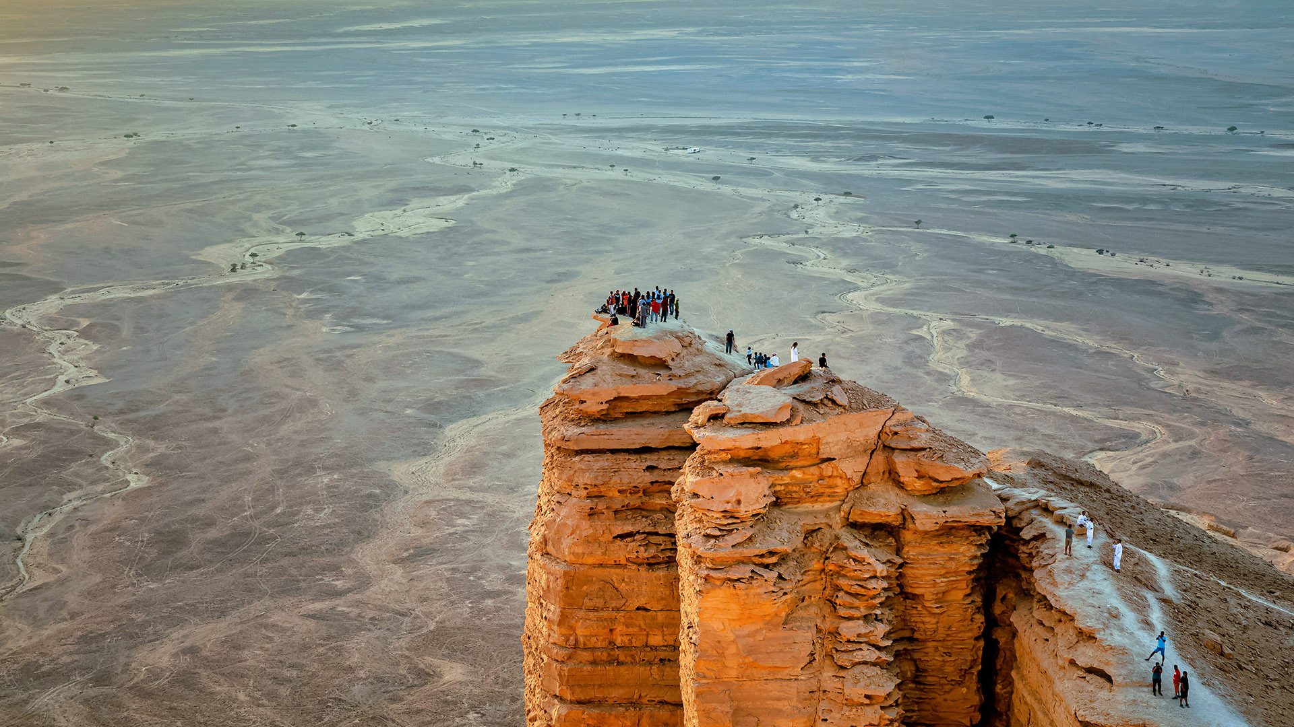
The Edge of the World
Tuwaik Mountain Range
Popular for hiking

Slide 24
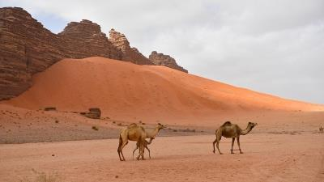
Beautiful and historical desert in northwestern Saudi Arabia
Hisma Desert

Slide 25
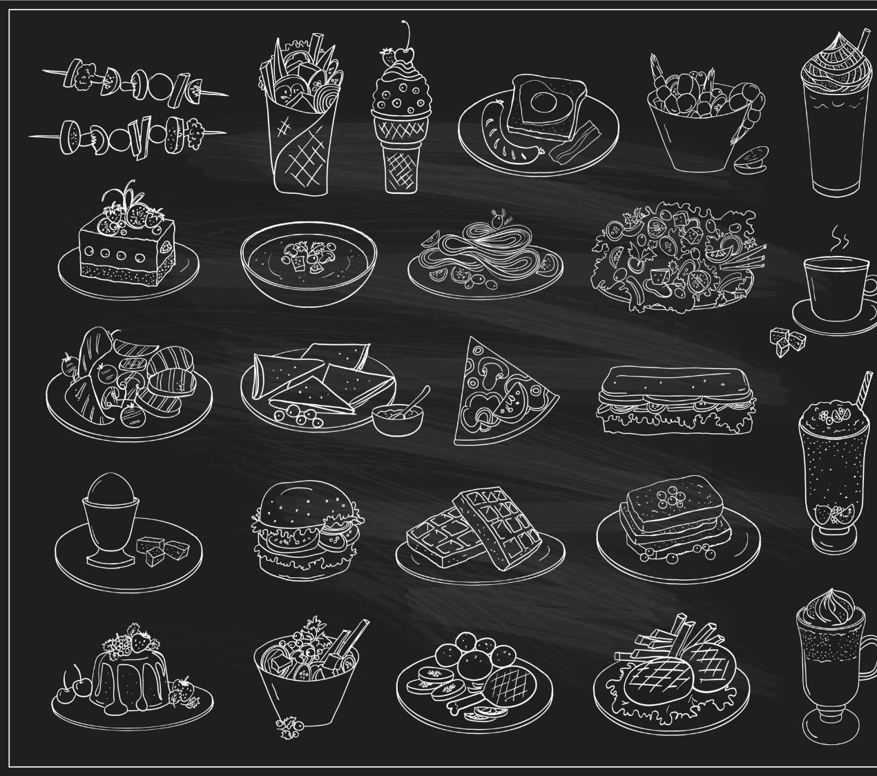
Food

Slide 26
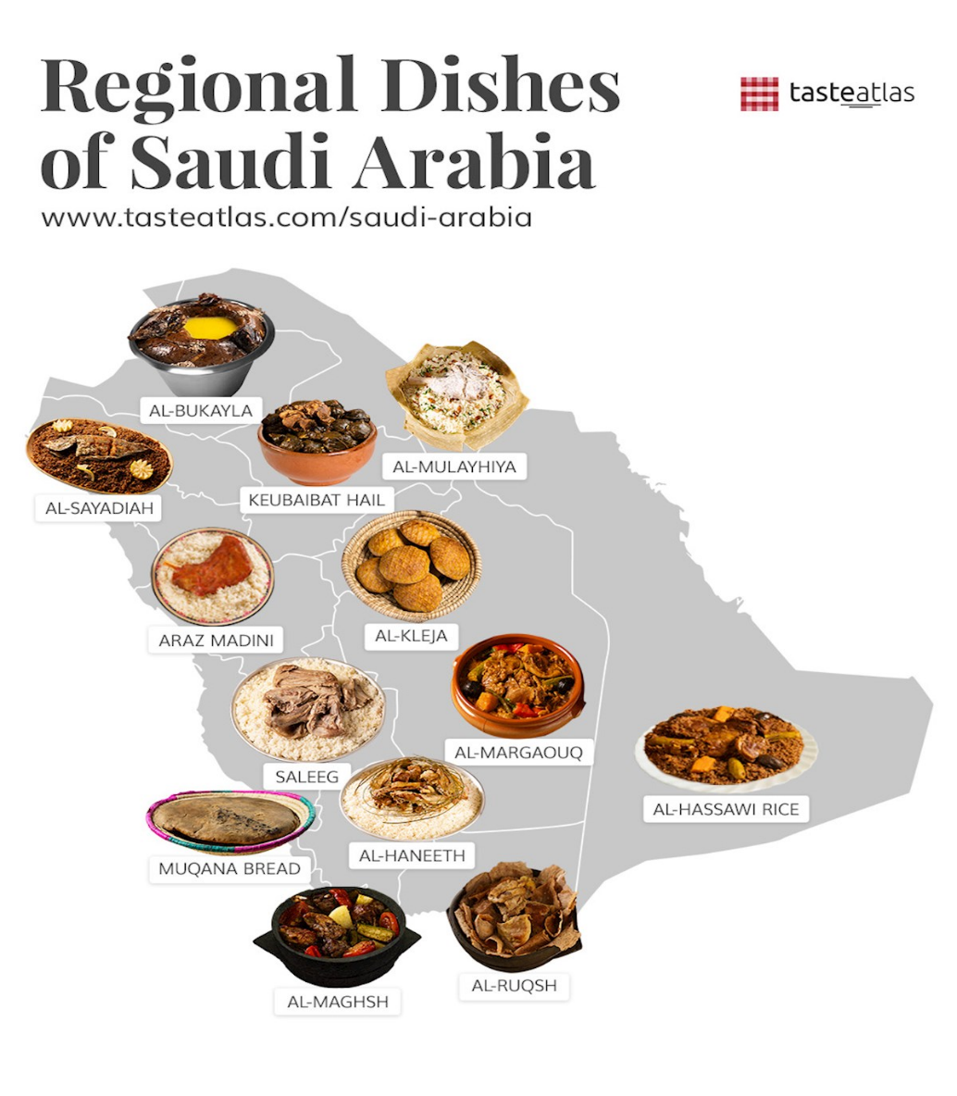
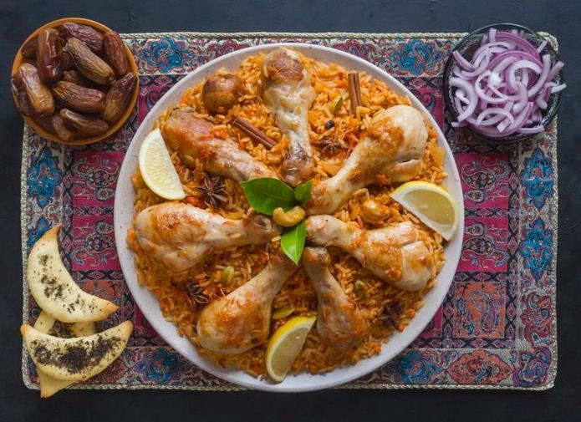

Slide 27
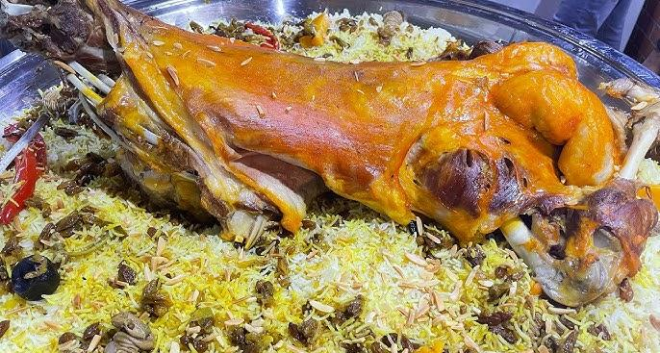
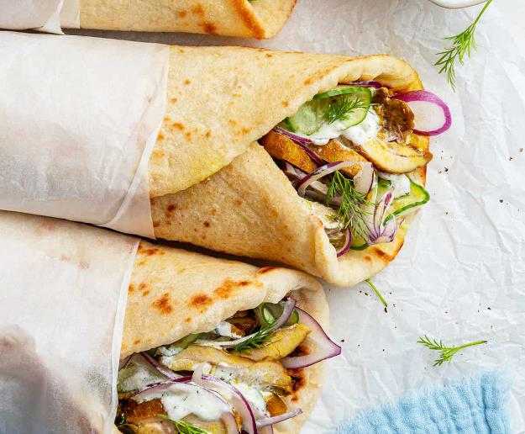
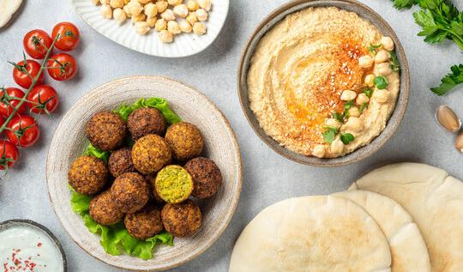
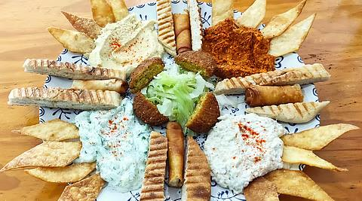

Slide 28
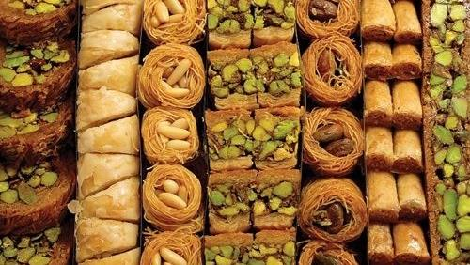

Slide 29
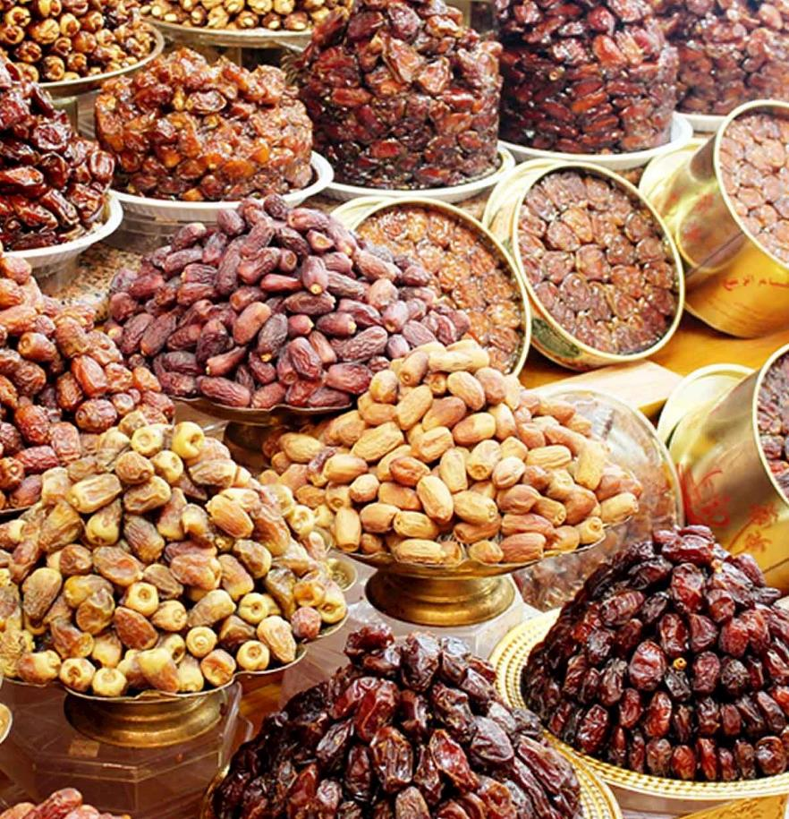
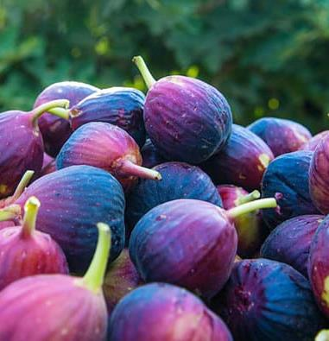

Slide 30
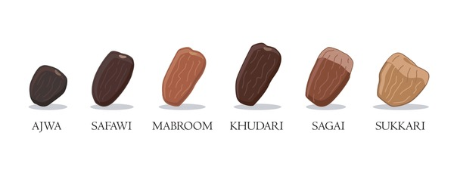
Different kinds of dates in Saudi Arabia

Slide 31
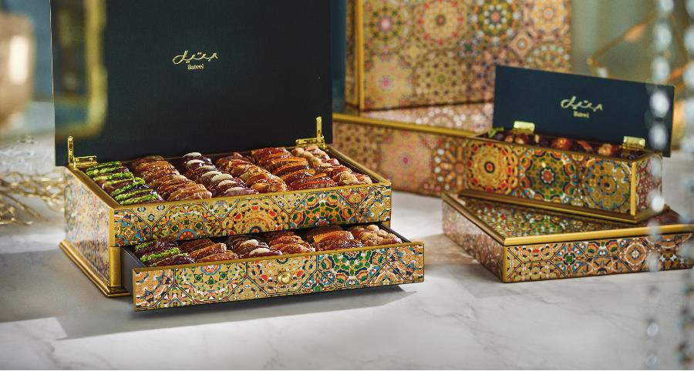
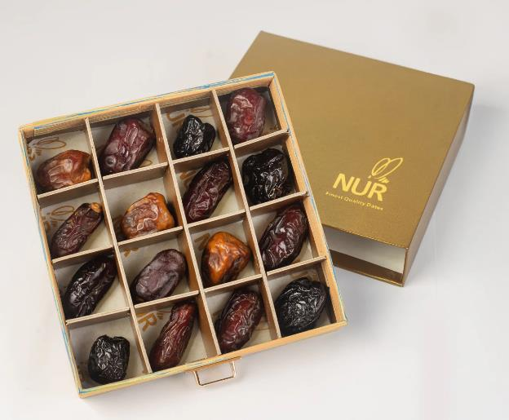

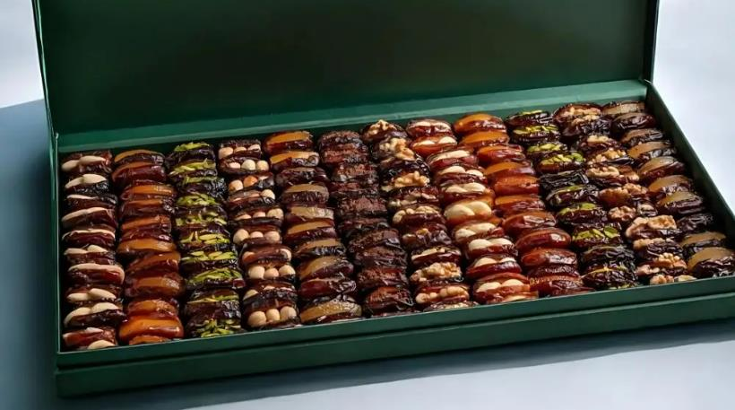

Slide 32
Animals

Slide 33
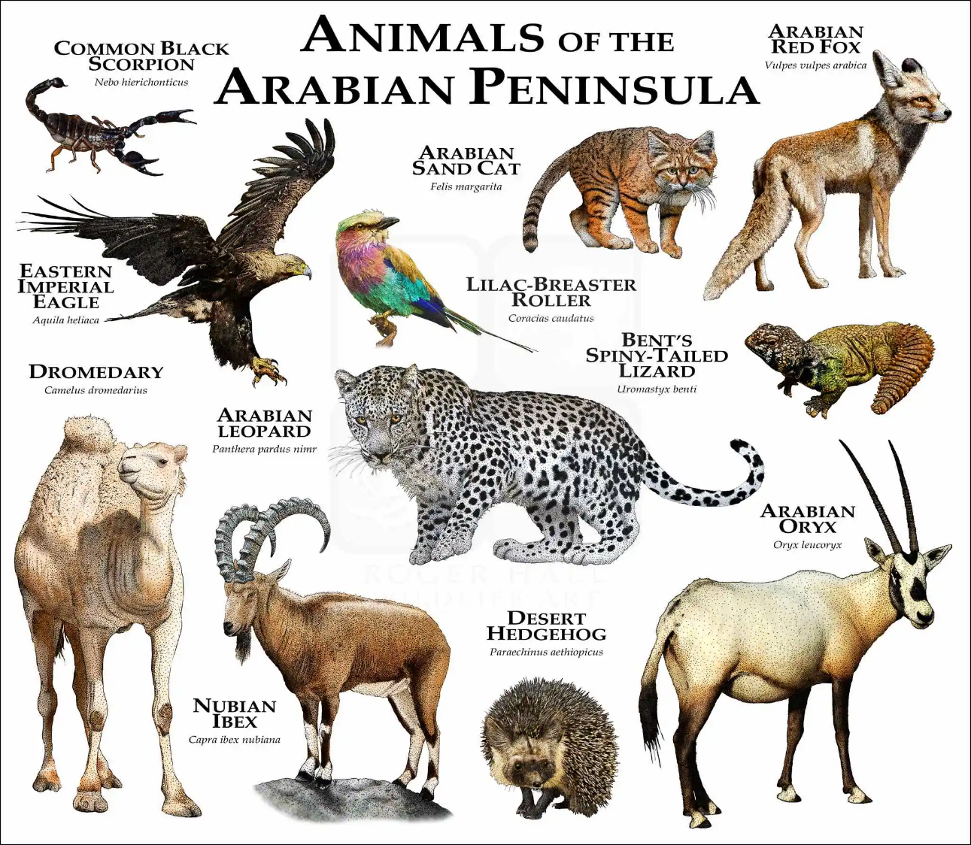

Slide 34


Slide 35



Slide 36

Saudi Arabia’s
Exports

Slide 37

Oil wells in Saudi Arabia

Slide 38




Slide 39


Slide 40


Gold

Slide 41

Gold mines

Slide 42


Football is the National Sport in Saudi Arabia

Slide 43

Cristiano Ronaldo plays for the
Al-Nassr Saudi football team

Slide 44

FIFA 2034 in Saudi Arabia

Slide 45

Tomorrow’s Cooking
Hummus and Pita Bread

Slide 46


Slide 47


Slide 48


