Slide 1
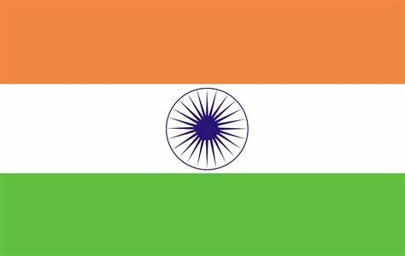
India

Slide 2
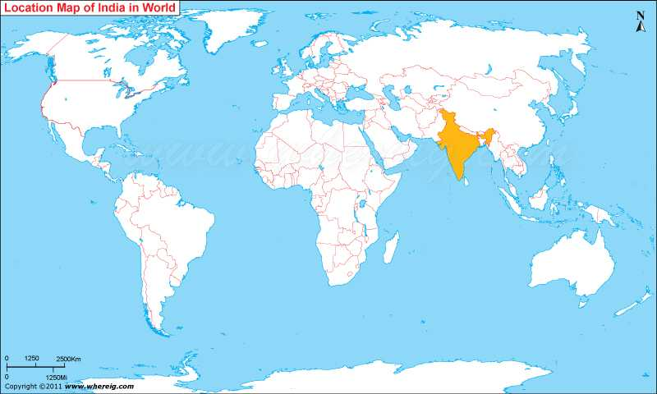
India in World Map

Slide 3
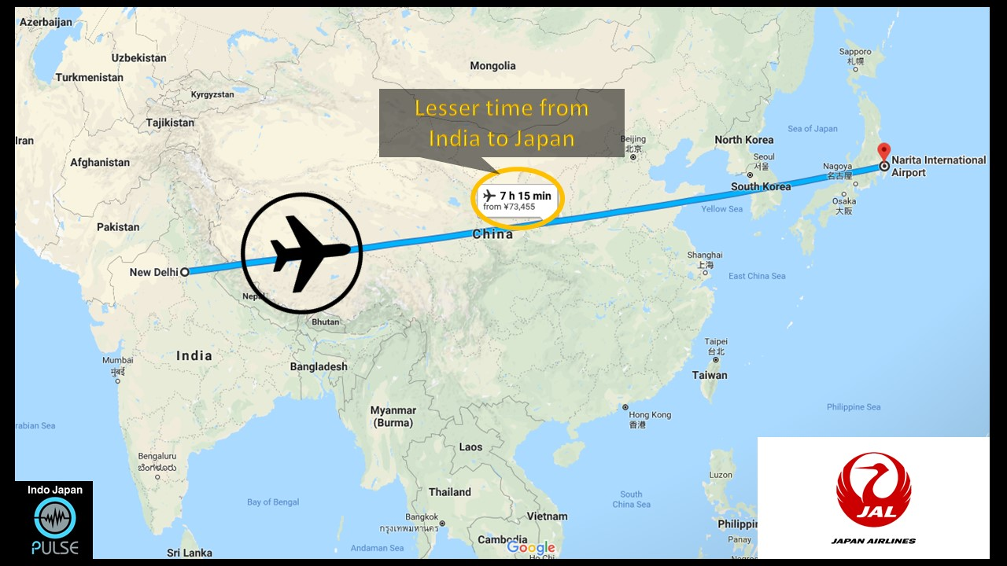
Distance between India and Japan- 7 hours

Slide 4
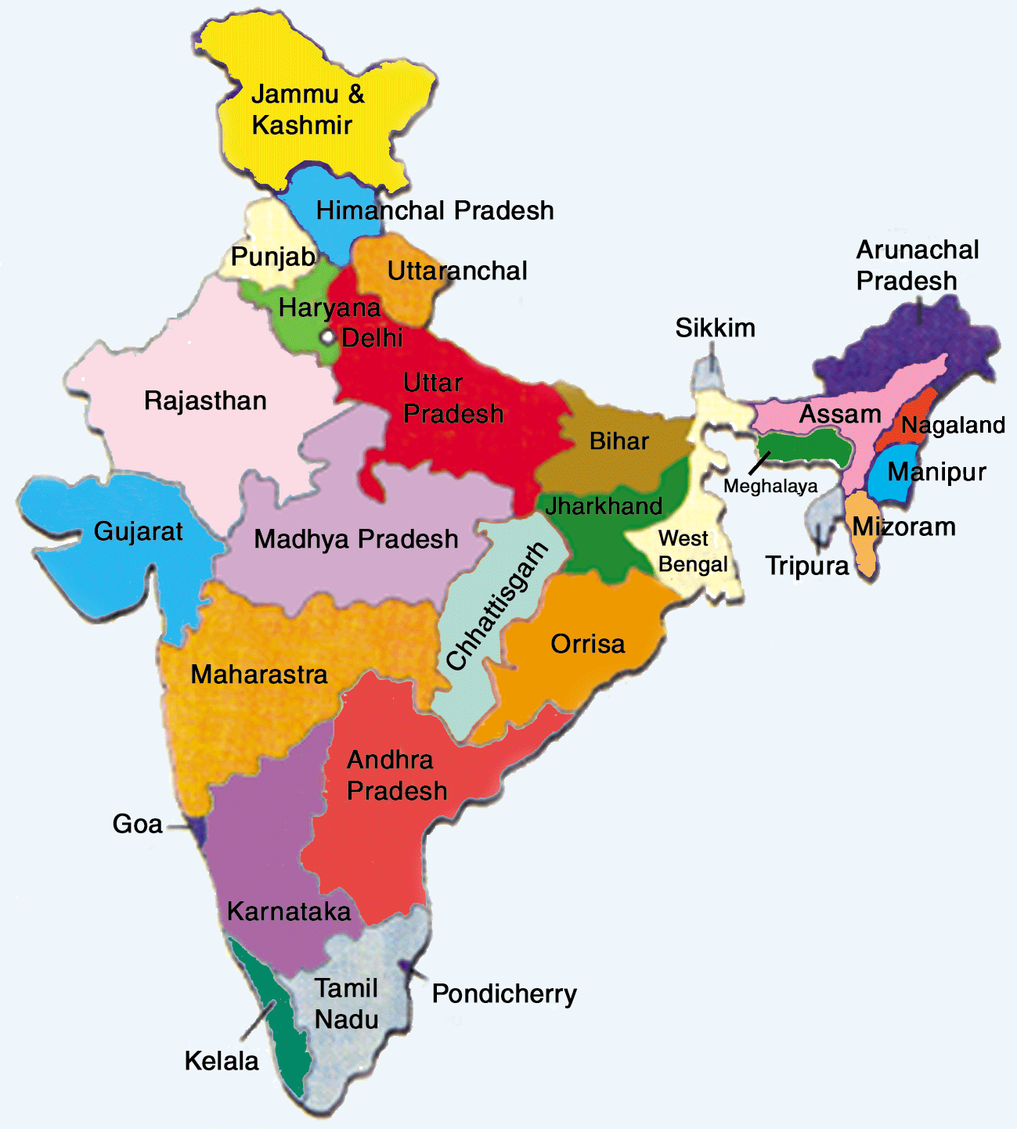
India Map and Capital
Capital: New Delhi

Slide 5
The Flag and its Meaning
Orange- Strength & courage
White- Peace
& truth
Green- Fertility and growth
Wheel of law
(Dharmachakra)

Slide 6
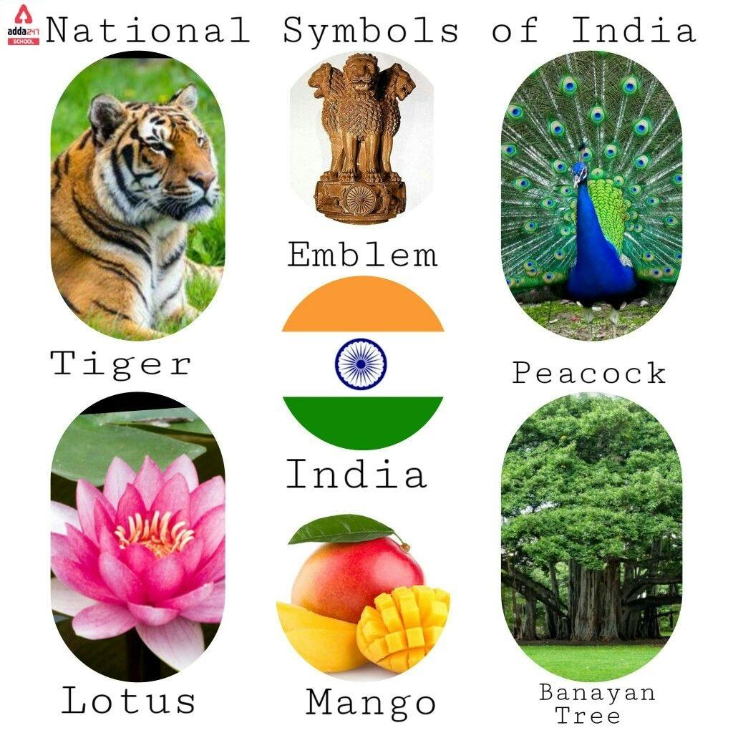

Slide 8
How many languages are there in India?

Slide 10
Famous Places to visit in India

Slide 11
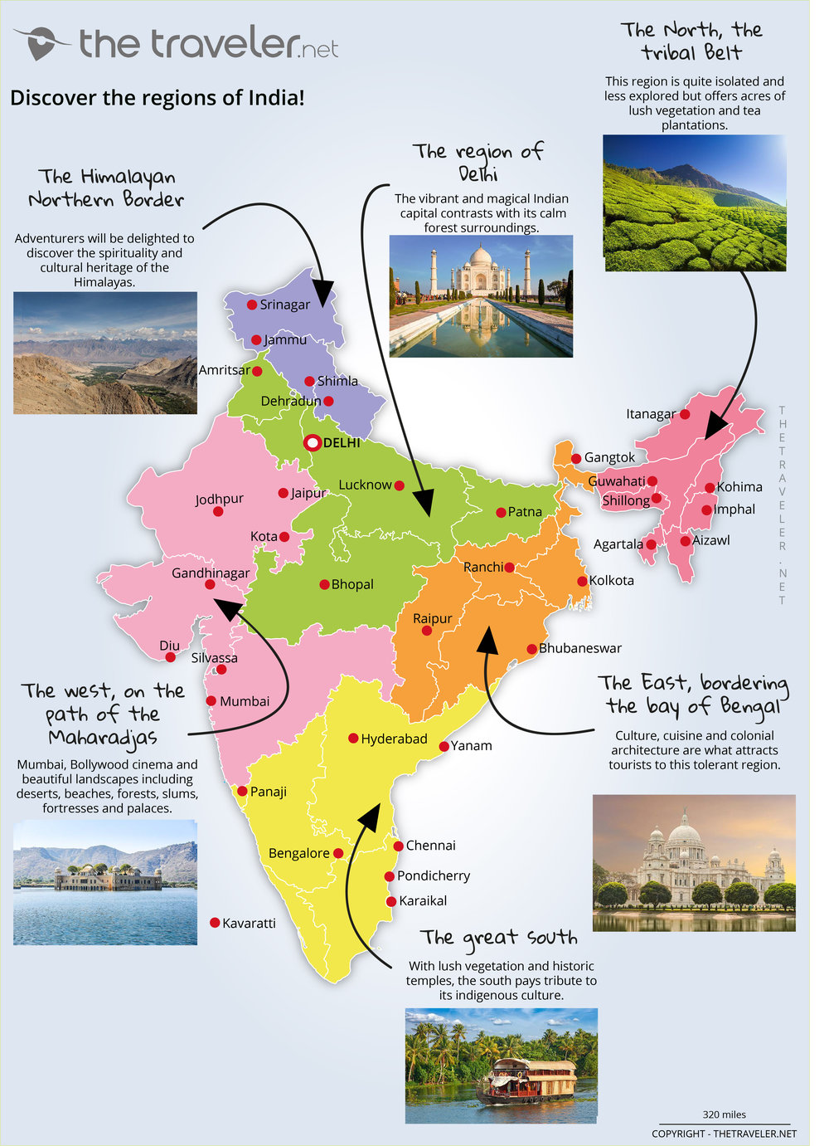
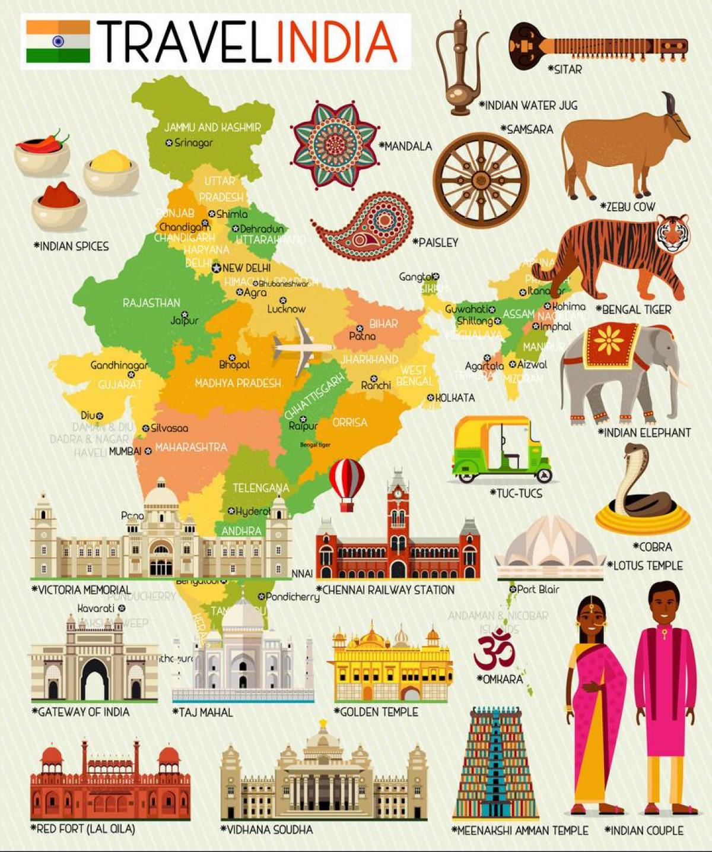

Slide 12
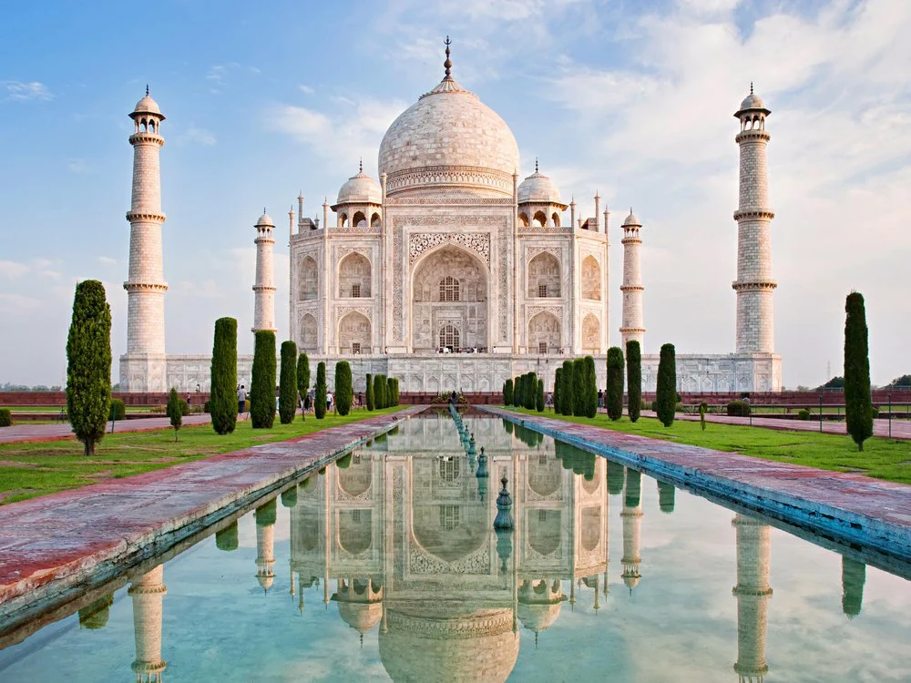
Taj Mahal

Slide 13
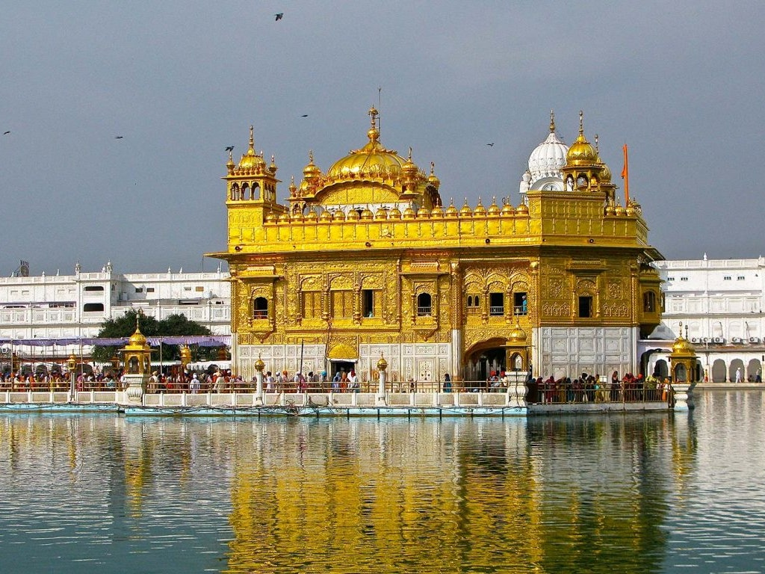
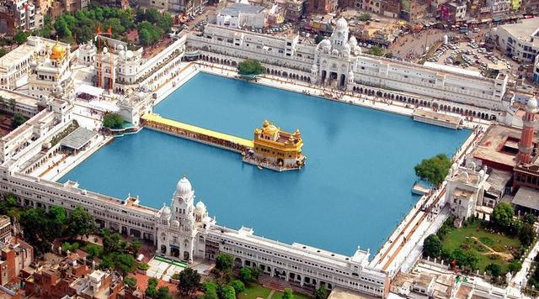
Golden Temple at Amritsar

Slide 14
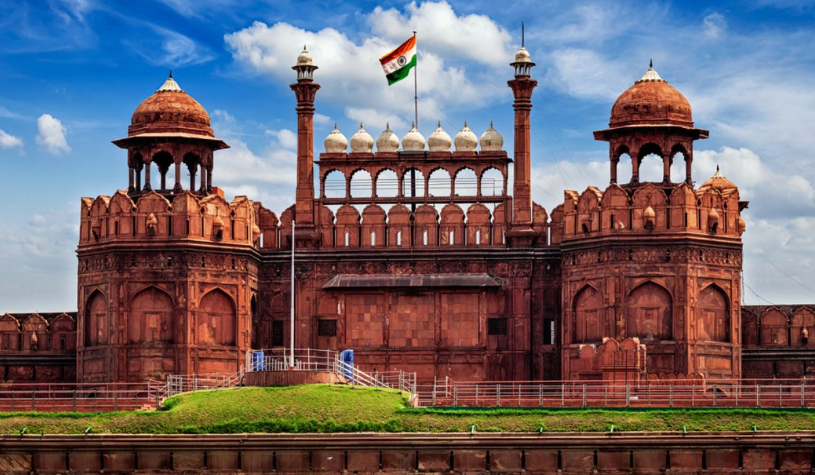
Red Fort at Delhi

Slide 15
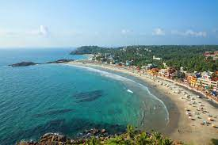
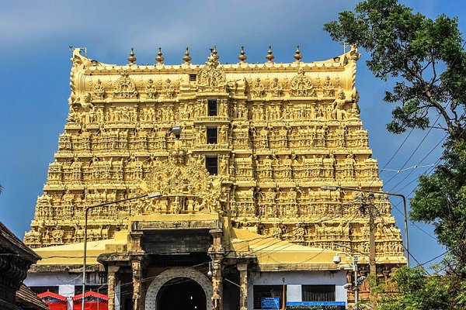
Thiruvananthapuram

Slide 16
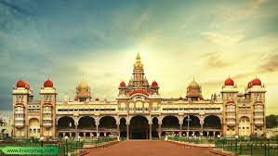
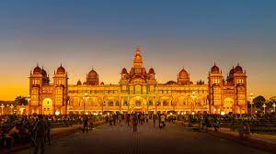
Mysore Palace

Slide 17
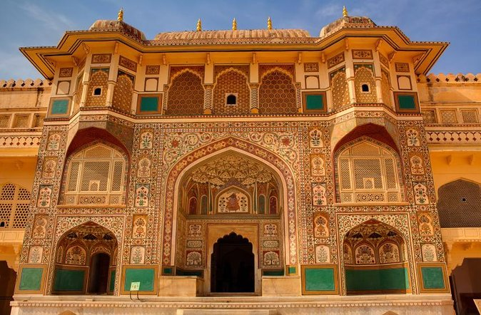
Amber Fort

Slide 18
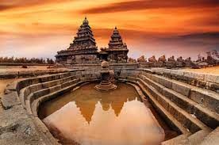
Mahabalipuram Temple

Slide 19
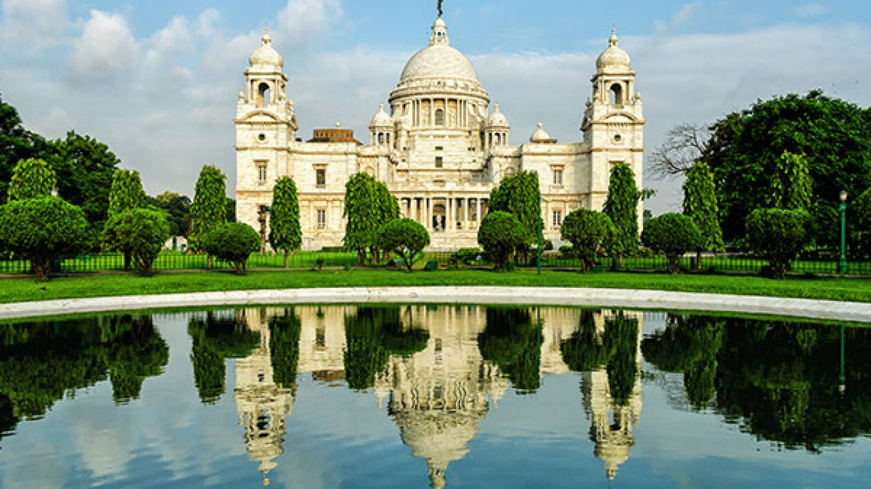
Victoria Memorial

Slide 20
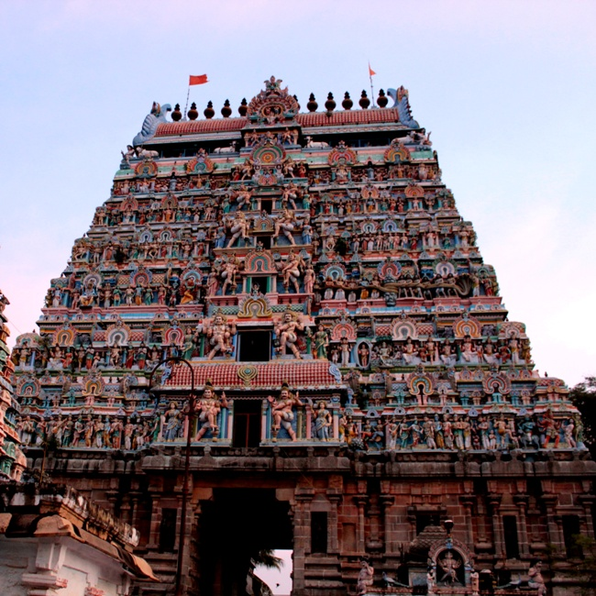
Chidambaram Temple

Slide 21
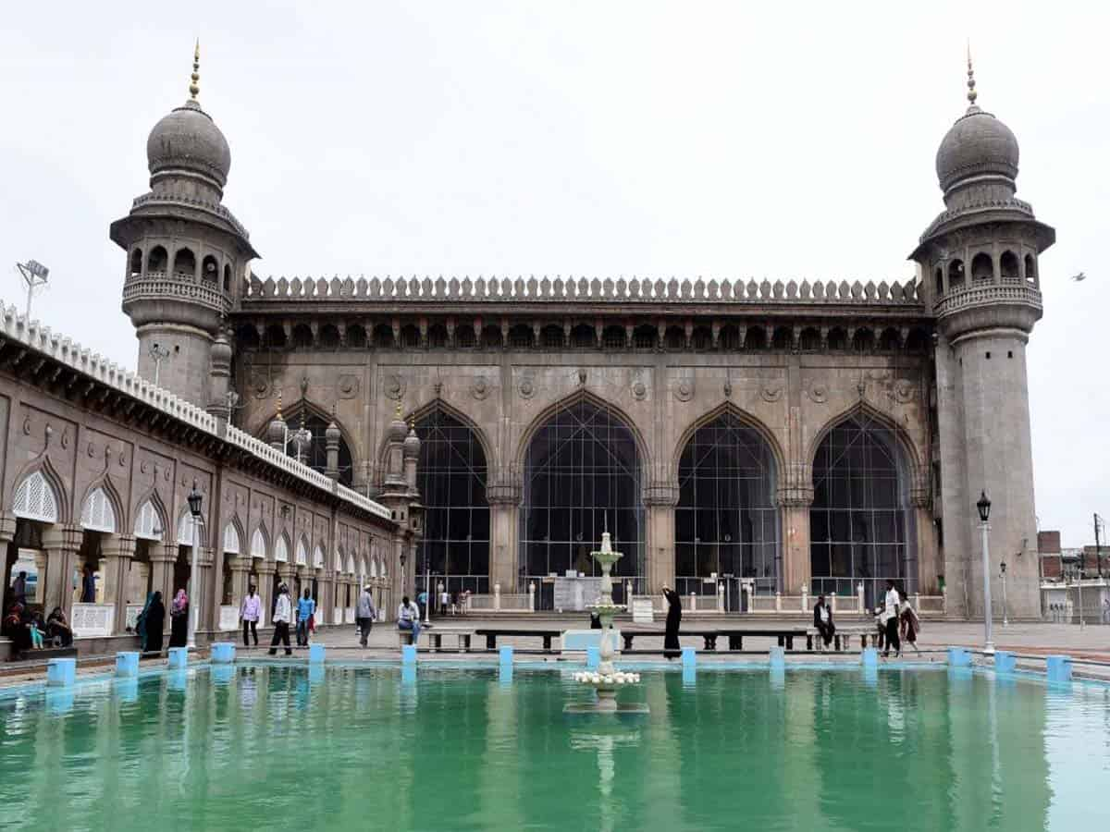
Mecca Masjid

Slide 22
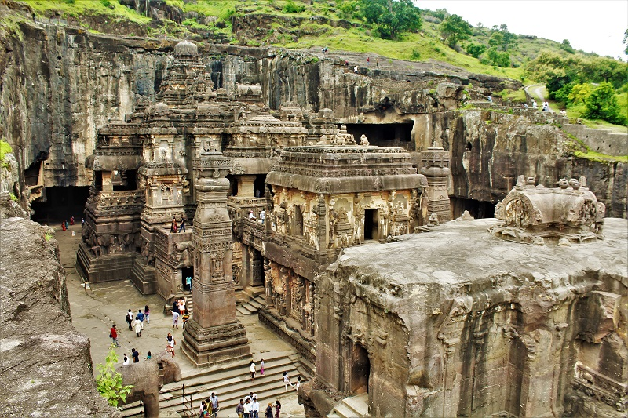
Ajanta and Ellora Caves

Slide 23
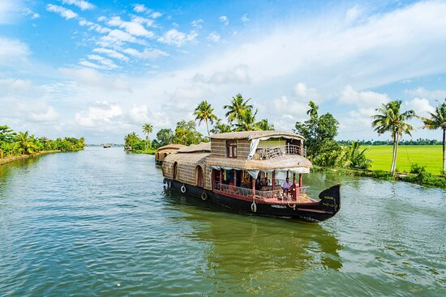
Kerala Backwaters

Slide 26
Animals

Slide 27
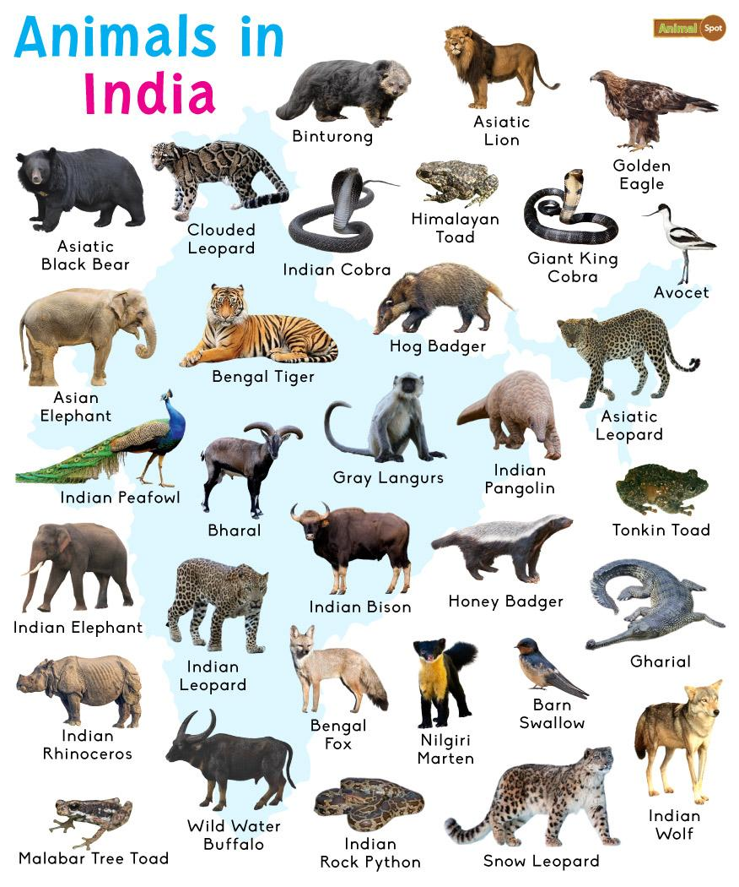

Slide 28
Food

Slide 29
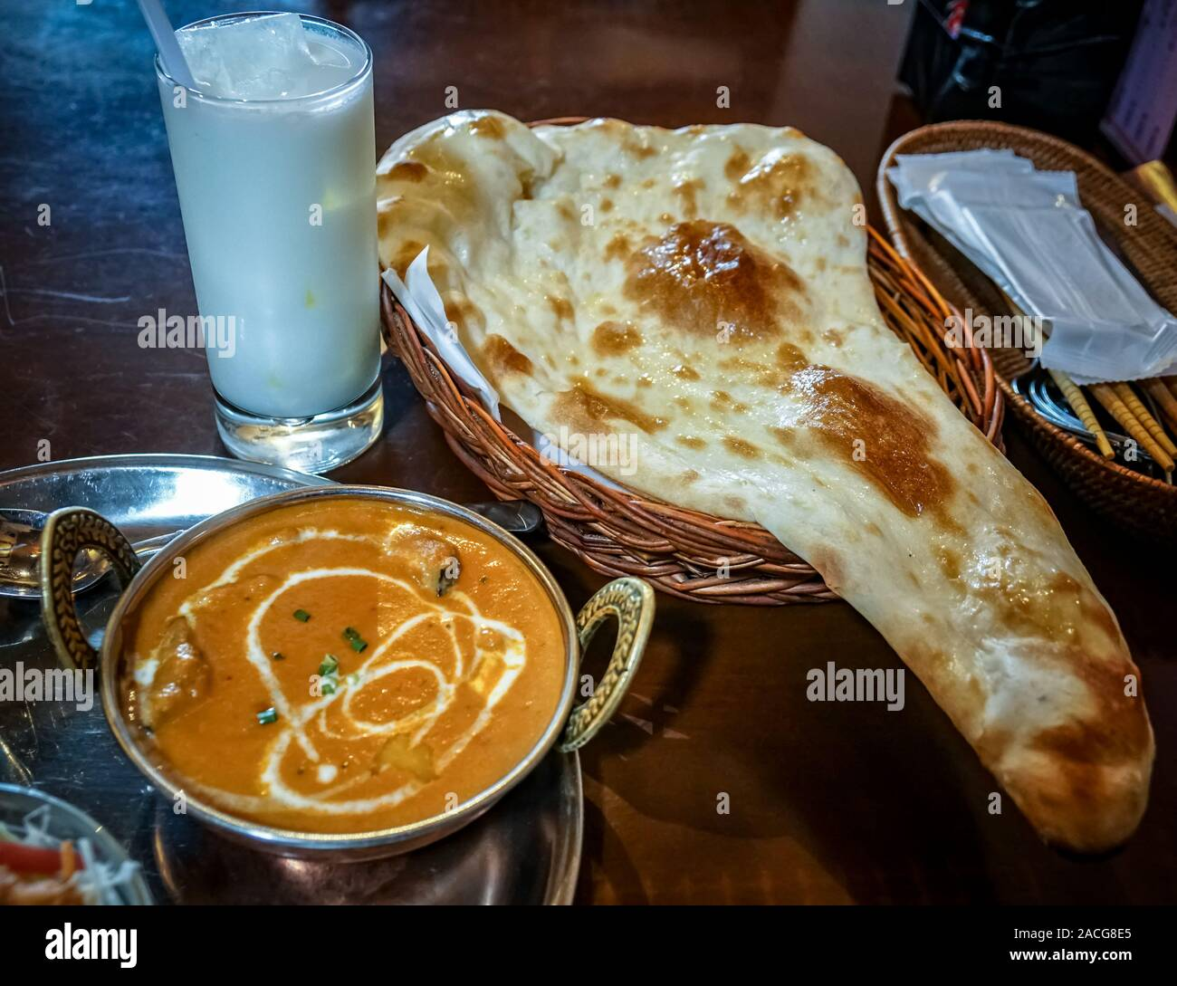
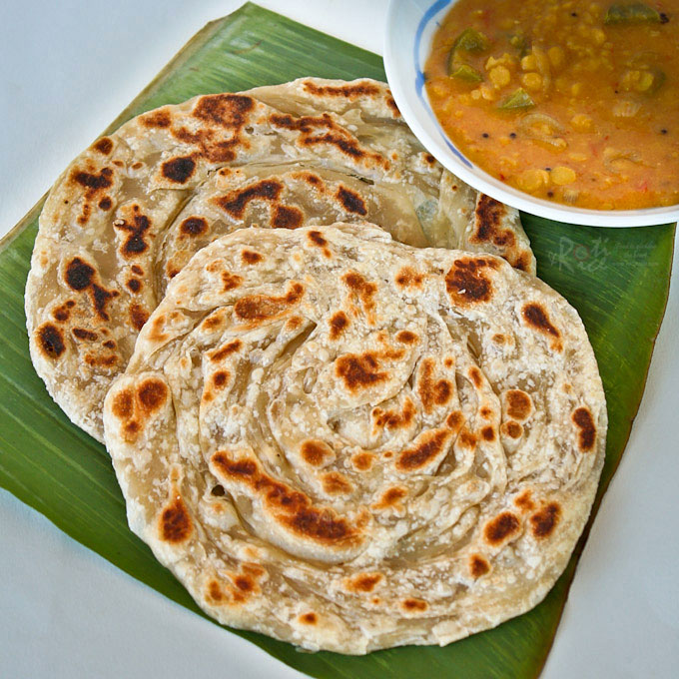
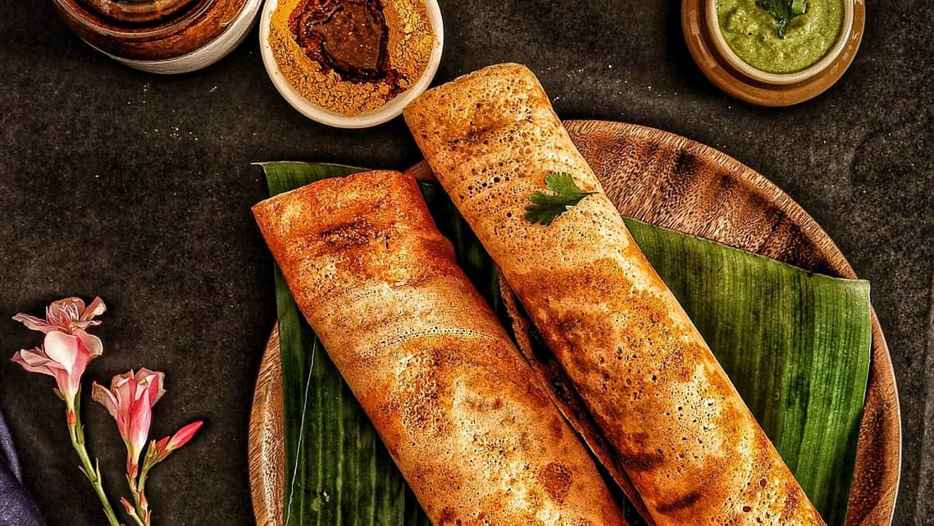
Indian Food

Slide 30
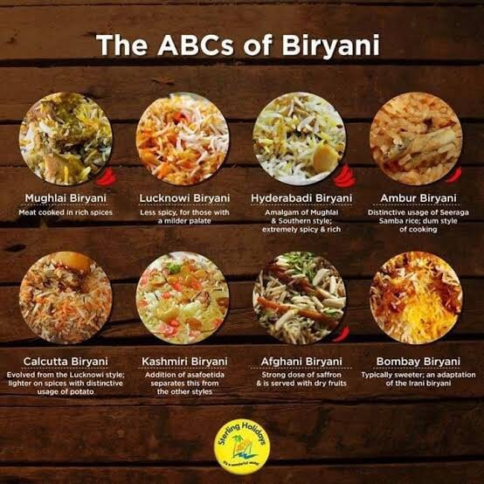
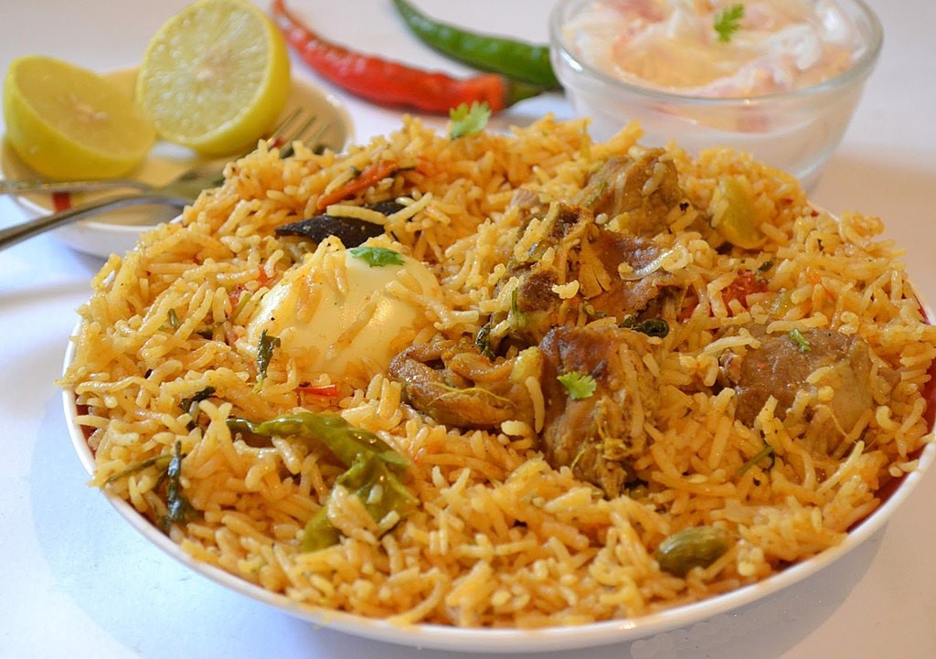

Slide 31
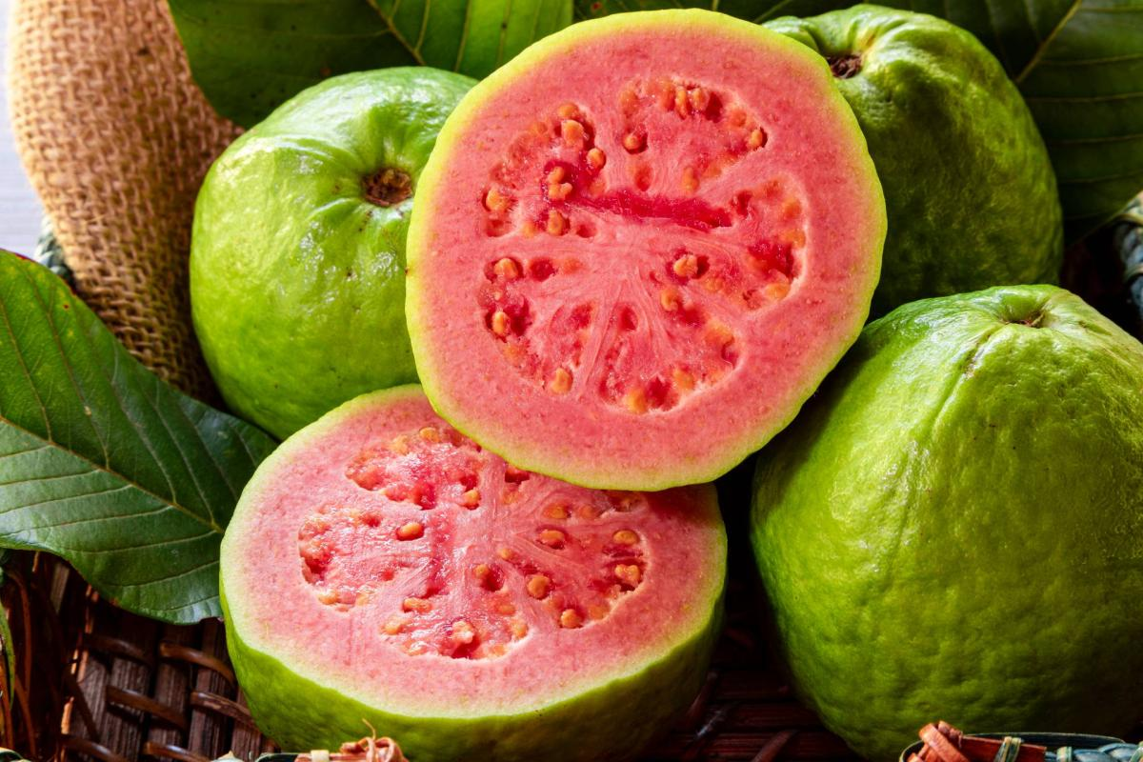
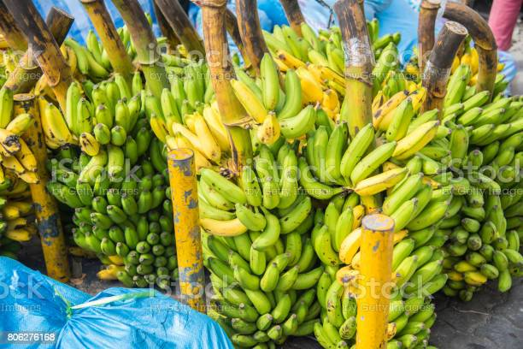
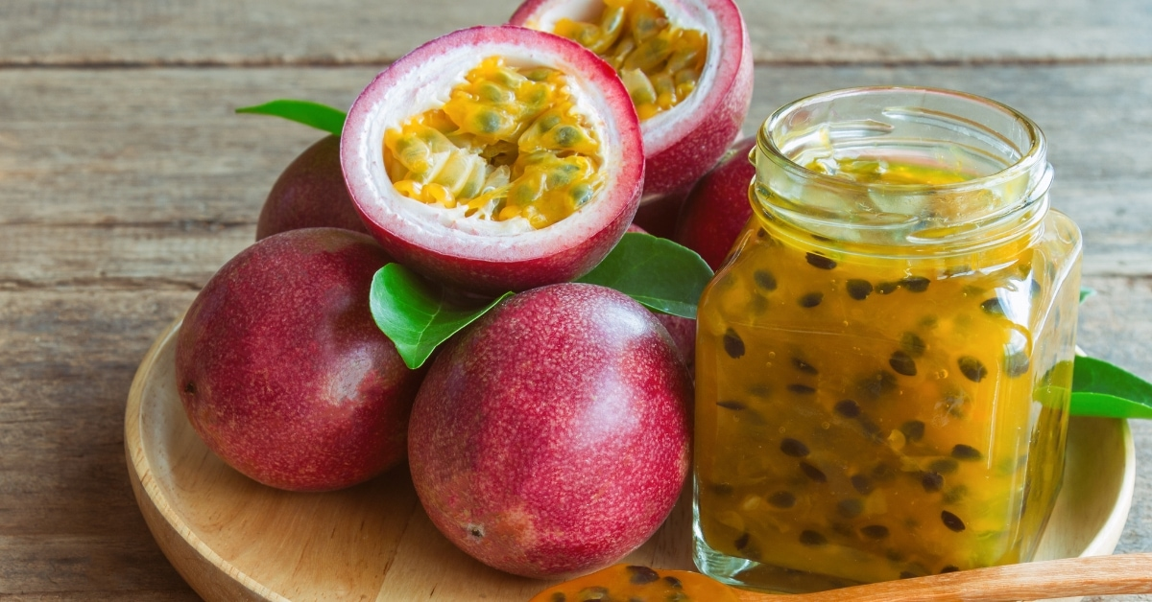
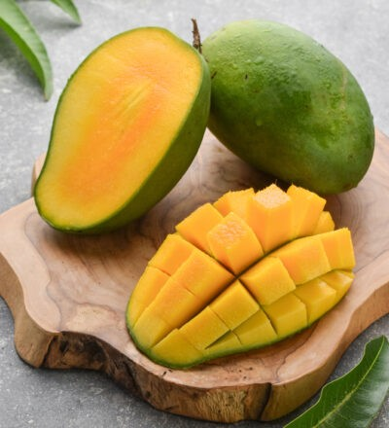
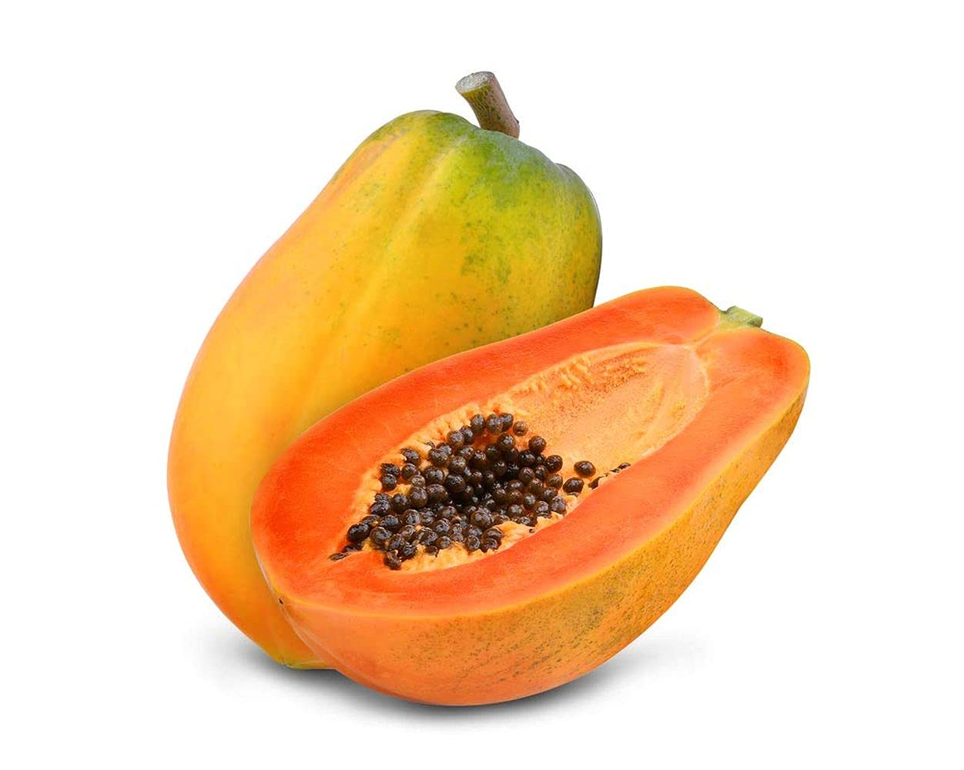
Indian Fruits

Slide 32
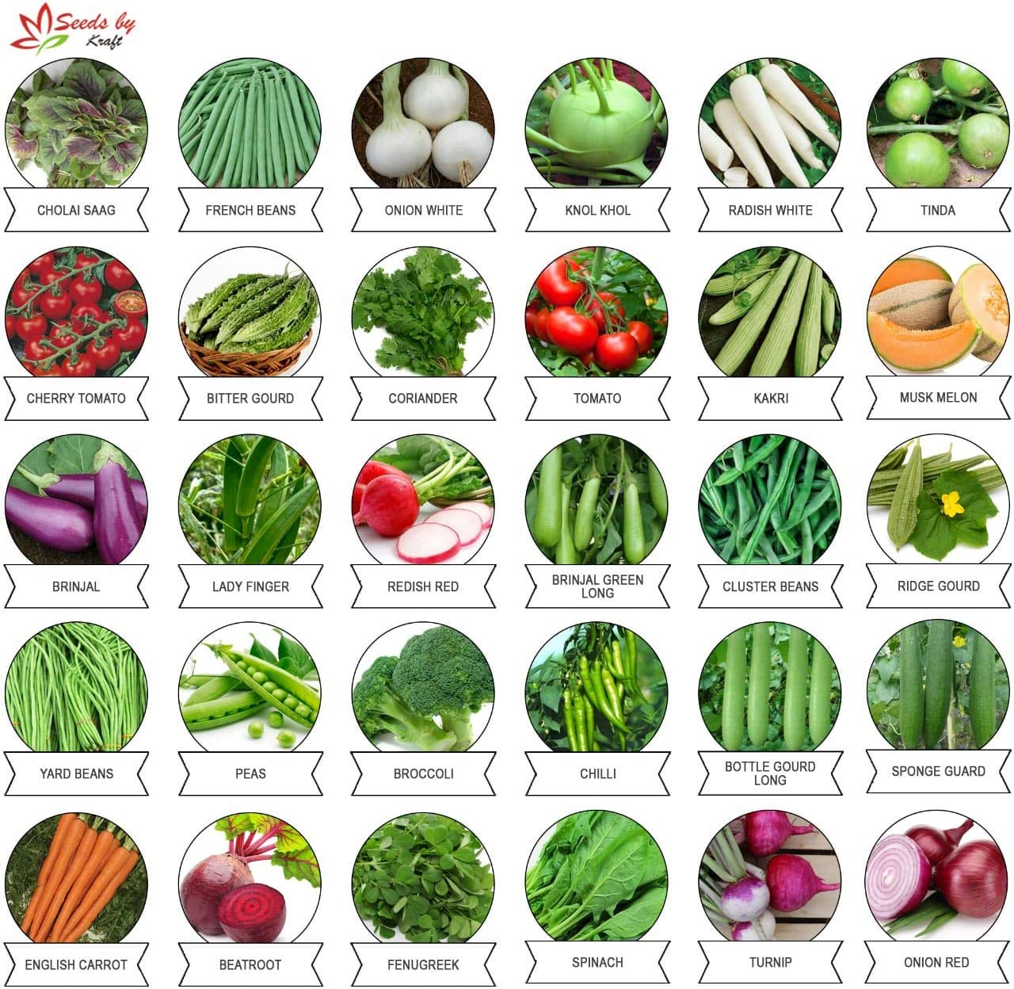

Slide 33
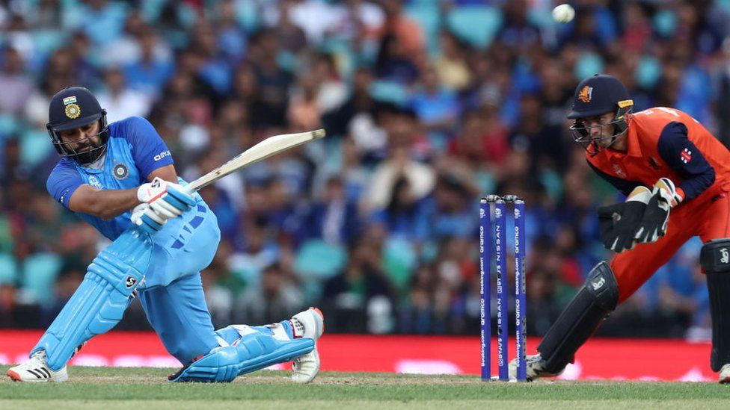
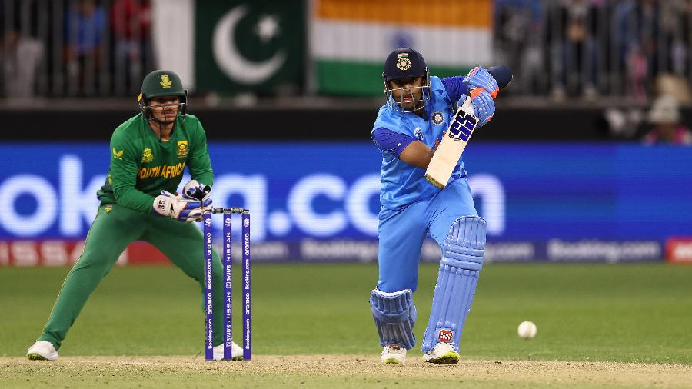
Cricket

Slide 34
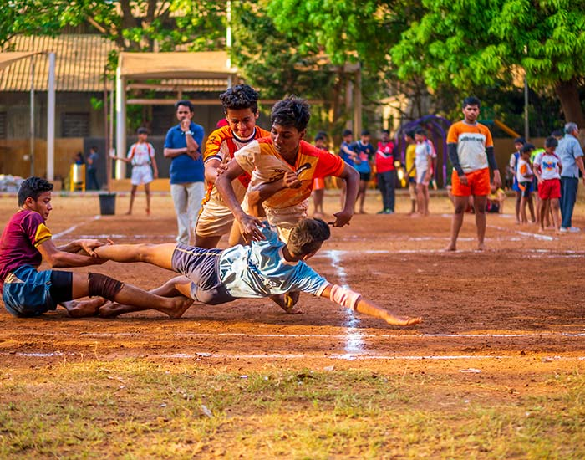
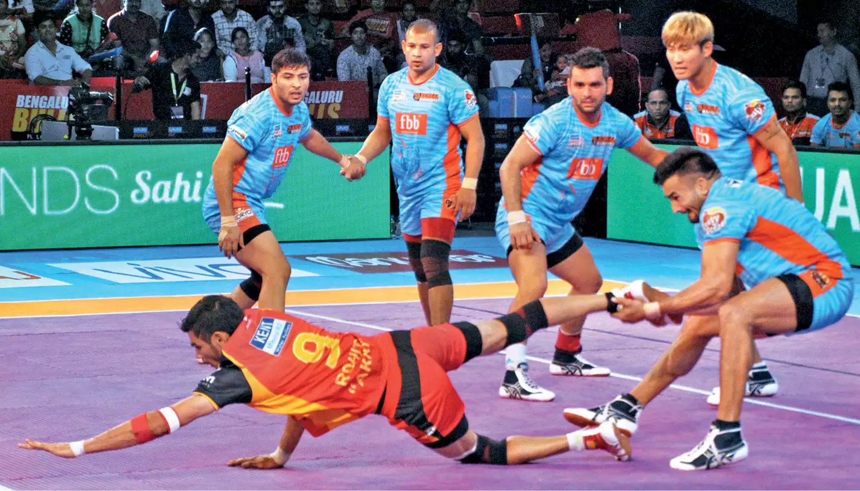
Kabbaddi

Slide 35
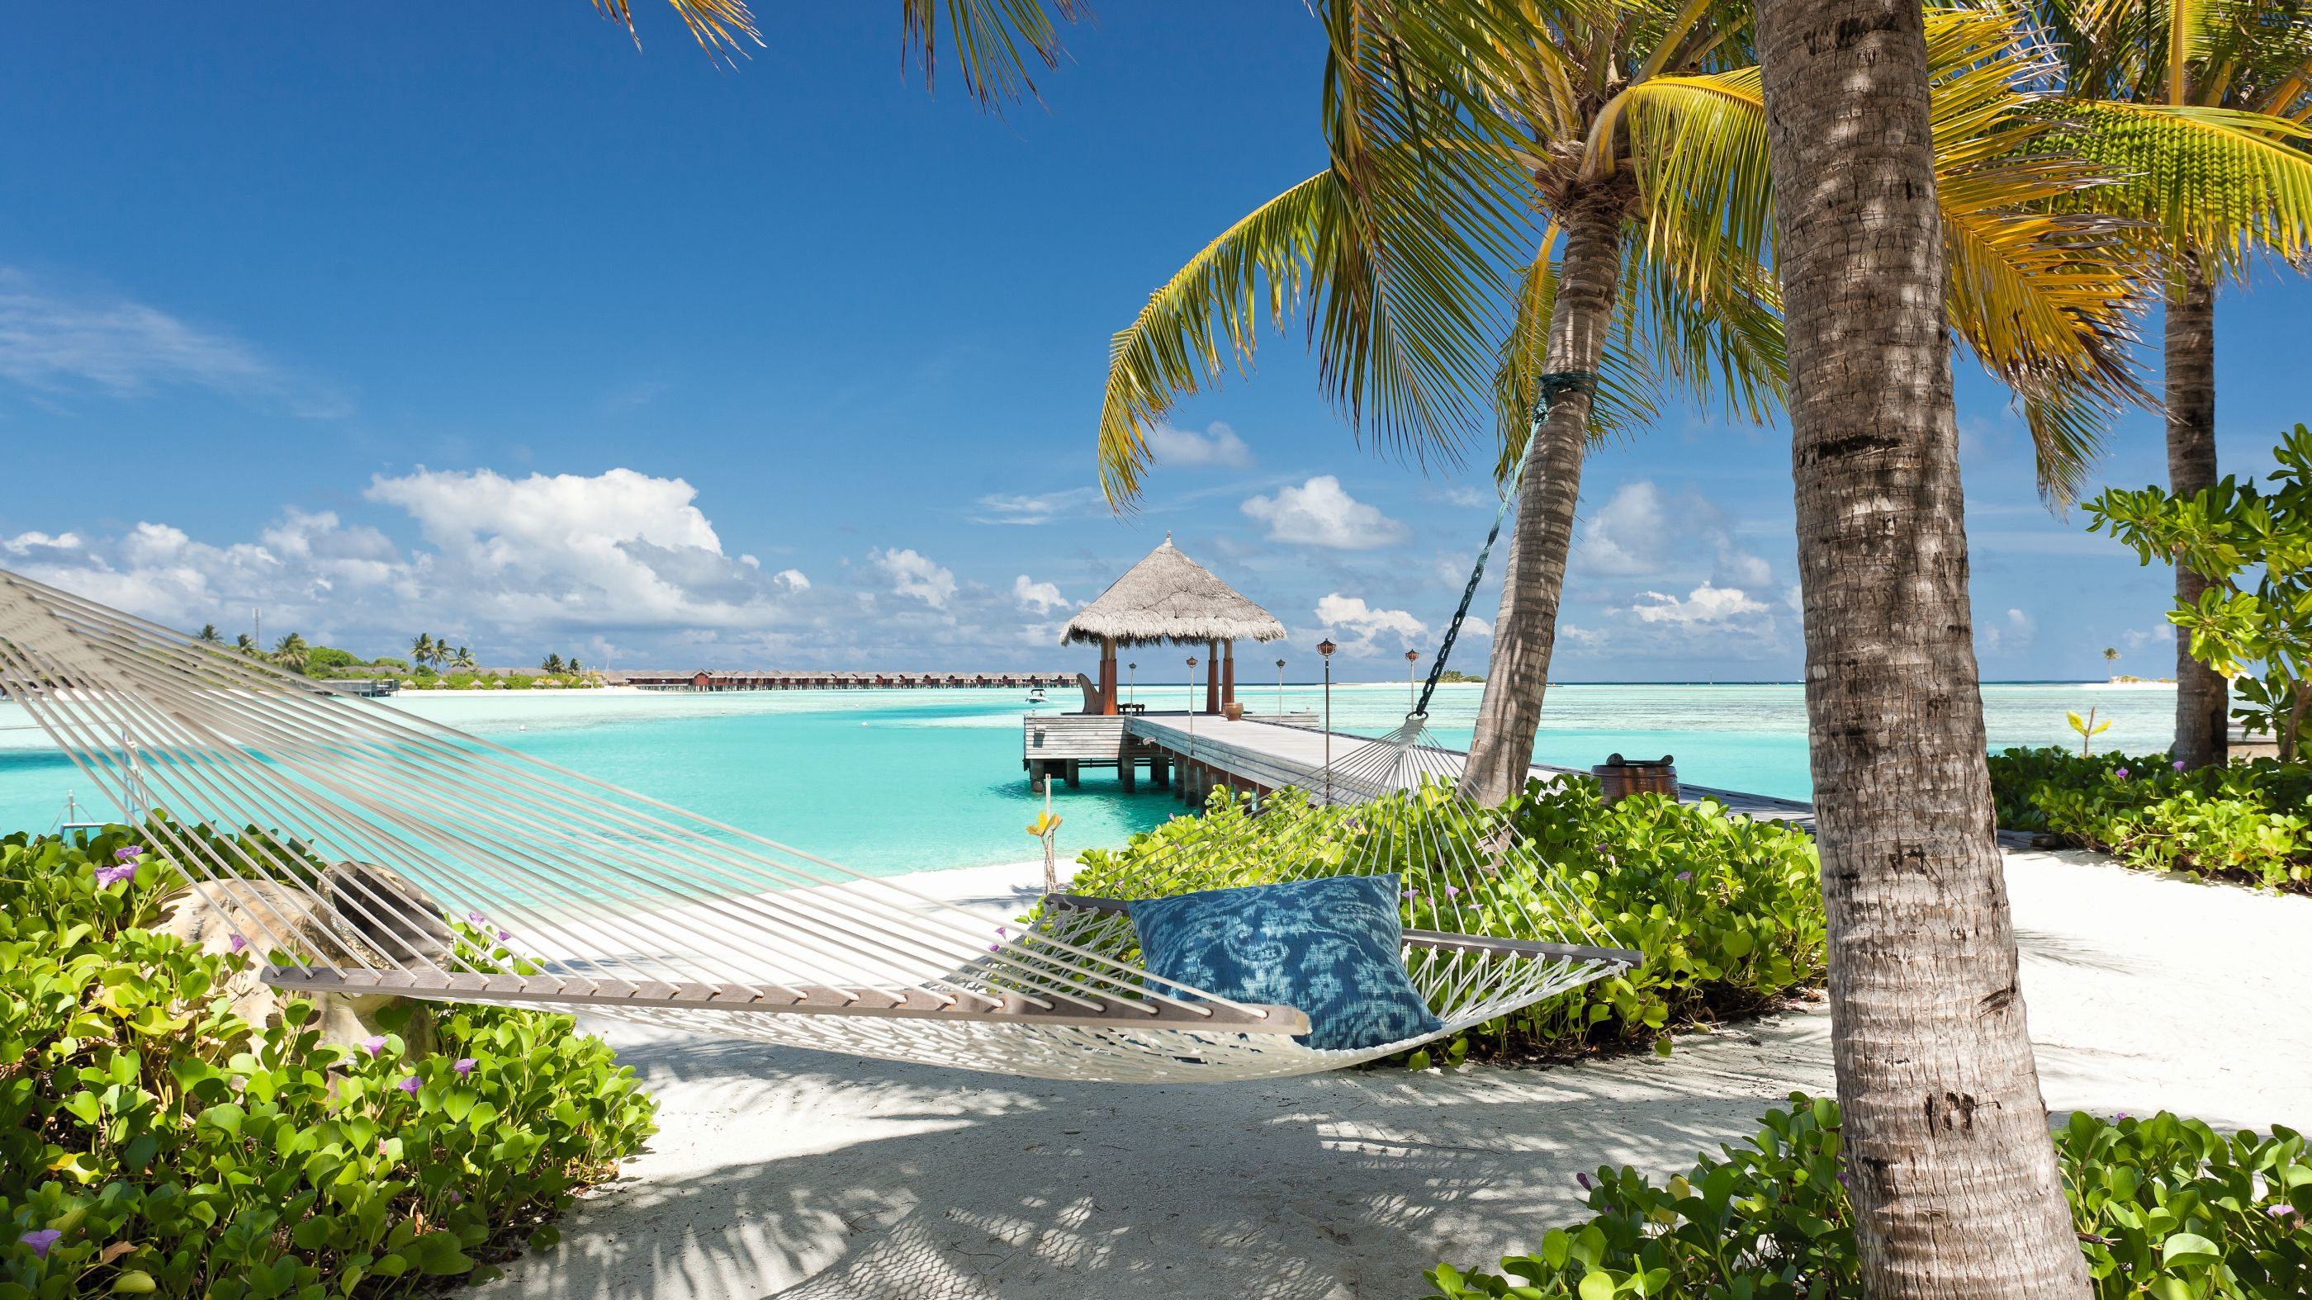
Facts about India
Official name is the Republic of India, Bharat
Capital is New Delhi
The population is 1,296,834,042
(One thousand two hundred and ninety six million eight hundred and thirty four thousand and forty two)
The national language is Hindi and English, and 21 others
Peninsula
Official currency is the Indian Rupee
Second largest English speaking country
Gandhi is one of India’s most famous icons
Largest number of vegetarians in the world
First country to refine and consume sugar
Shampoo originated in India
Cows are considered sacred in India

Slide 36
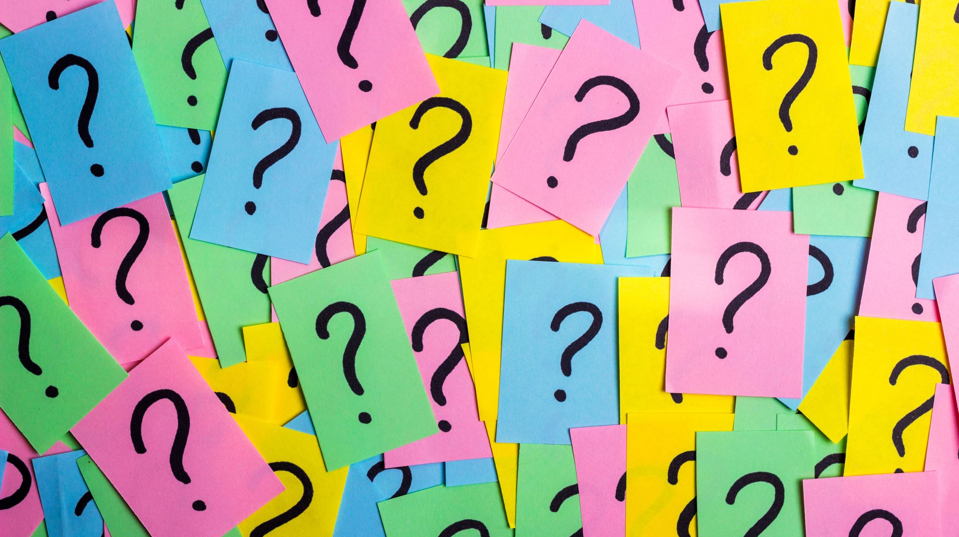
Quiz
What languages are spoken in India?
a) Hindi b) Divehi c) Sinhala
How to say hello in Hindhi?
a) Ayubowan b) Namaste c) Konnichiwa
Is India a:
a) Peninsula? b) Gulf? c) Archipelago?
What is the symbol in the centre of the Indian flag?
a) A lion b) A red sun c) A chakra
India has :
a) 50 states b) 28 states c) 9 states
What is the capital of India?
a)Colombo b)New Delhi c)Tokyo

Slide 37
Quiz
Which continent is India in?
a) Asia b) Europe c) Africa
What countries are near India?
Germany, England, France b) Kenya, Egypt, South Africa
c) Sri Lanka, Pakistan, Bangladesh
What is the staple food of India?
a) Pasta and pizza b) Rice and naan c) Bread and baguette
Which animal is considered sacred?
a) Cow b) Horse c) Donkey

Slide 38
Shukriya!

