Slide 1
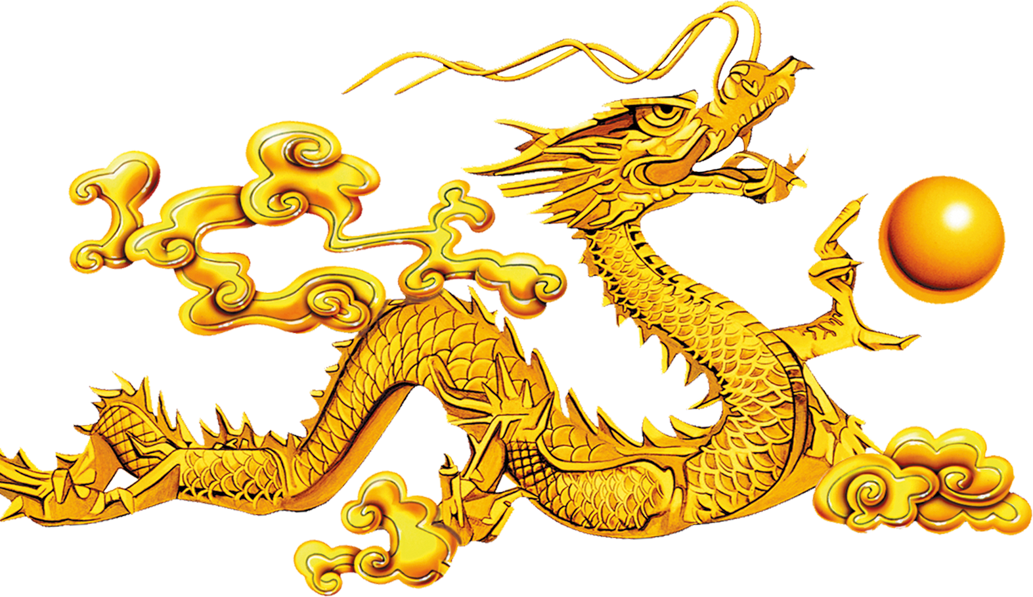
Let’s learn all about CHINA
Let’s learn all about CHINA!
By Philip and Mihaly

Slide 2
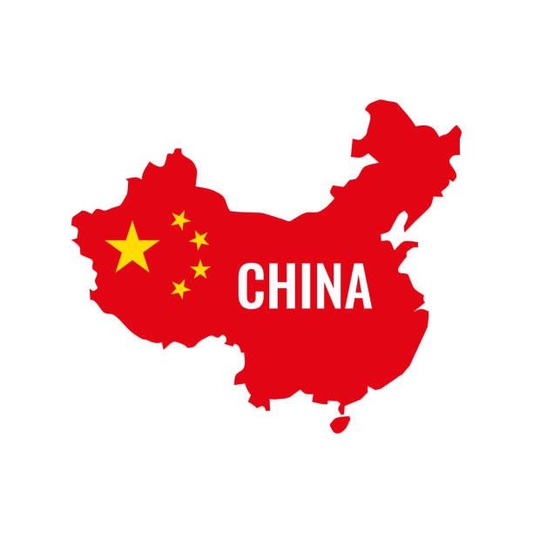
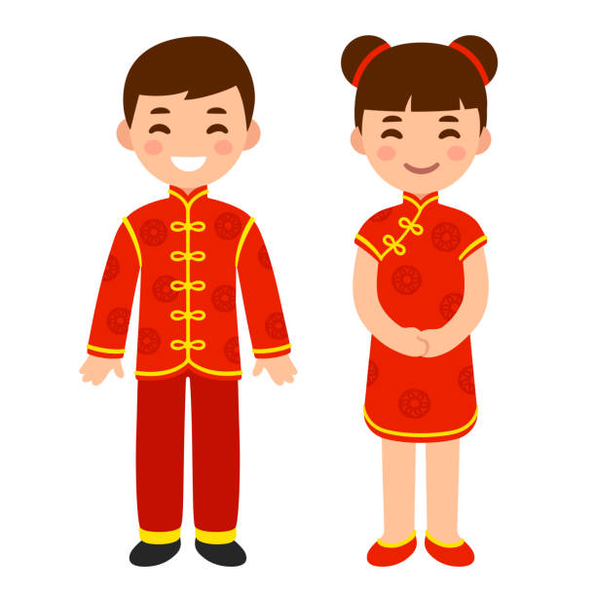
https://www.youtube.com/watch?v=RDrfE9I8_hs&t=49s

Slide 3
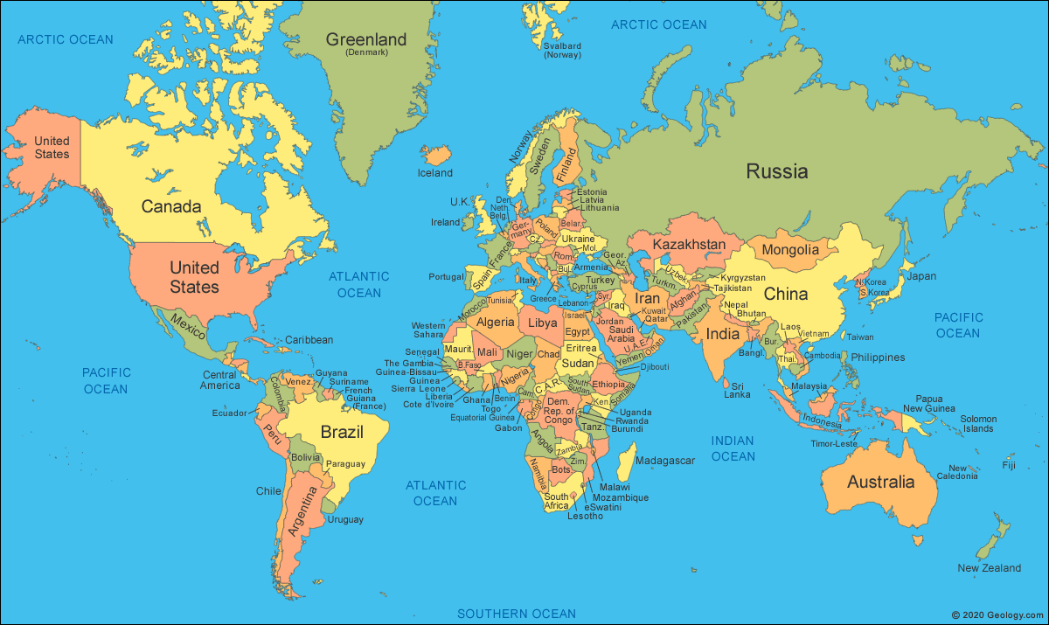

Slide 4
How many stars are there in the Chinese flag?

Slide 5
How many stars are there in the Chinese flag?
a Two b Three
c Four d Five

Slide 6
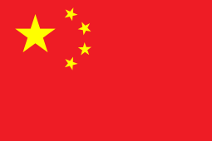
How many stars are there in the Chinese flag?

Slide 7
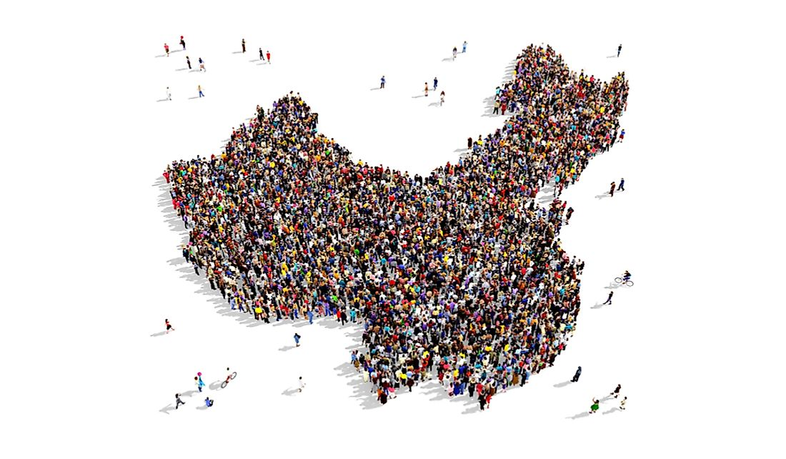
How many people live in China?

Slide 8
How many people live in China?
Population: all the people of a country/city
1
10
100
1 000
10 000
100 000
1 000 000
10 000 000
100 000 000
1 000 000 000
https://www.youtube.com/watch?v=u_aLESDql1U&t=18s

Slide 9
How many people live in China? (Closest number)
a 1,000,000 b 10,000,000
c 100,000,000 d 1,000,000,000

Slide 10
How many people live in China? (Closest number)
a 1,000,000 b 10,000,000
c 100,000,000 d 1,000,000,000

Slide 11
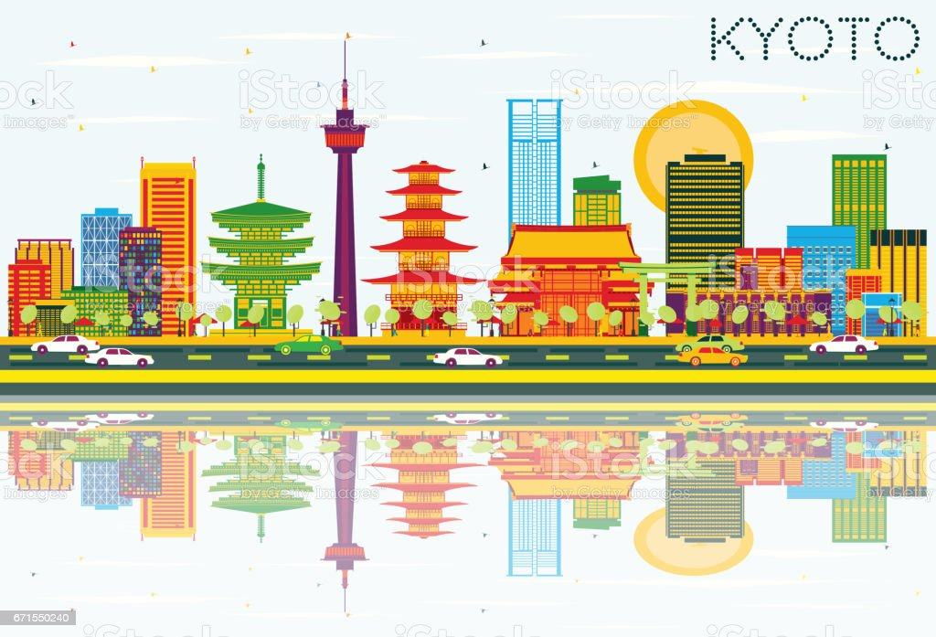
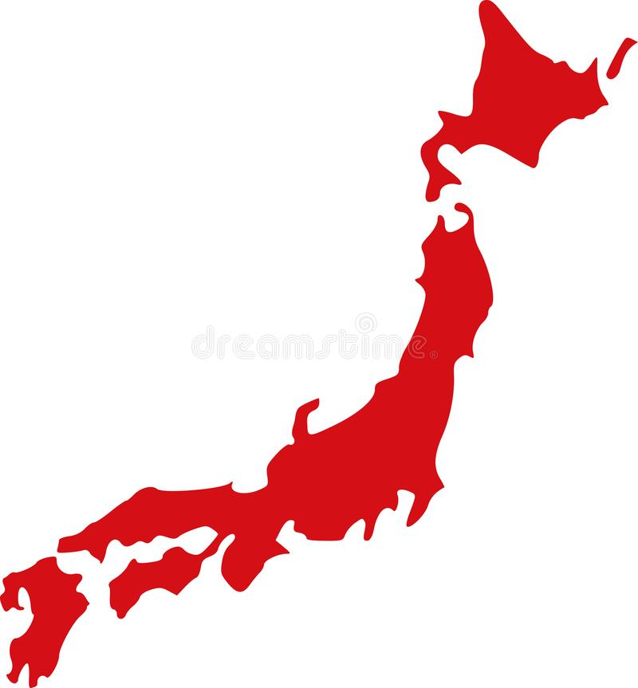
How many people live in China?
1,500,000 14,000,000
126,000,000 1,400,000,000

Slide 12
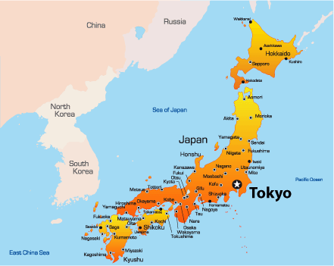
What’s the capital city of Japan?

Slide 13
What’s the capital city of China?
a Hong Kong b Shanghai
c Beijing d Wuhan

Slide 14
What’s the capital city of China?
a Hong Kong b Shanghai
c Beijing d Wuhan

Slide 15
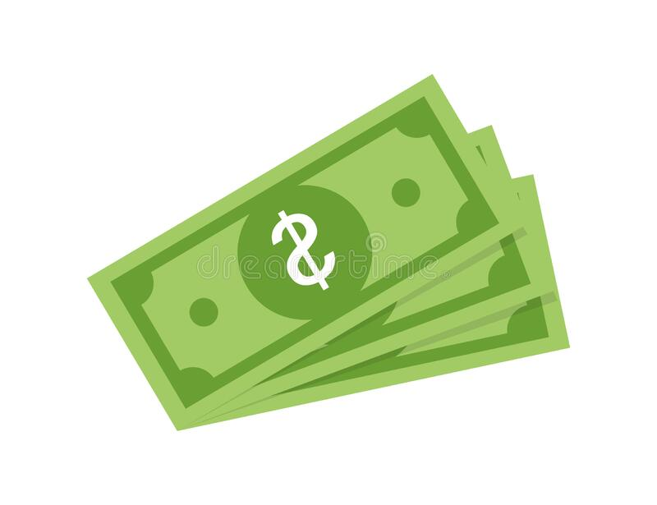
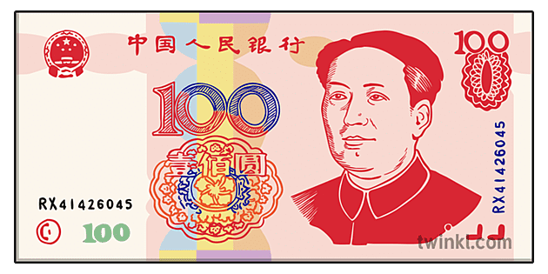
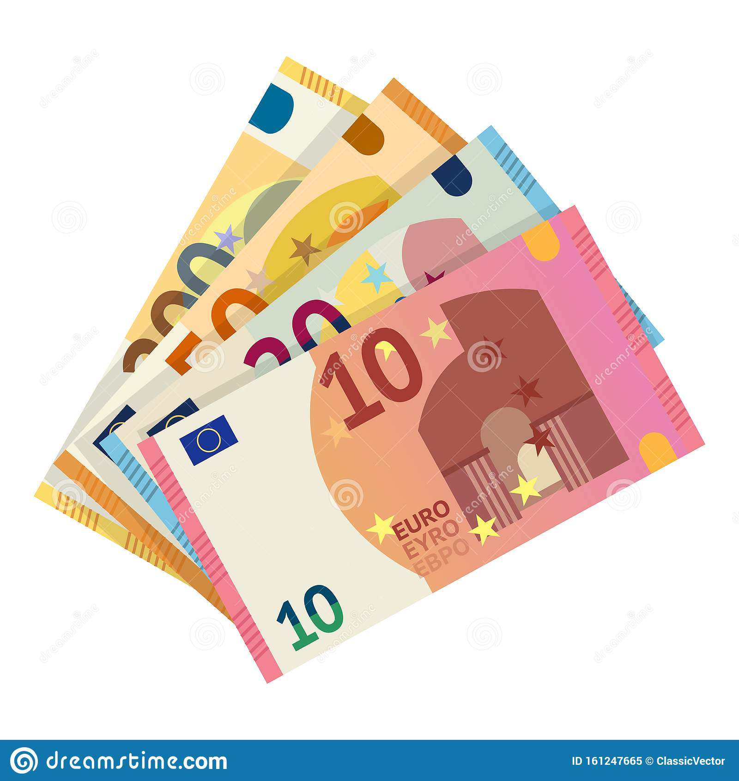
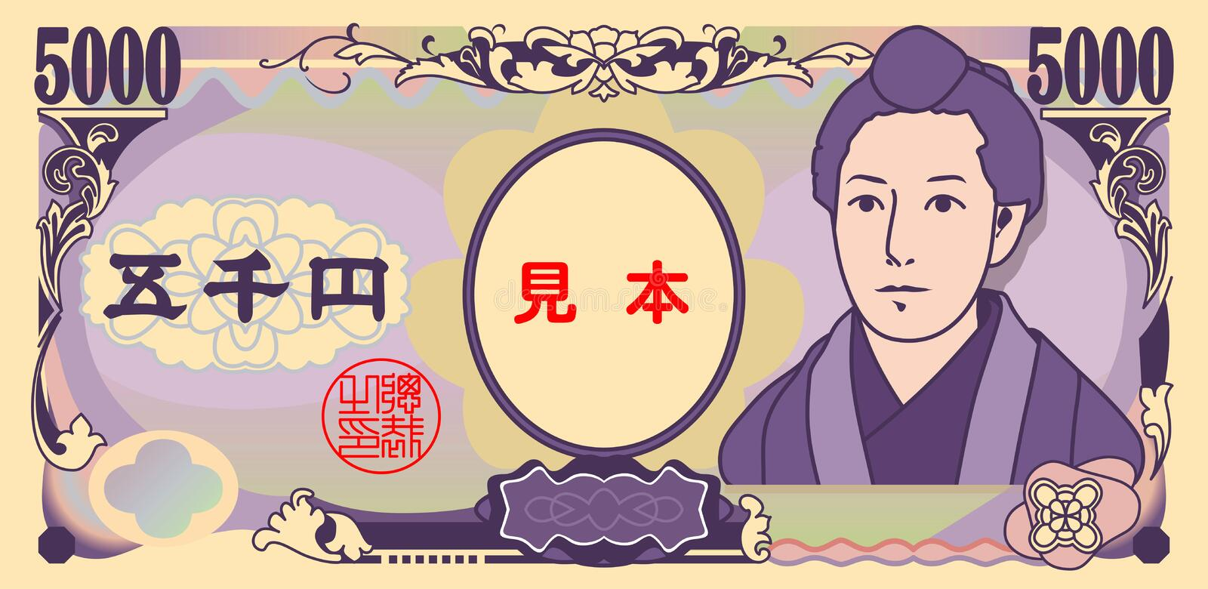
What is Chinese money called?
a Dollar b Yuan
c Yen d Euro

Slide 16
What is Chinese money called?
a Dollar b Yuan
c Yen d Euro

Slide 17
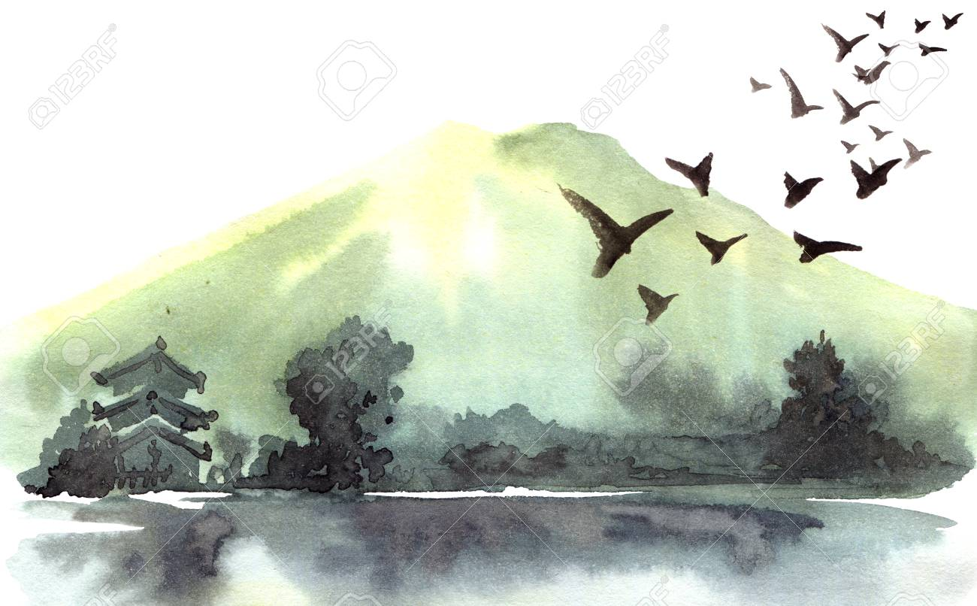
Let’s learn about Chinese nature

Slide 18
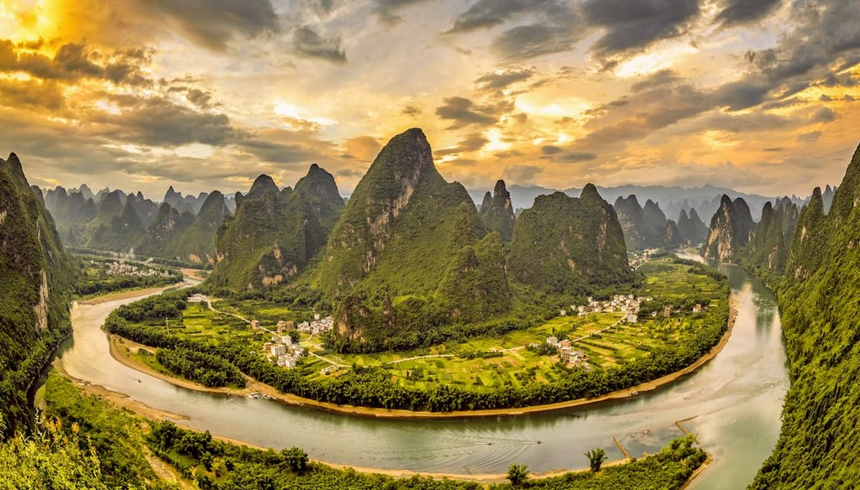
Mountains

Slide 19
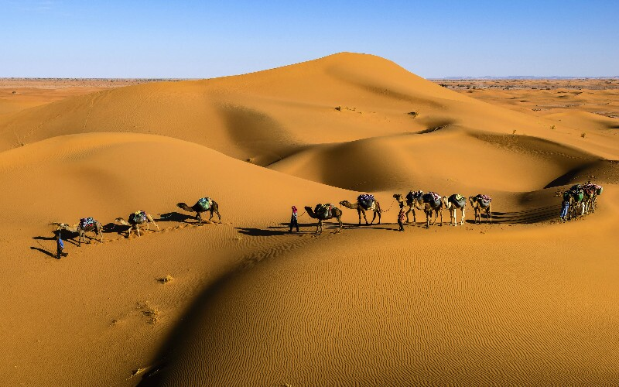
Desert

Slide 20
Forest

Slide 21
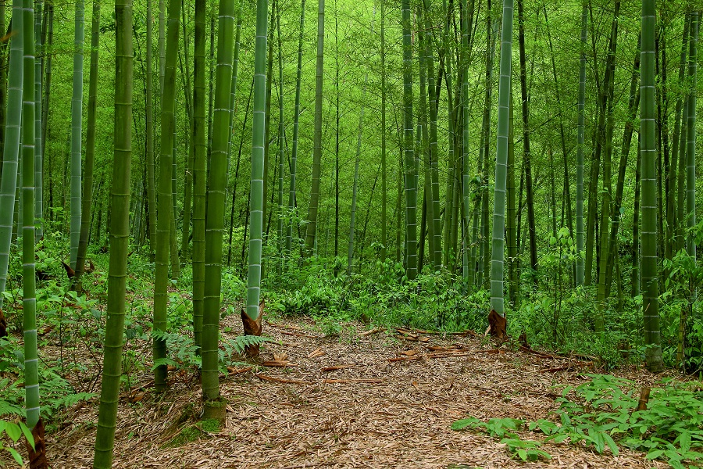
Bamboo Forest

Slide 22
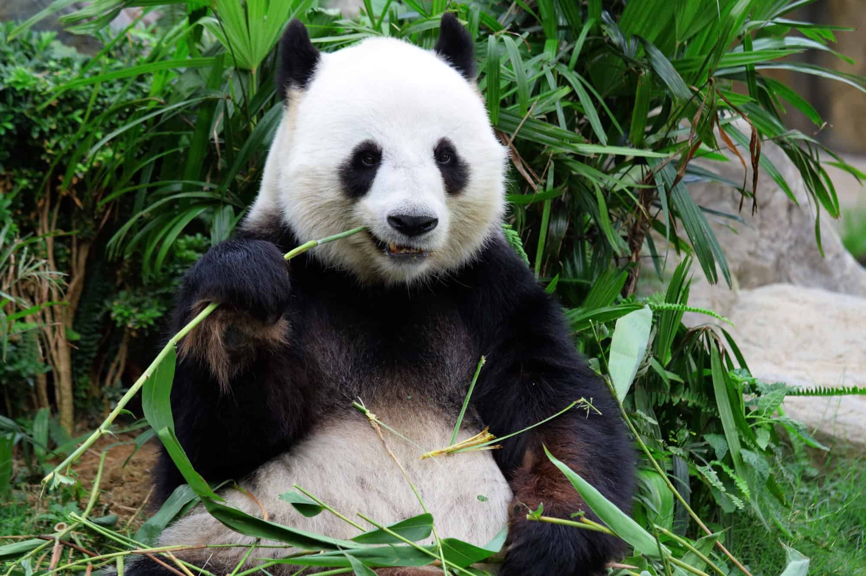
Bamboo Forest

Slide 23
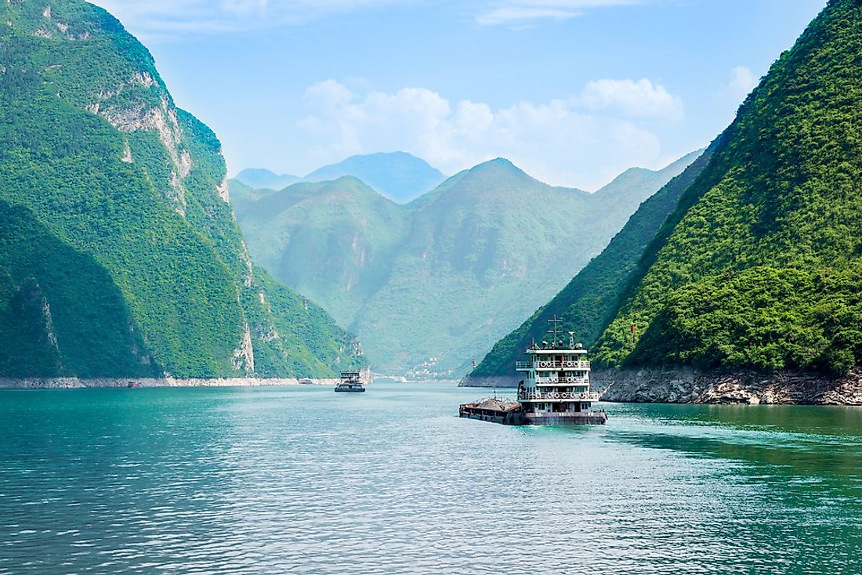
River

Slide 24
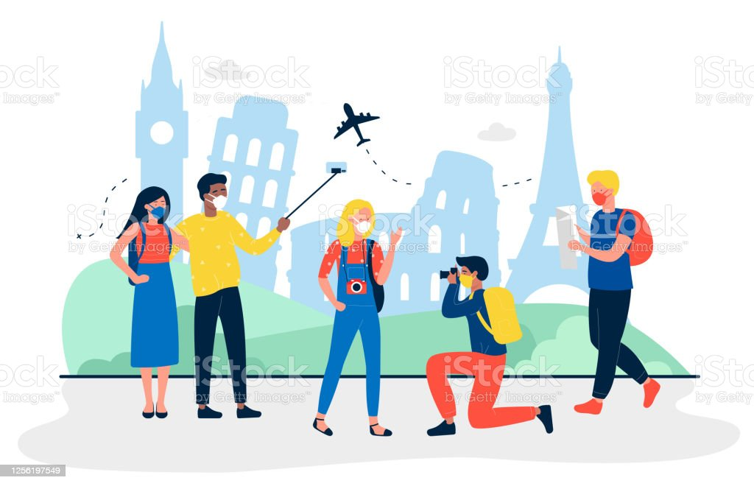
Let’s go for sightseeing!

Slide 25
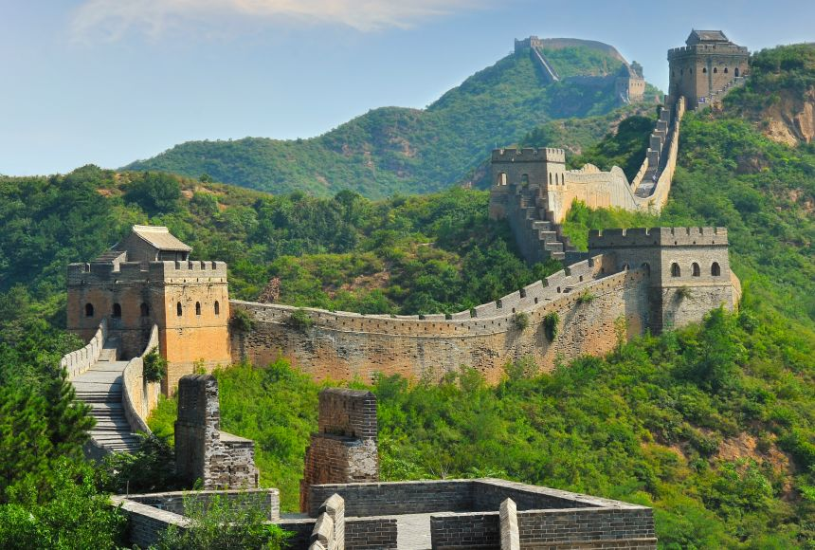
Great Wall of China

Slide 26
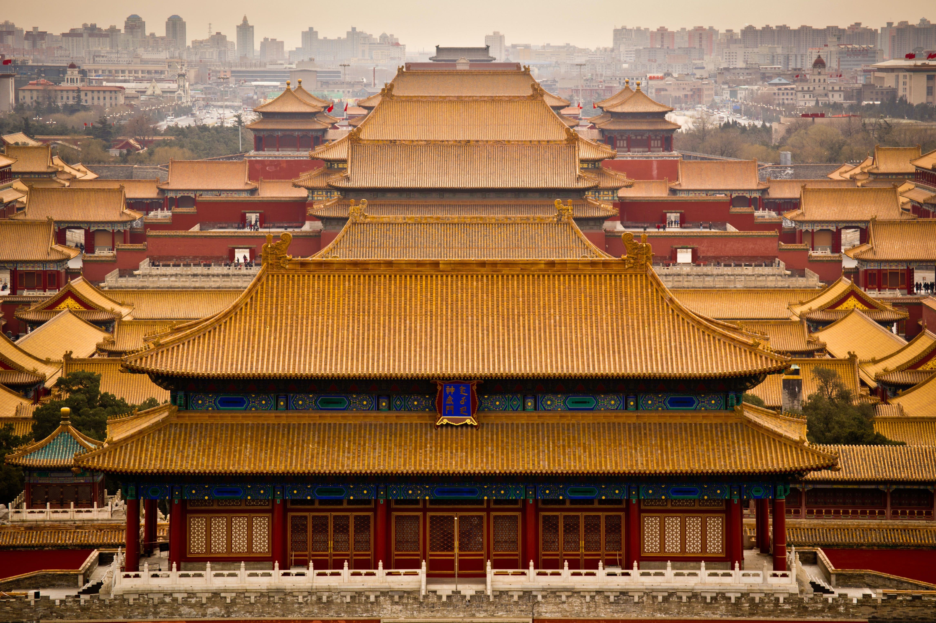
Forbidden City

Slide 27
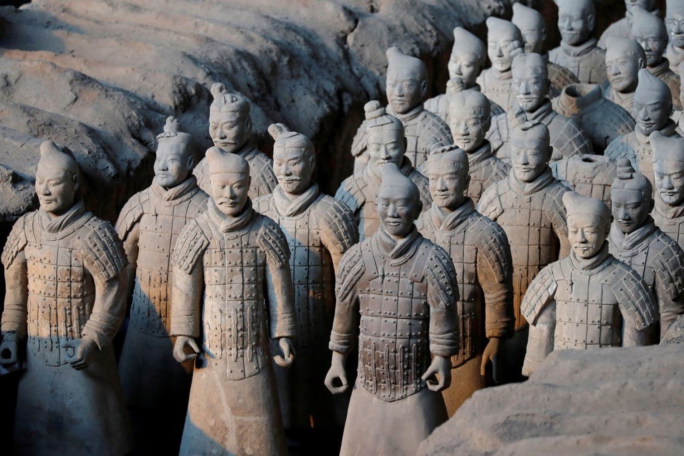
Terracotta Amy

Slide 28
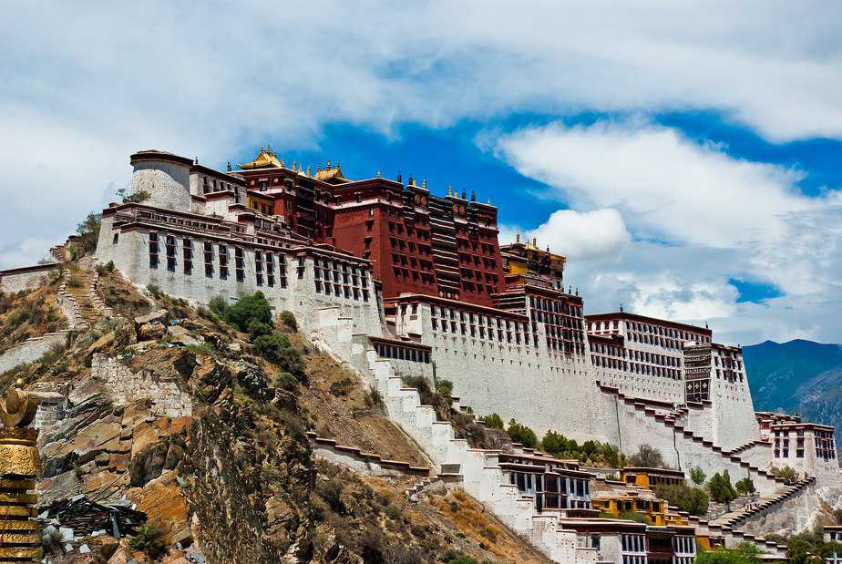
Potala Palace

Slide 29
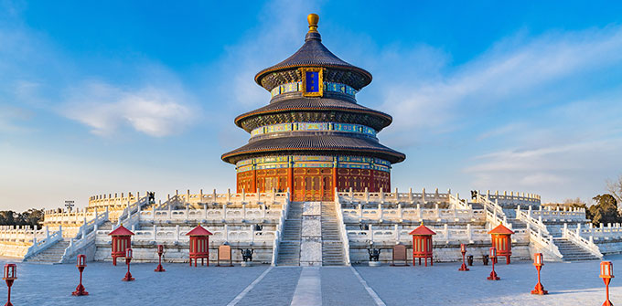
Temple of Heaven

Slide 30
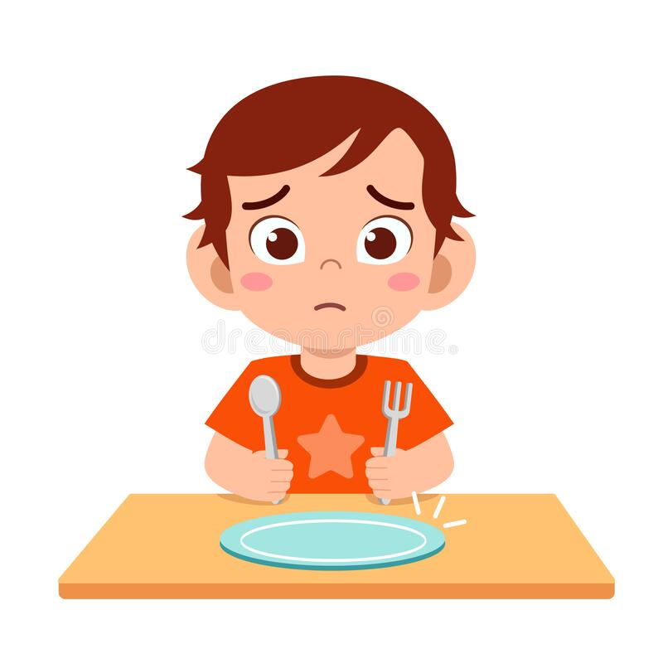
Are you hungry? Let’s talk about Chinese food!

Slide 31
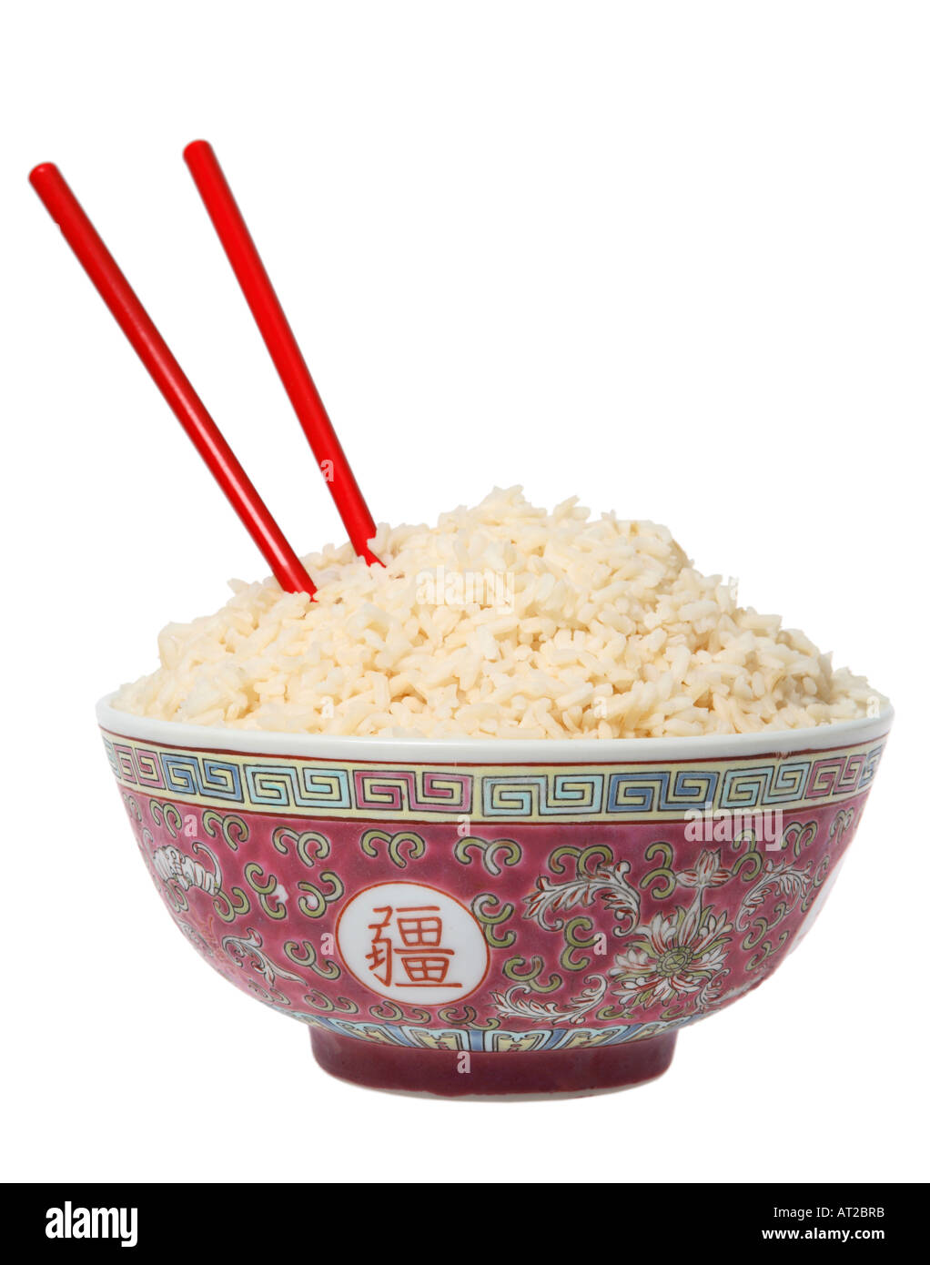
Rice

Slide 32
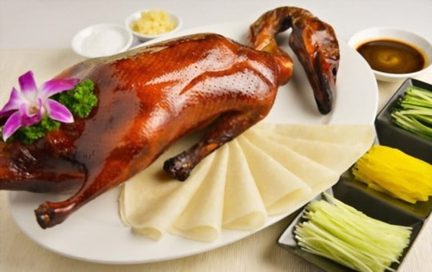
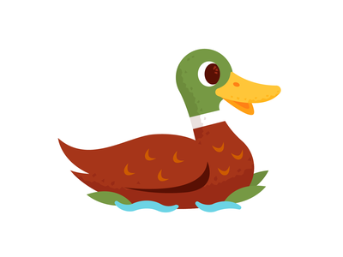
Peking Duck

Slide 33
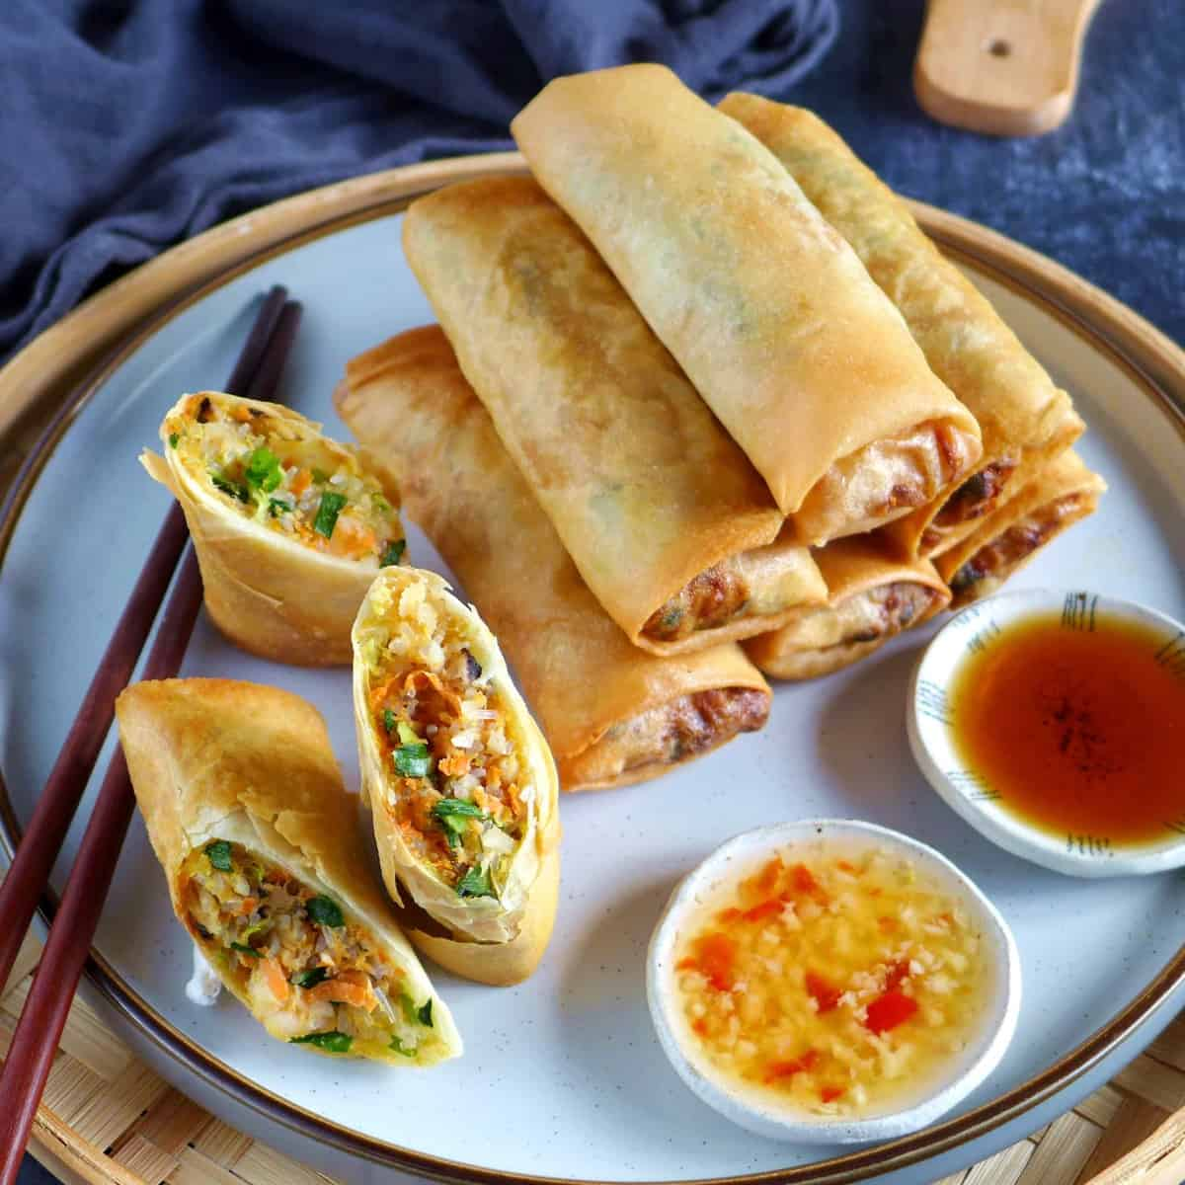
Spring Rolls

Slide 34
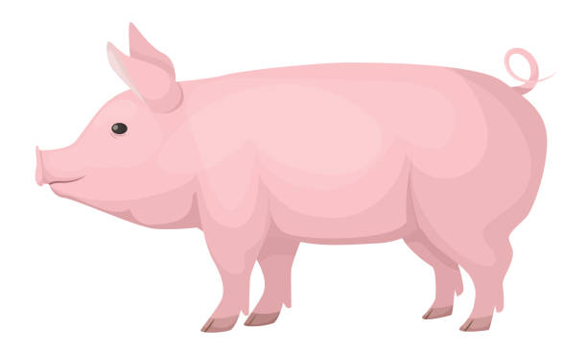
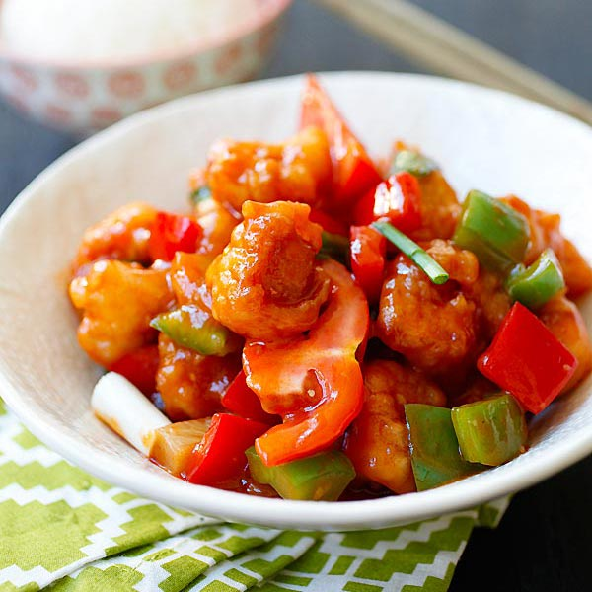
Sweet and Sour Pork

Slide 35
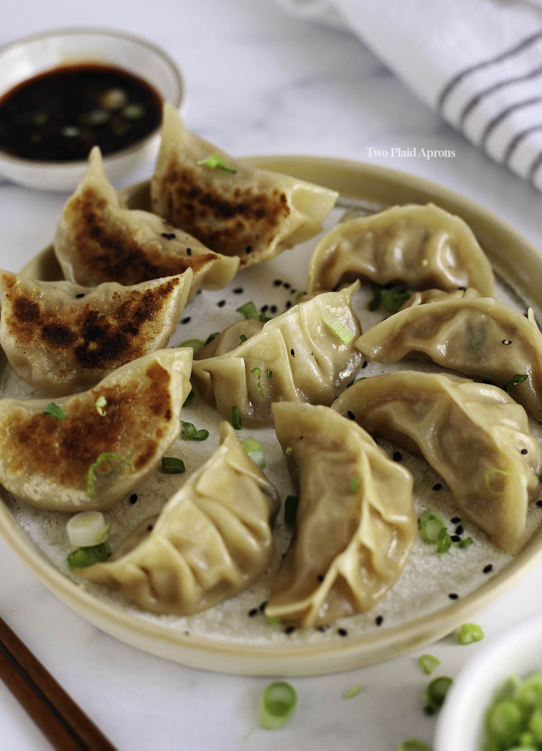
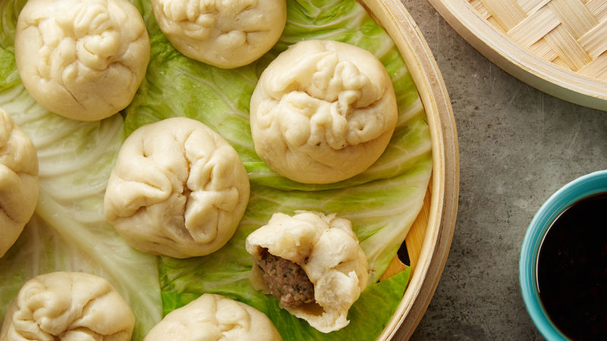
Dumplings

Slide 36
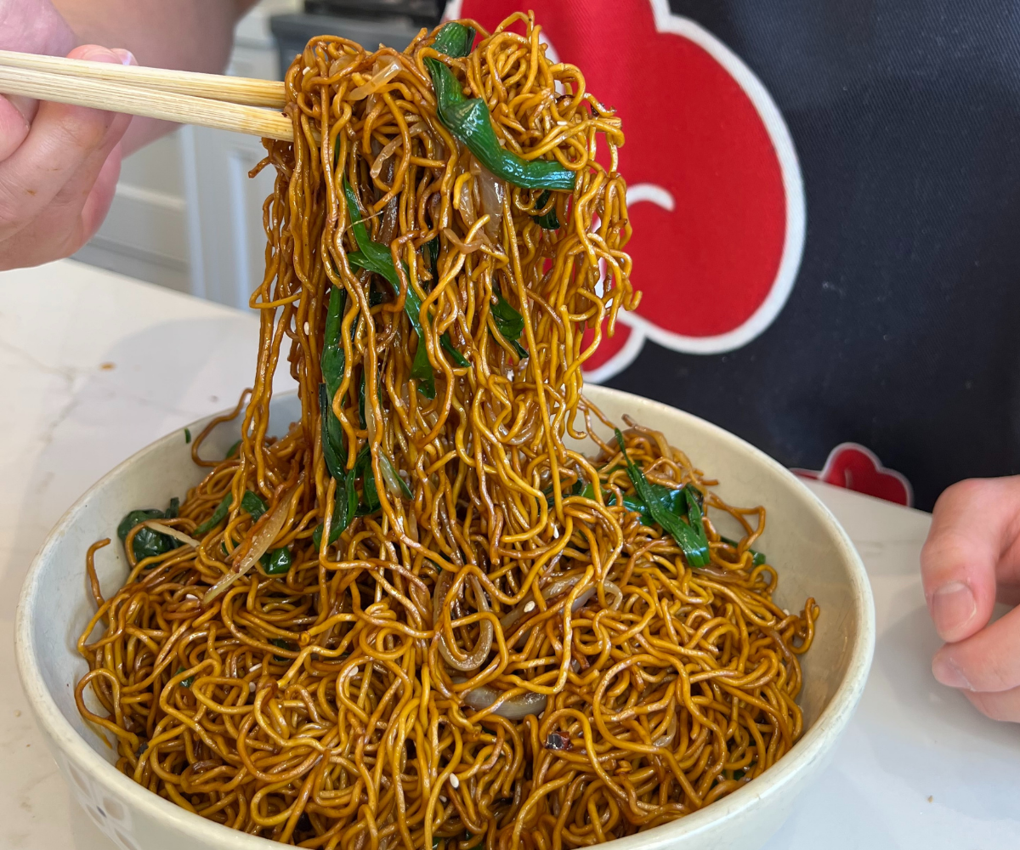
Noodles

Slide 37
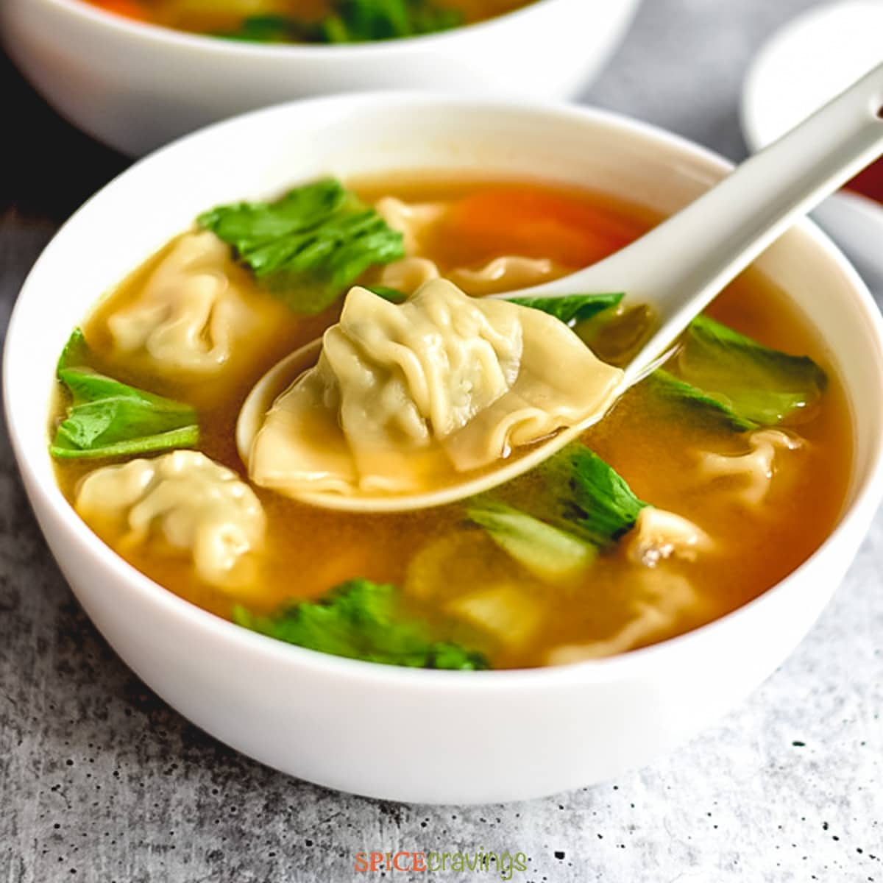
Wonton Soup

Slide 38
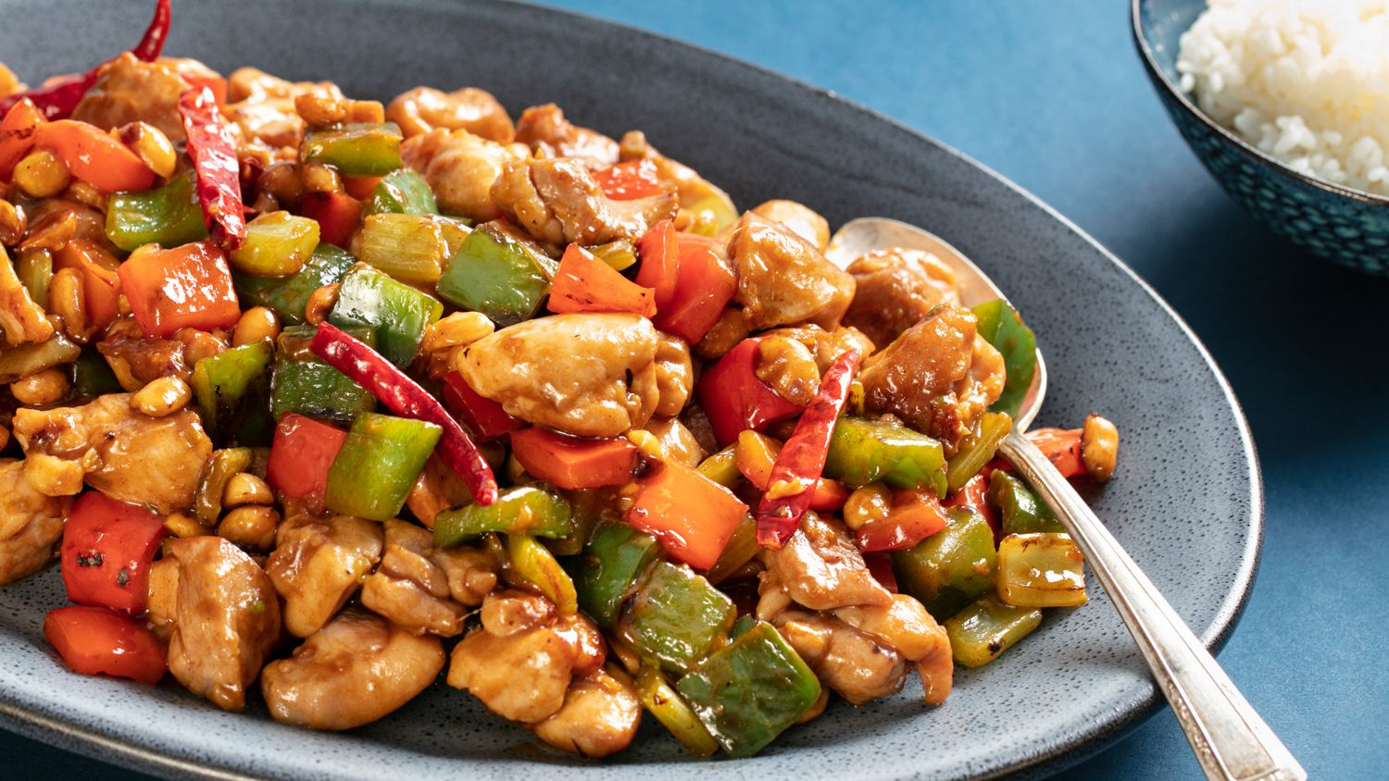
Kung Pao Chicken

Slide 39
Speaking of Kung Pao… Do you know Kung Fu?

Slide 40
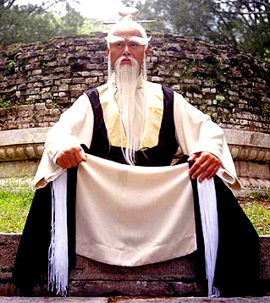
Speaking of Kung Pao… Do you know Kung Fu?

Slide 41
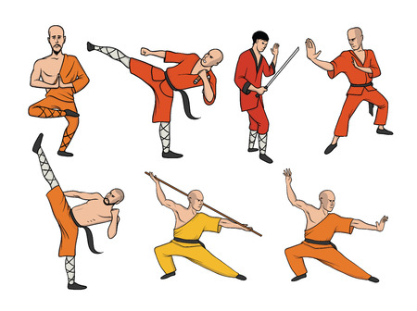
Kung Fu is a general name for several ancient martial arts from China. Some styles were developed by monks for self defense.

Slide 42
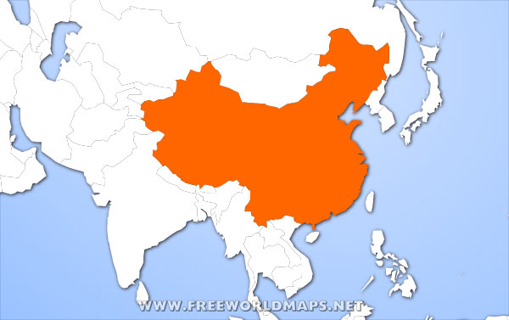
Hundreds
of years
ago, Chinese
merchant
sailors
practicing
their Kung Fu
in Okinawa
introduced
their martial arts...
China
Okinawa
.

Slide 43
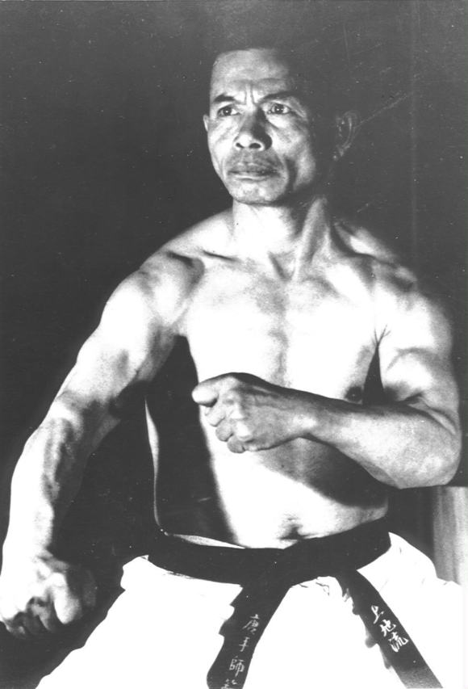
Weapons were banned in Okinawa, but Okinawan “Peichin” (the King’s bodyguards) studied Kung Fu and modified it into a powerful new fighting system to protect the King and his family, and to defend themselves. This empty-hand style became known as “Karate”

Slide 44
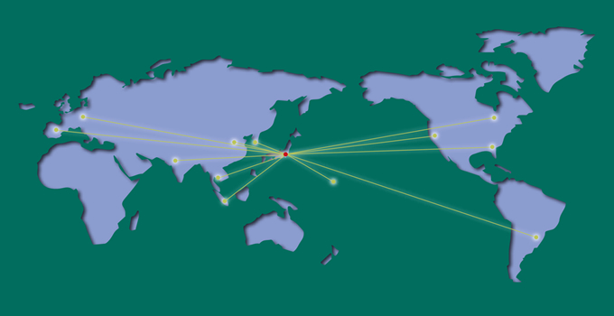
Are you hungry? Let’s talk about Chinese food!
Okinawan Karate Masters brought Karate from Okinawa to mainland Japan, where it became very popular.
From there, in the 20th century, it spread across the world

Slide 45
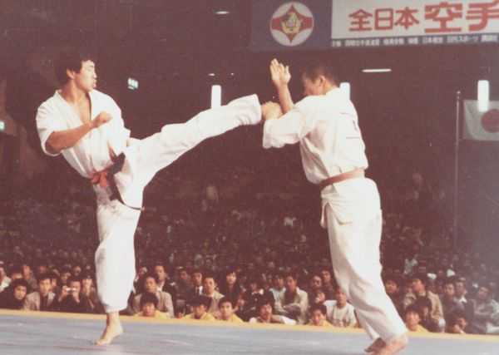
Today, people do Karate for exercise, self defense and even for sport, if they want to test their skills.

Slide 46
Karate practitioners are grateful to China for their Kung Fu legacy

Slide 47
Let’s learn all about CHINA
Thank you for watching!
Zaijian!
By Philip and Mihaly

