Slide 1
Maldives

Slide 2
Maldives in World Map

Slide 3
Distance between Maldives and Japan- 10 hours

Slide 4
Maldives Map and Capital
Archipelago of 1192 islands

Slide 5
The Flag and its Meaning
Red- Boldness
Green- Wealth and Peace
White Crescent- Islam

Slide 6
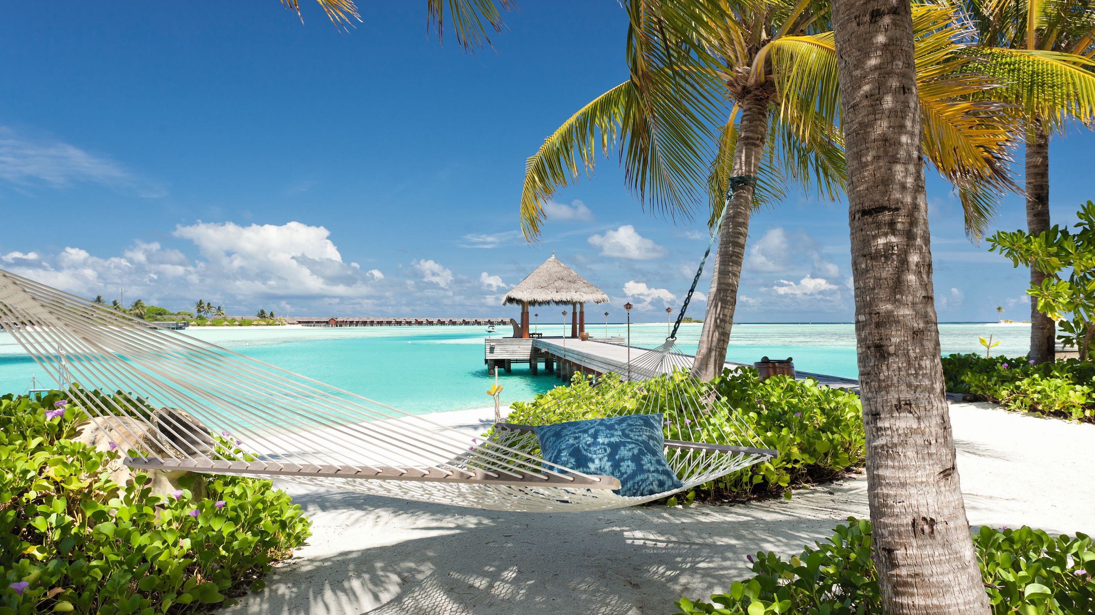
Facts about Maldives
Archipelago
The national language is Divehi
Flattest country in the world
Friday and Saturday are the weekend days: Sunday is a weekday
The white sand found in Maldives makes up 5% of the white sand found around the world
Climate is cloudy and rainy because of its location on the equator
The angle of sunlight is almost always 90°
One of the safest tourist countries
The country is sinking
Islands and coral reefs are found everywhere
The national symbol is the coconut tree

Slide 7
Famous Places to visit in the Maldives

Slide 8
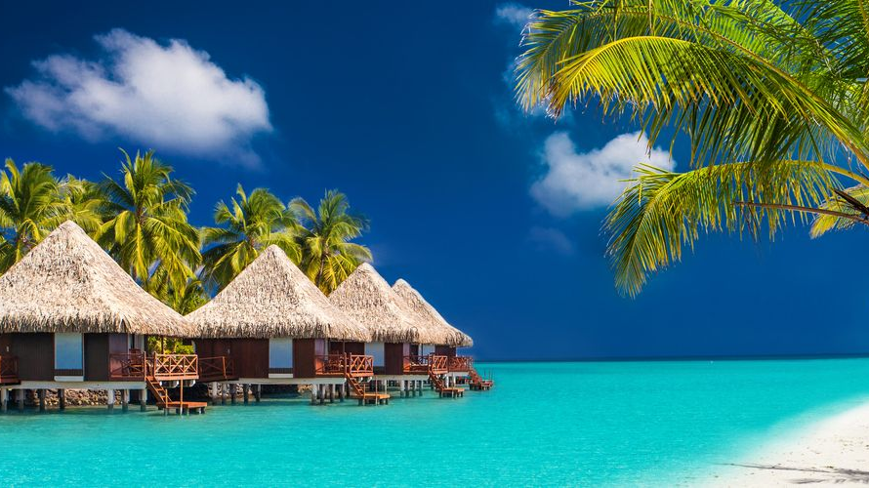
Beaches

Slide 9
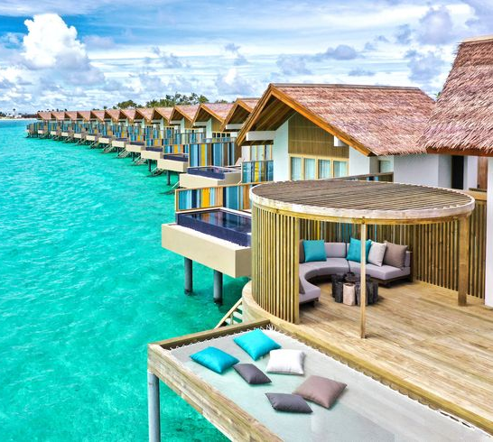
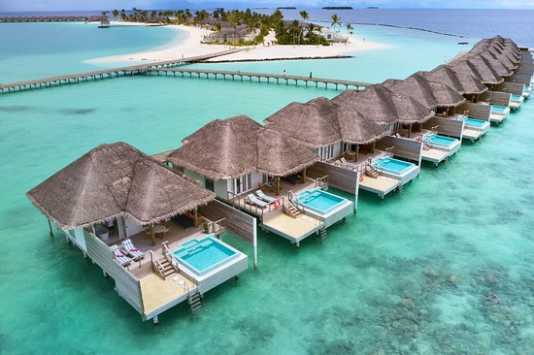
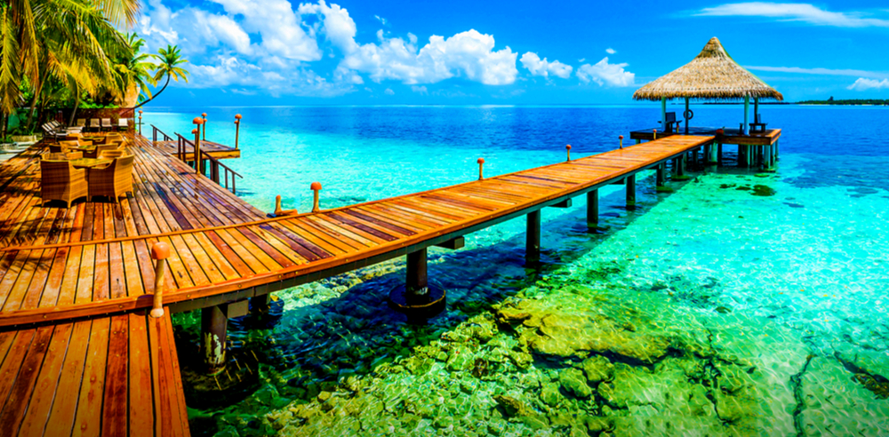
Beach Resorts

Slide 10
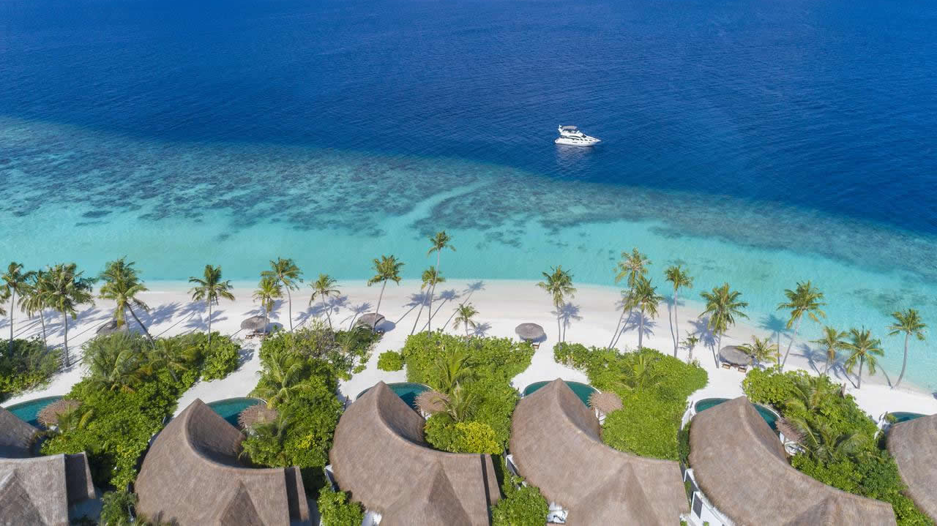
Milaidhoo Island

Slide 11
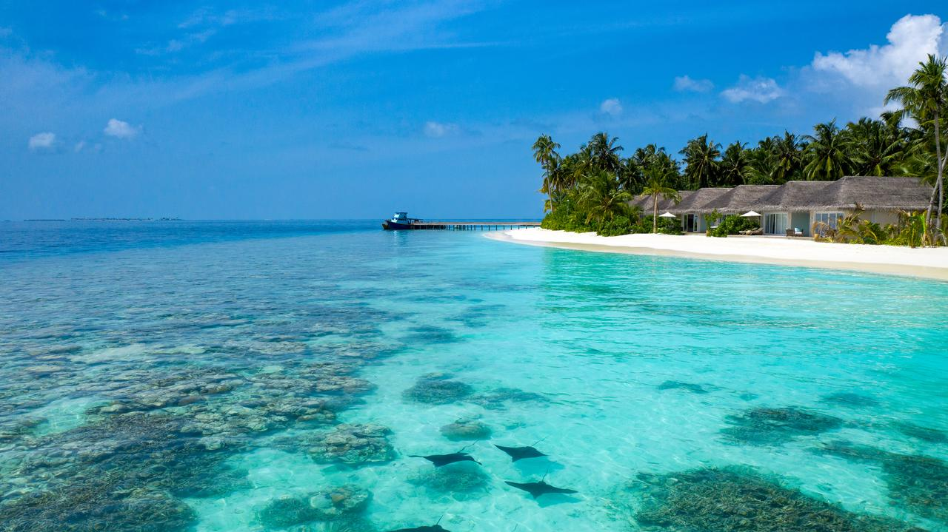
Dhaalu Atoll

Slide 12
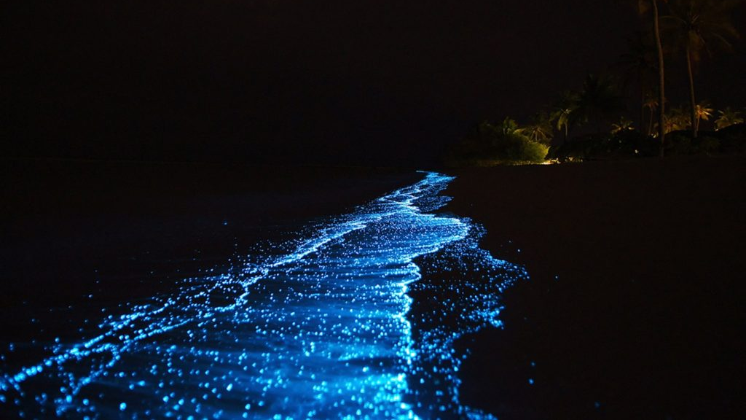
Vaadhoo Island
Microscopic plants in the water causes it to glow

Slide 13
Male City

Slide 14
Male Airport- Manmade Island

Slide 15
Artificial Beach

Slide 16
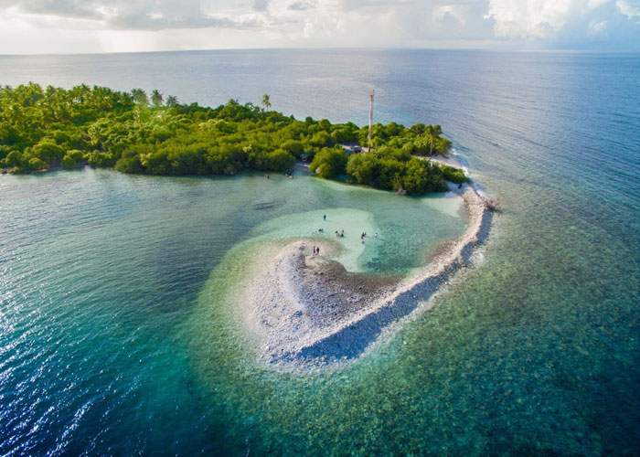
Addu Atoll
The island is made of coral, or Atoll in Divehi

Slide 17
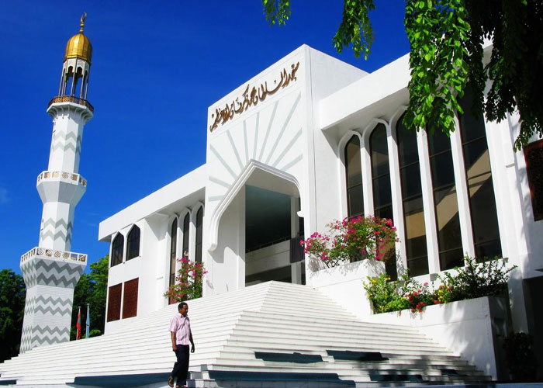
Grand Friday Mosque

Slide 18
An Underwater Villa

Slide 19
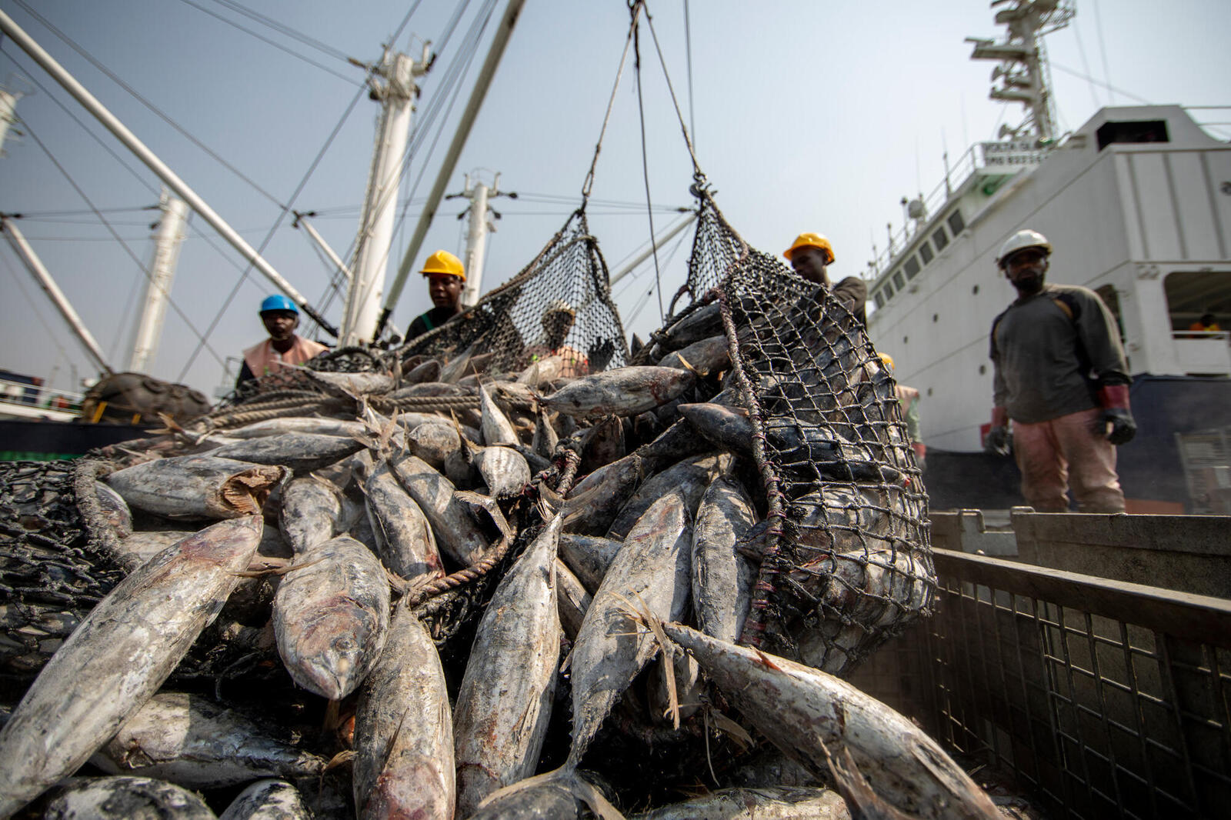
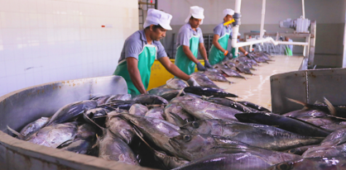
Maldives Main Export

Slide 20
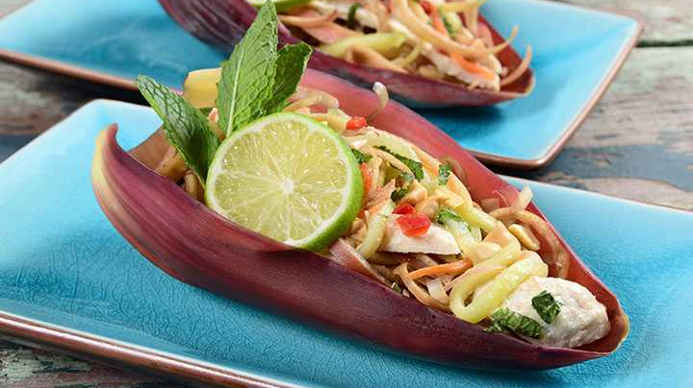
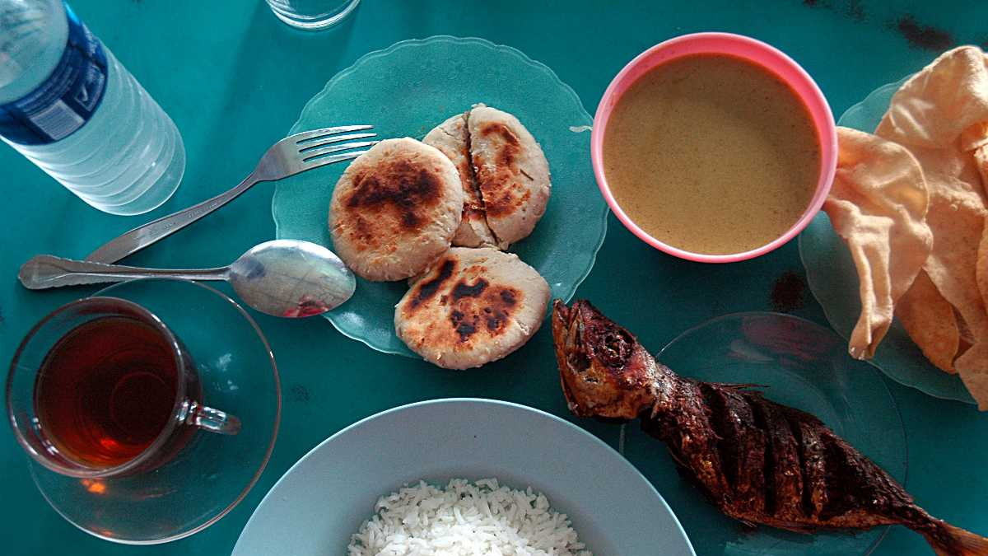
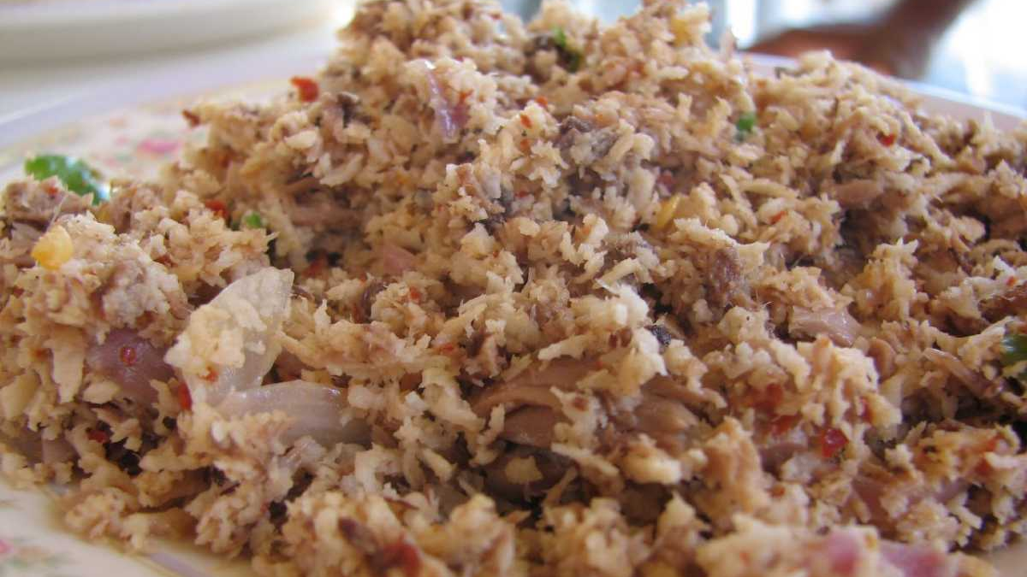
Maldivian Food

Slide 21
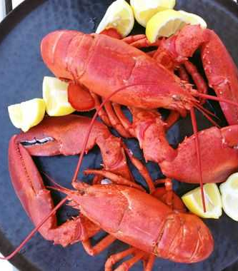
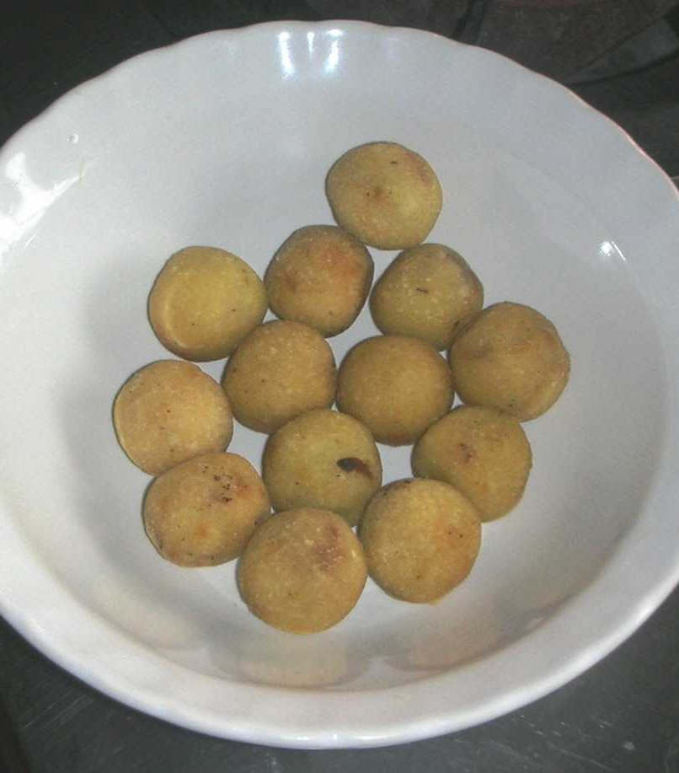
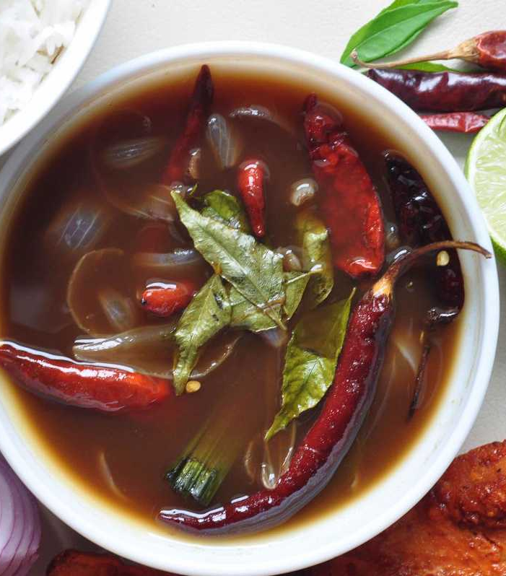
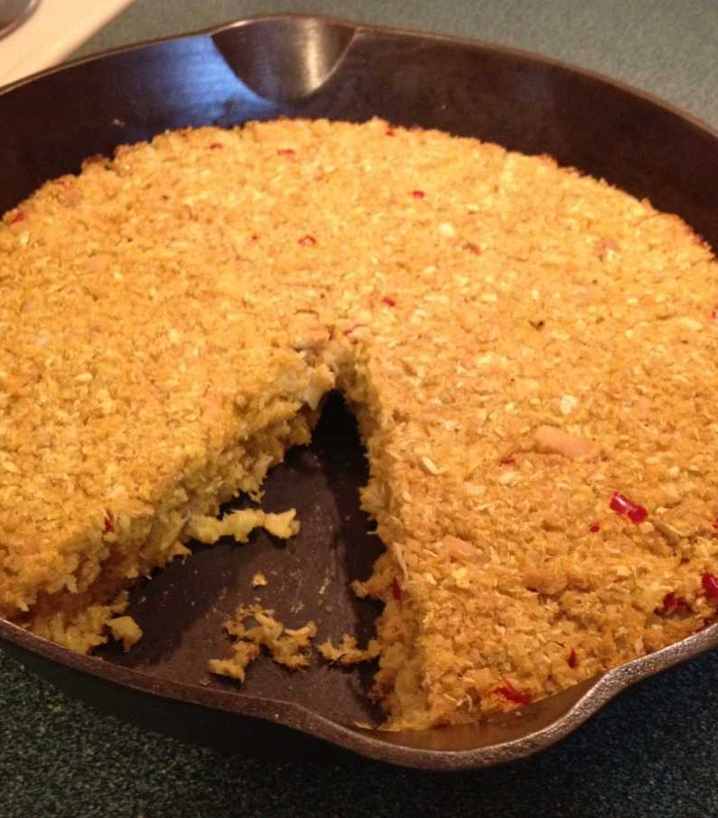
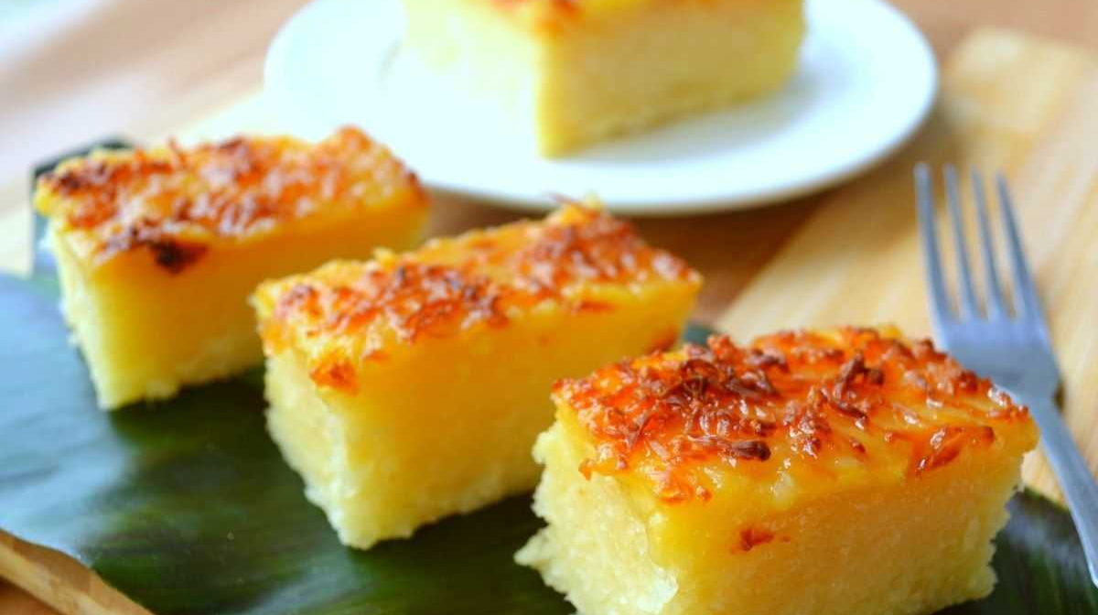
Most of their dishes are made from seafood

Slide 22
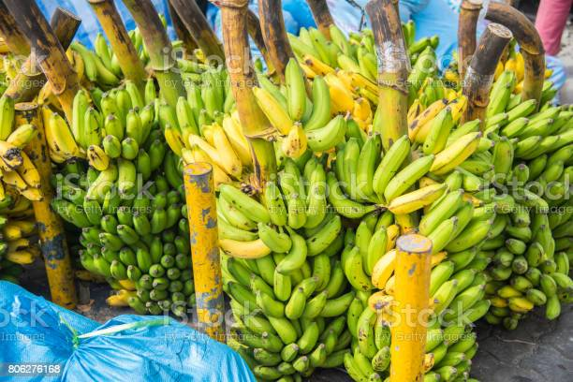
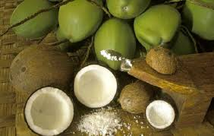
Maldivian Fruits

Slide 23
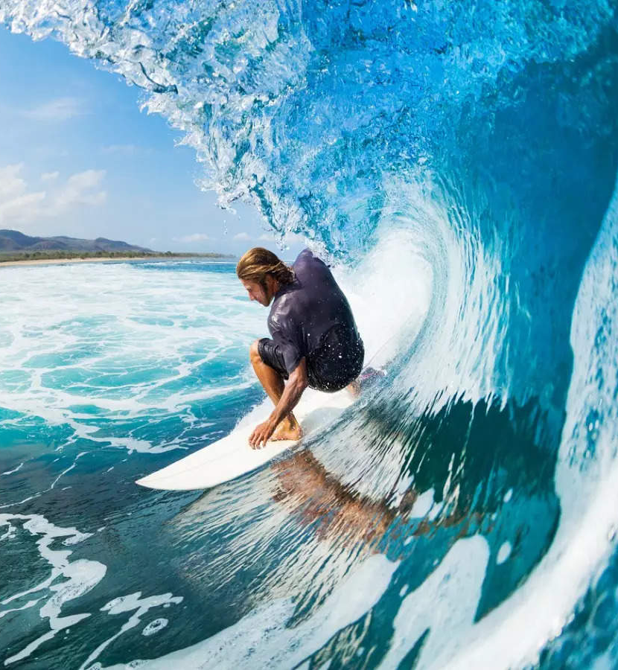
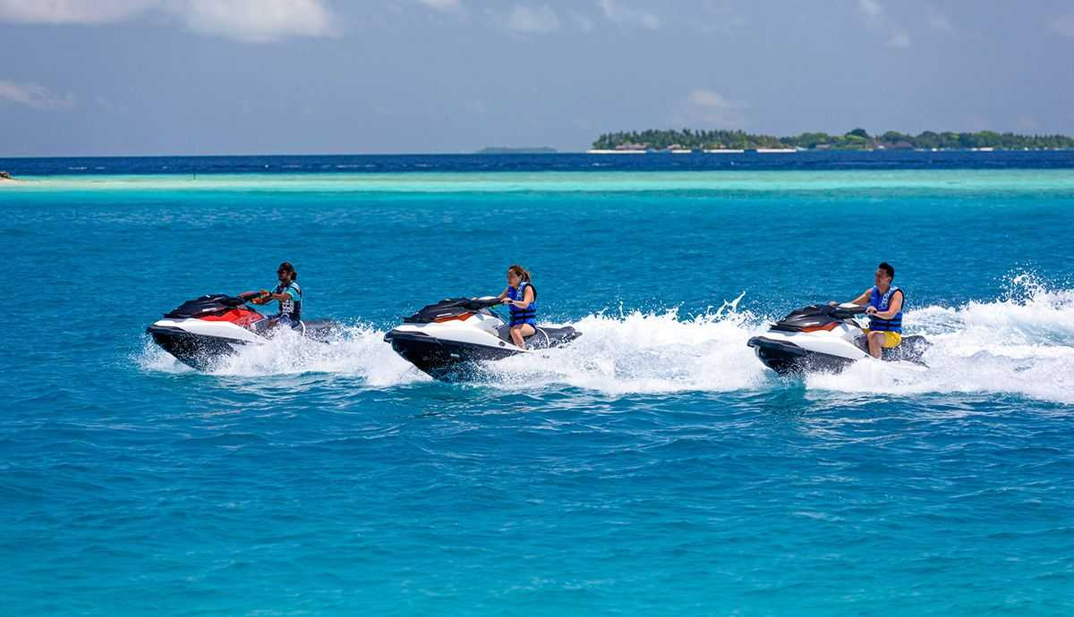
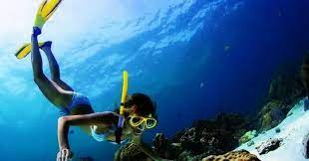
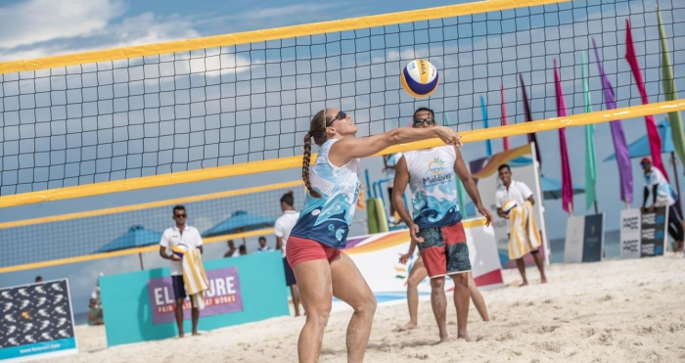
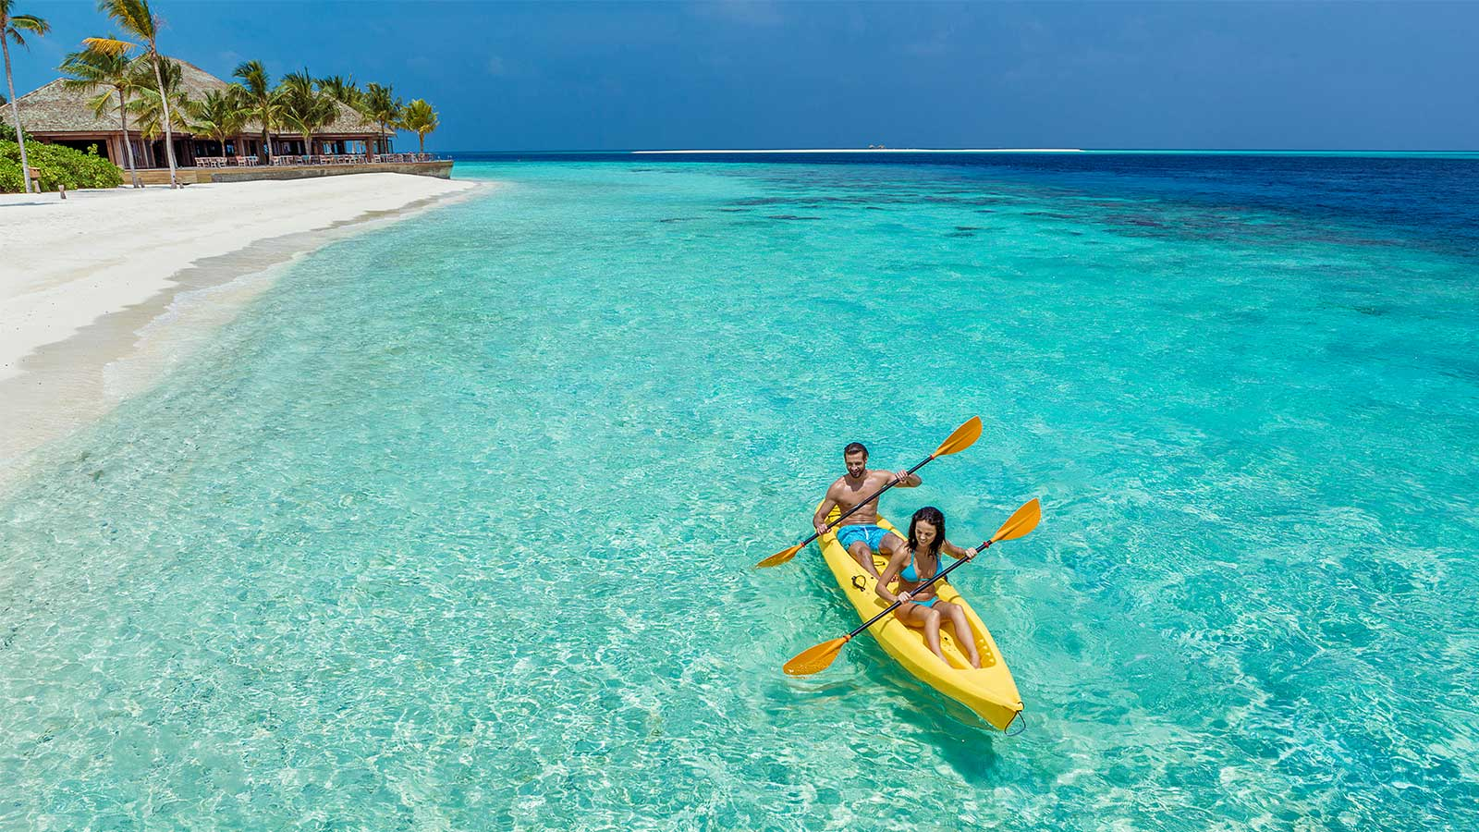
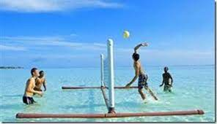
Sports

Slide 24
Beach Volleyball

Slide 25
Aqua Volleyball and Waterpolo

Slide 26
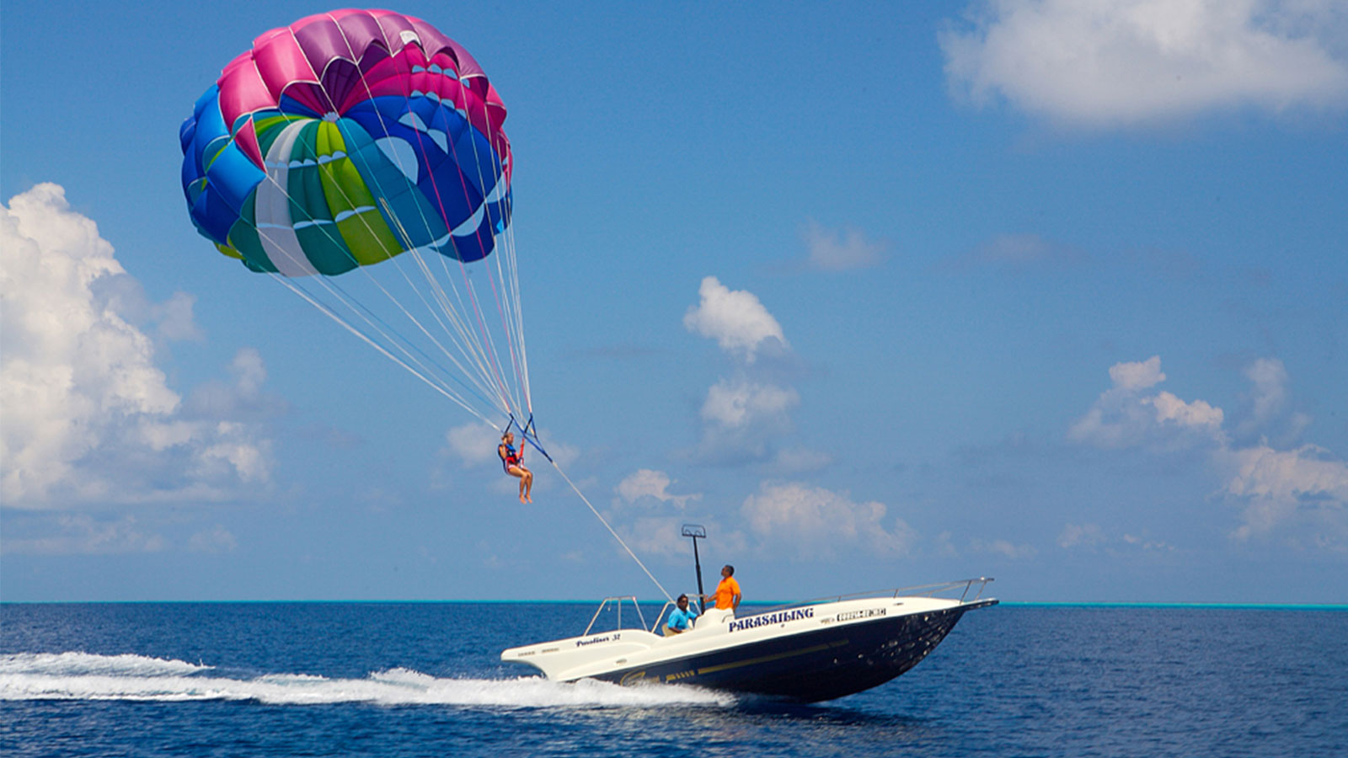
Water Sports
Parasailing
Windsurfing

Slide 27
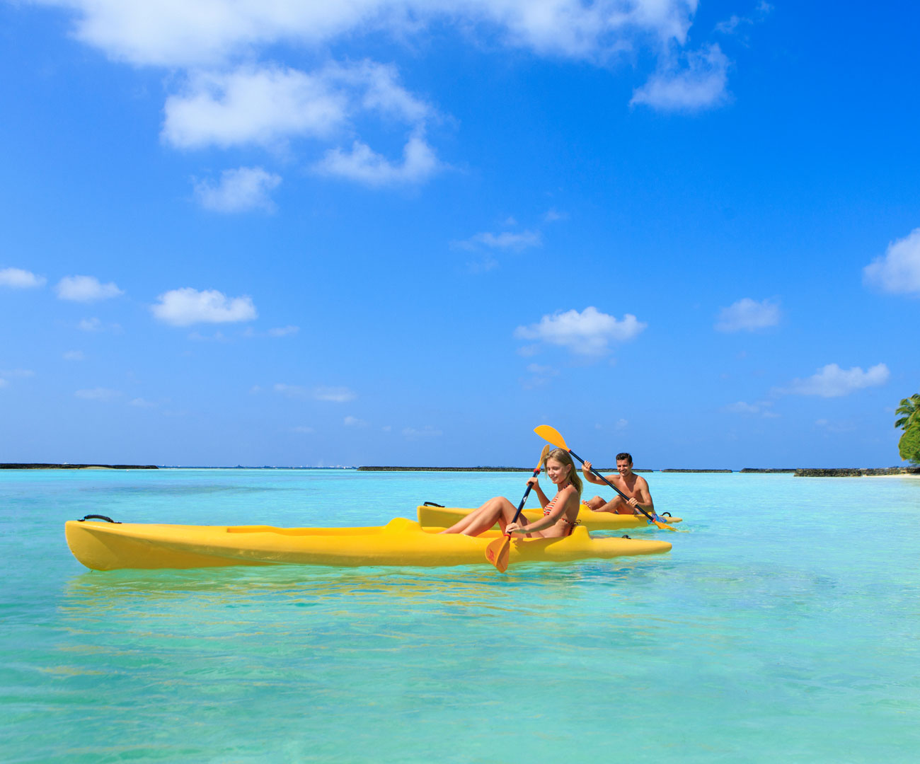
Boat-related activities
Paddle boating
Kayaking
Banana boat

Slide 28
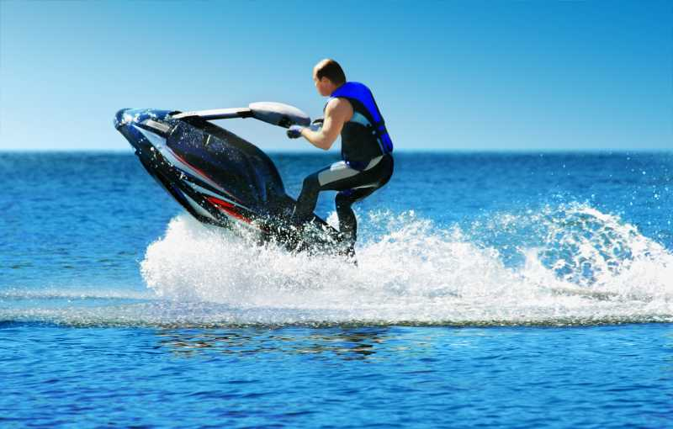
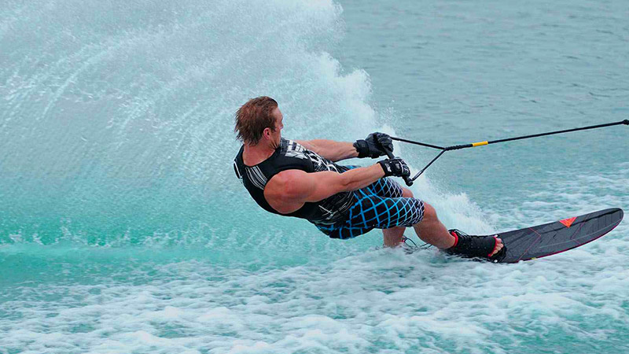
Motorized Water Sports
X-Jet-blade
Jet ski
Water ski

Slide 29
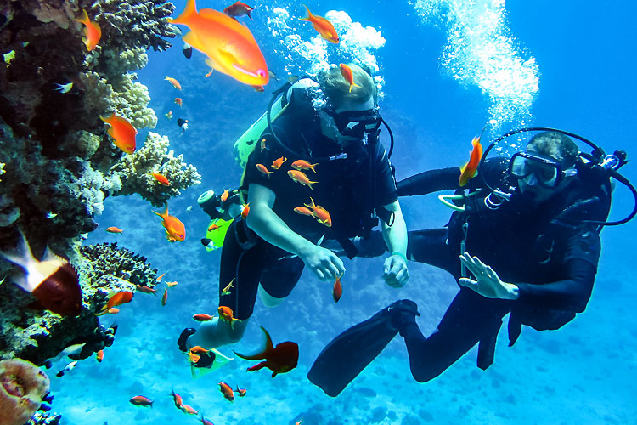
Diving and Scuba diving

Slide 30
The People of Maldives

Slide 34
Quiz
What language is spoken in Maldives?
a) Hindi b) Divehi c) Sinhala
How to say thank you in Divehi?
a) Shukriya b) Thank you c) Arigato
Is Maldives a:
a) Peninsula? b) Gulf? c) Archipelago?
What is the symbol in the centre of the Maldivian flag?
a) A crescent b) A star c) A sun
Maldivians eat:
a) Lots of potato b) Lots of meat c)Lots of fish

Slide 35
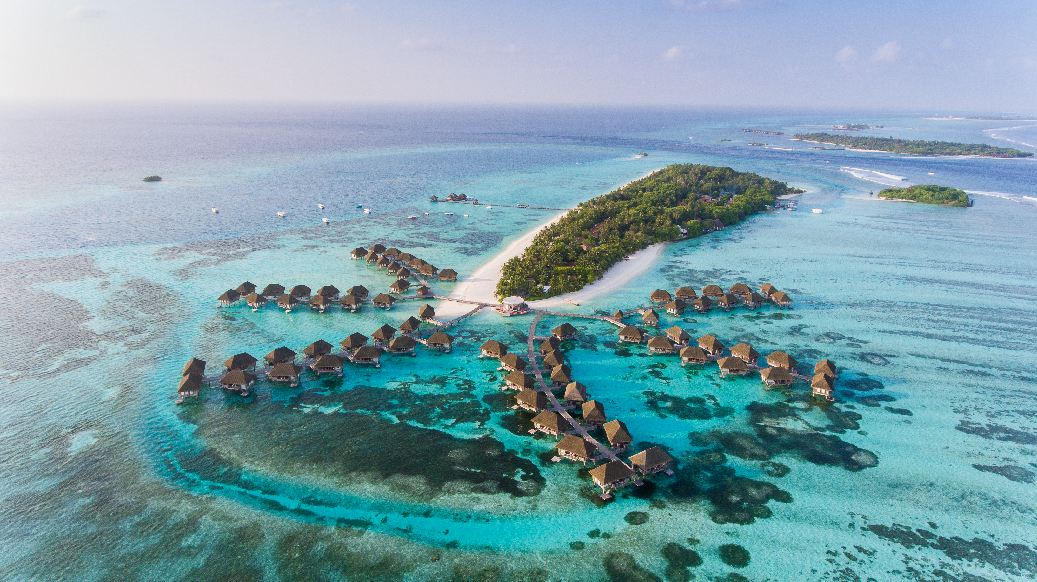
Shukriya!
Thank you!

